Slide 1



46th IASP Annual Conference 2025
People, Planet, Prosperity: Demographic Drivers of India's Inclusive Growth
Kolkata-27-29 November 2025

Slide 2
Conference Overview
Day 1: 27 Nov
Day 2: 28 Nov
Day 3: 29 Nov
Inaugural & Plenaries
Research Showcase
Awards & Synthesis
Opening ceremony
IUSSP felicitation
PFI session
5 Panel Discussions
10 technical sessions
Poster Sessions
2 plenaries
Award sessions
Poster Presentation
5 technical sessions
Valedictory

Slide 3
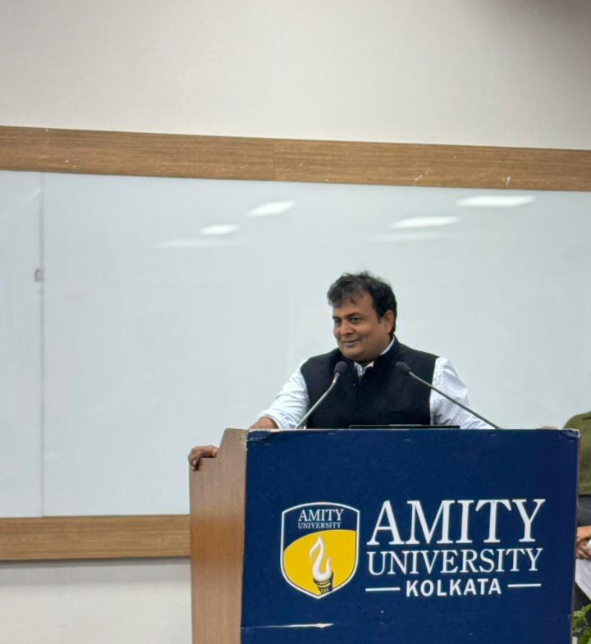
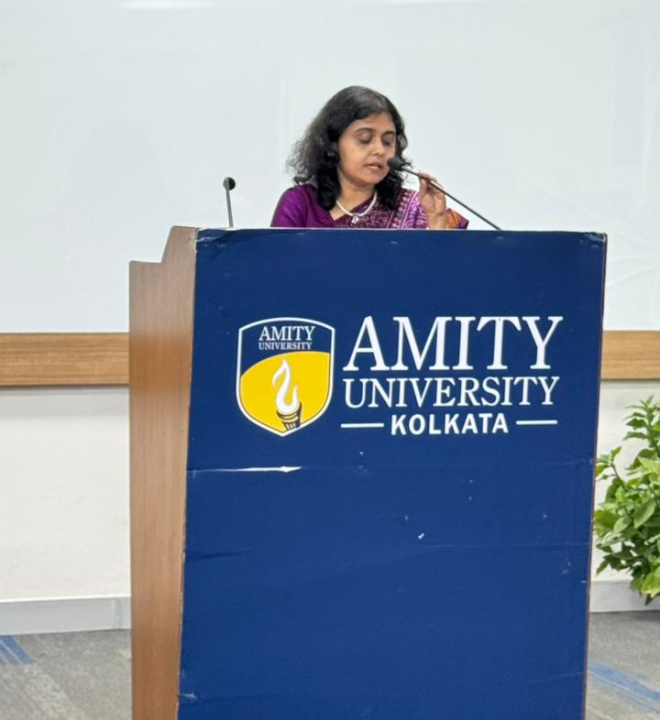
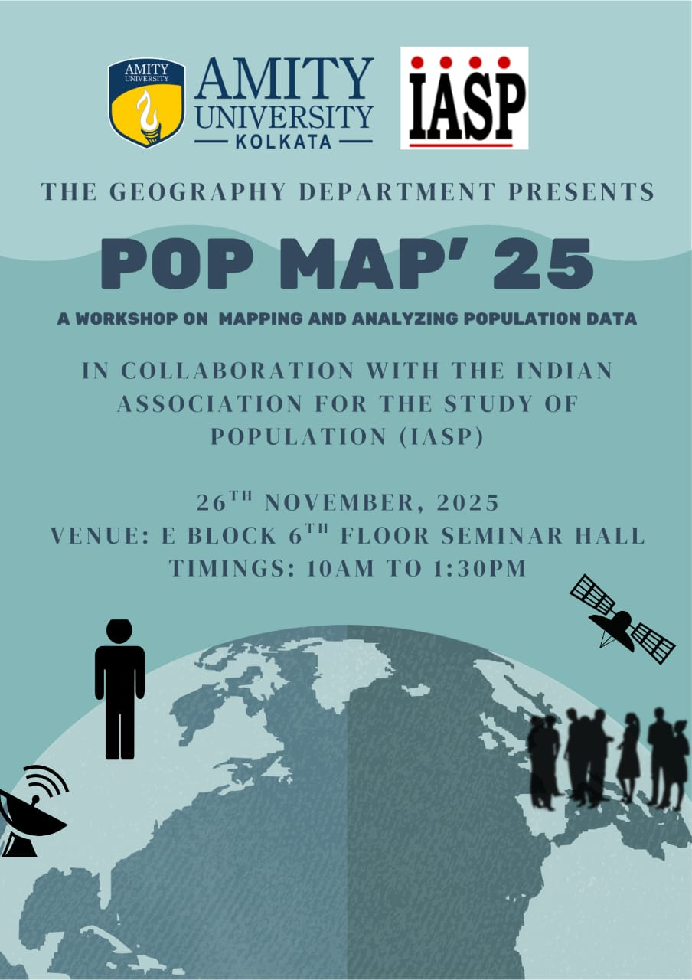
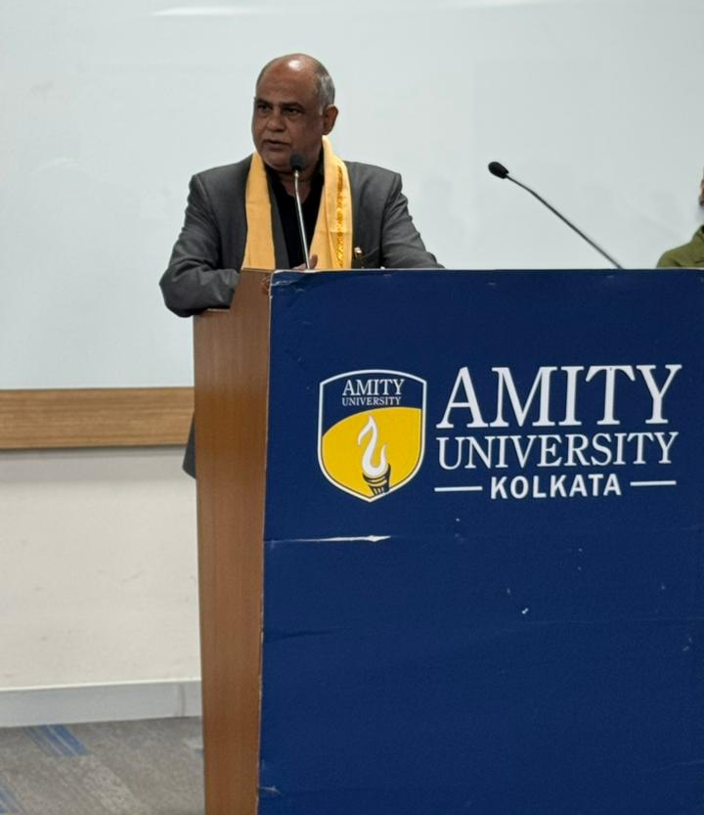
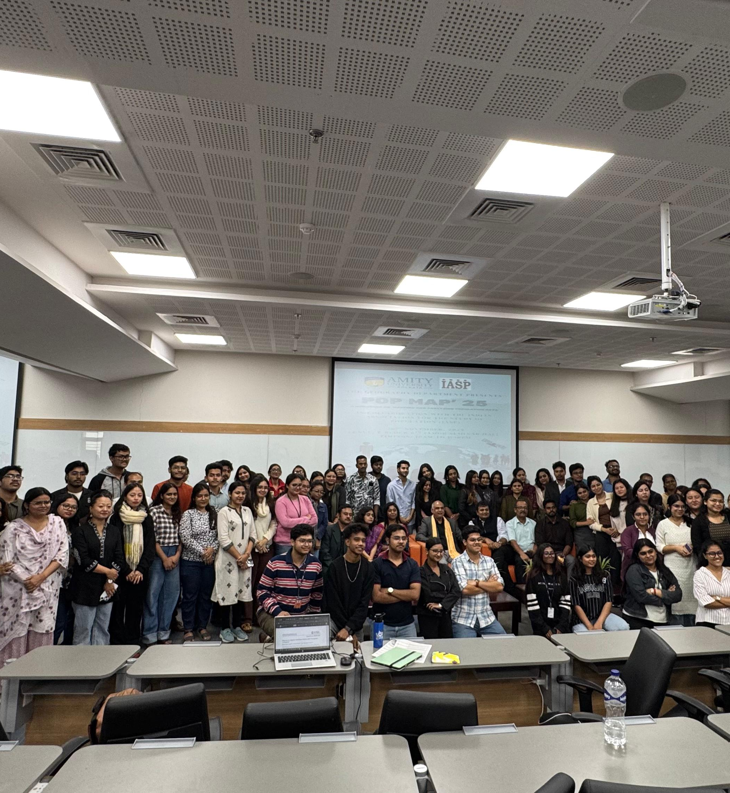
Pre Conference Workshop Use of GIS in Population Data 26, November, 2025 Department of Geography, Amity University, Kolkata

Slide 4
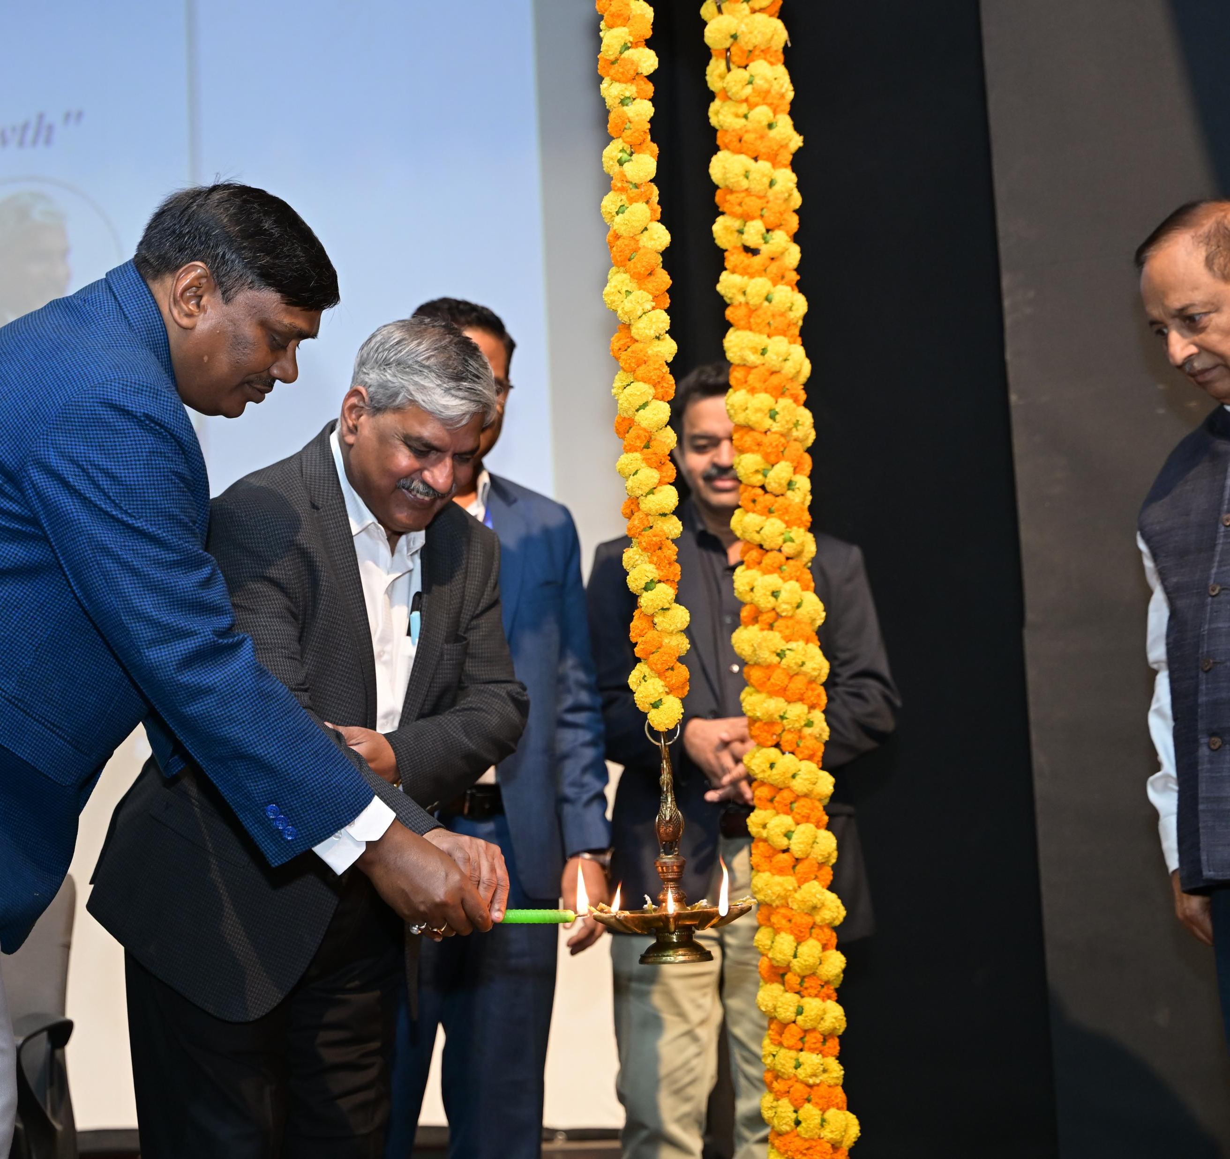
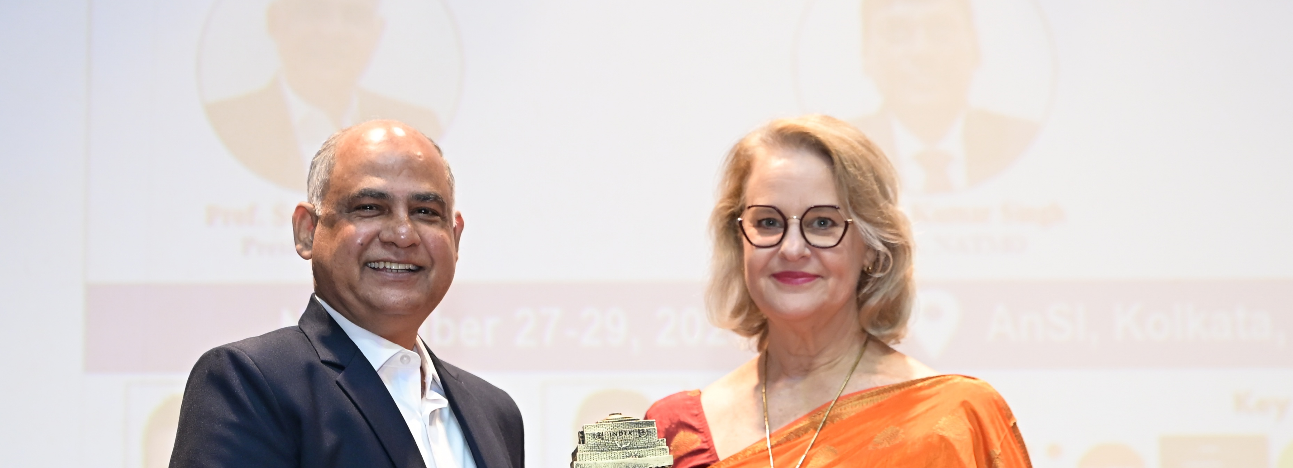
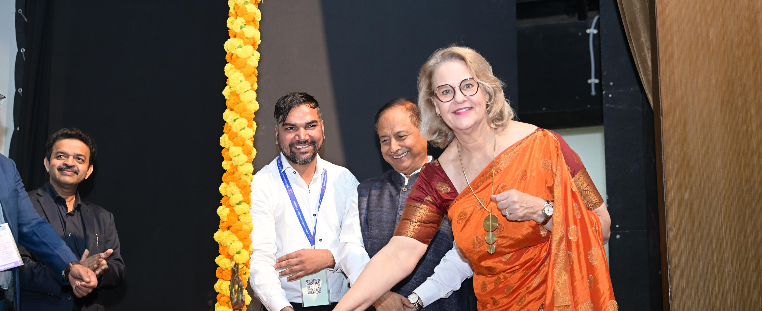
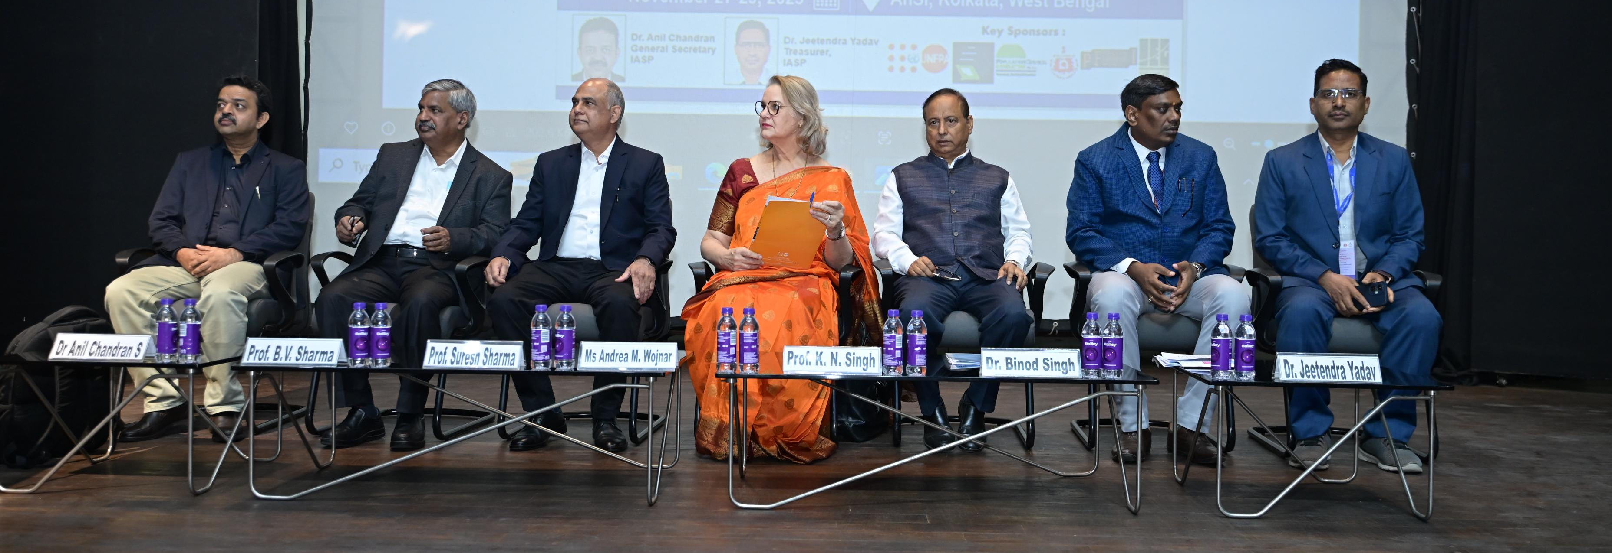
Inauguration Session – Day 1 (27 Nov 2025)

Slide 5
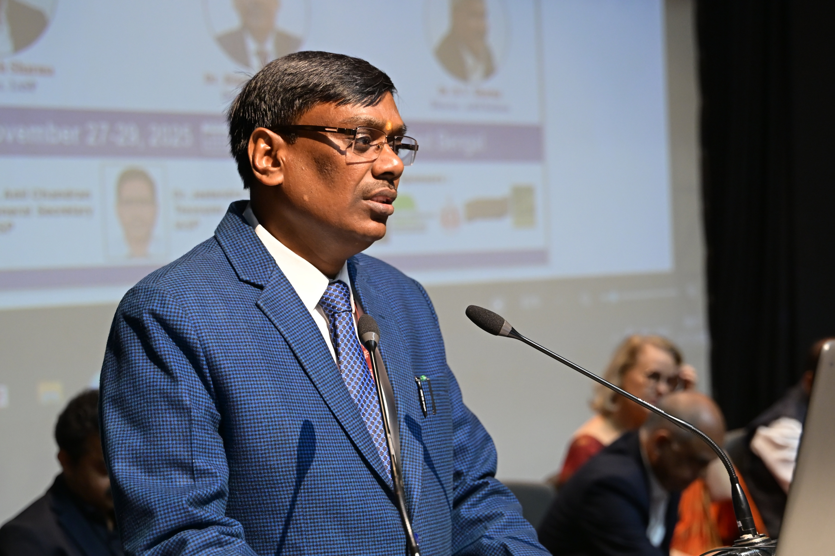
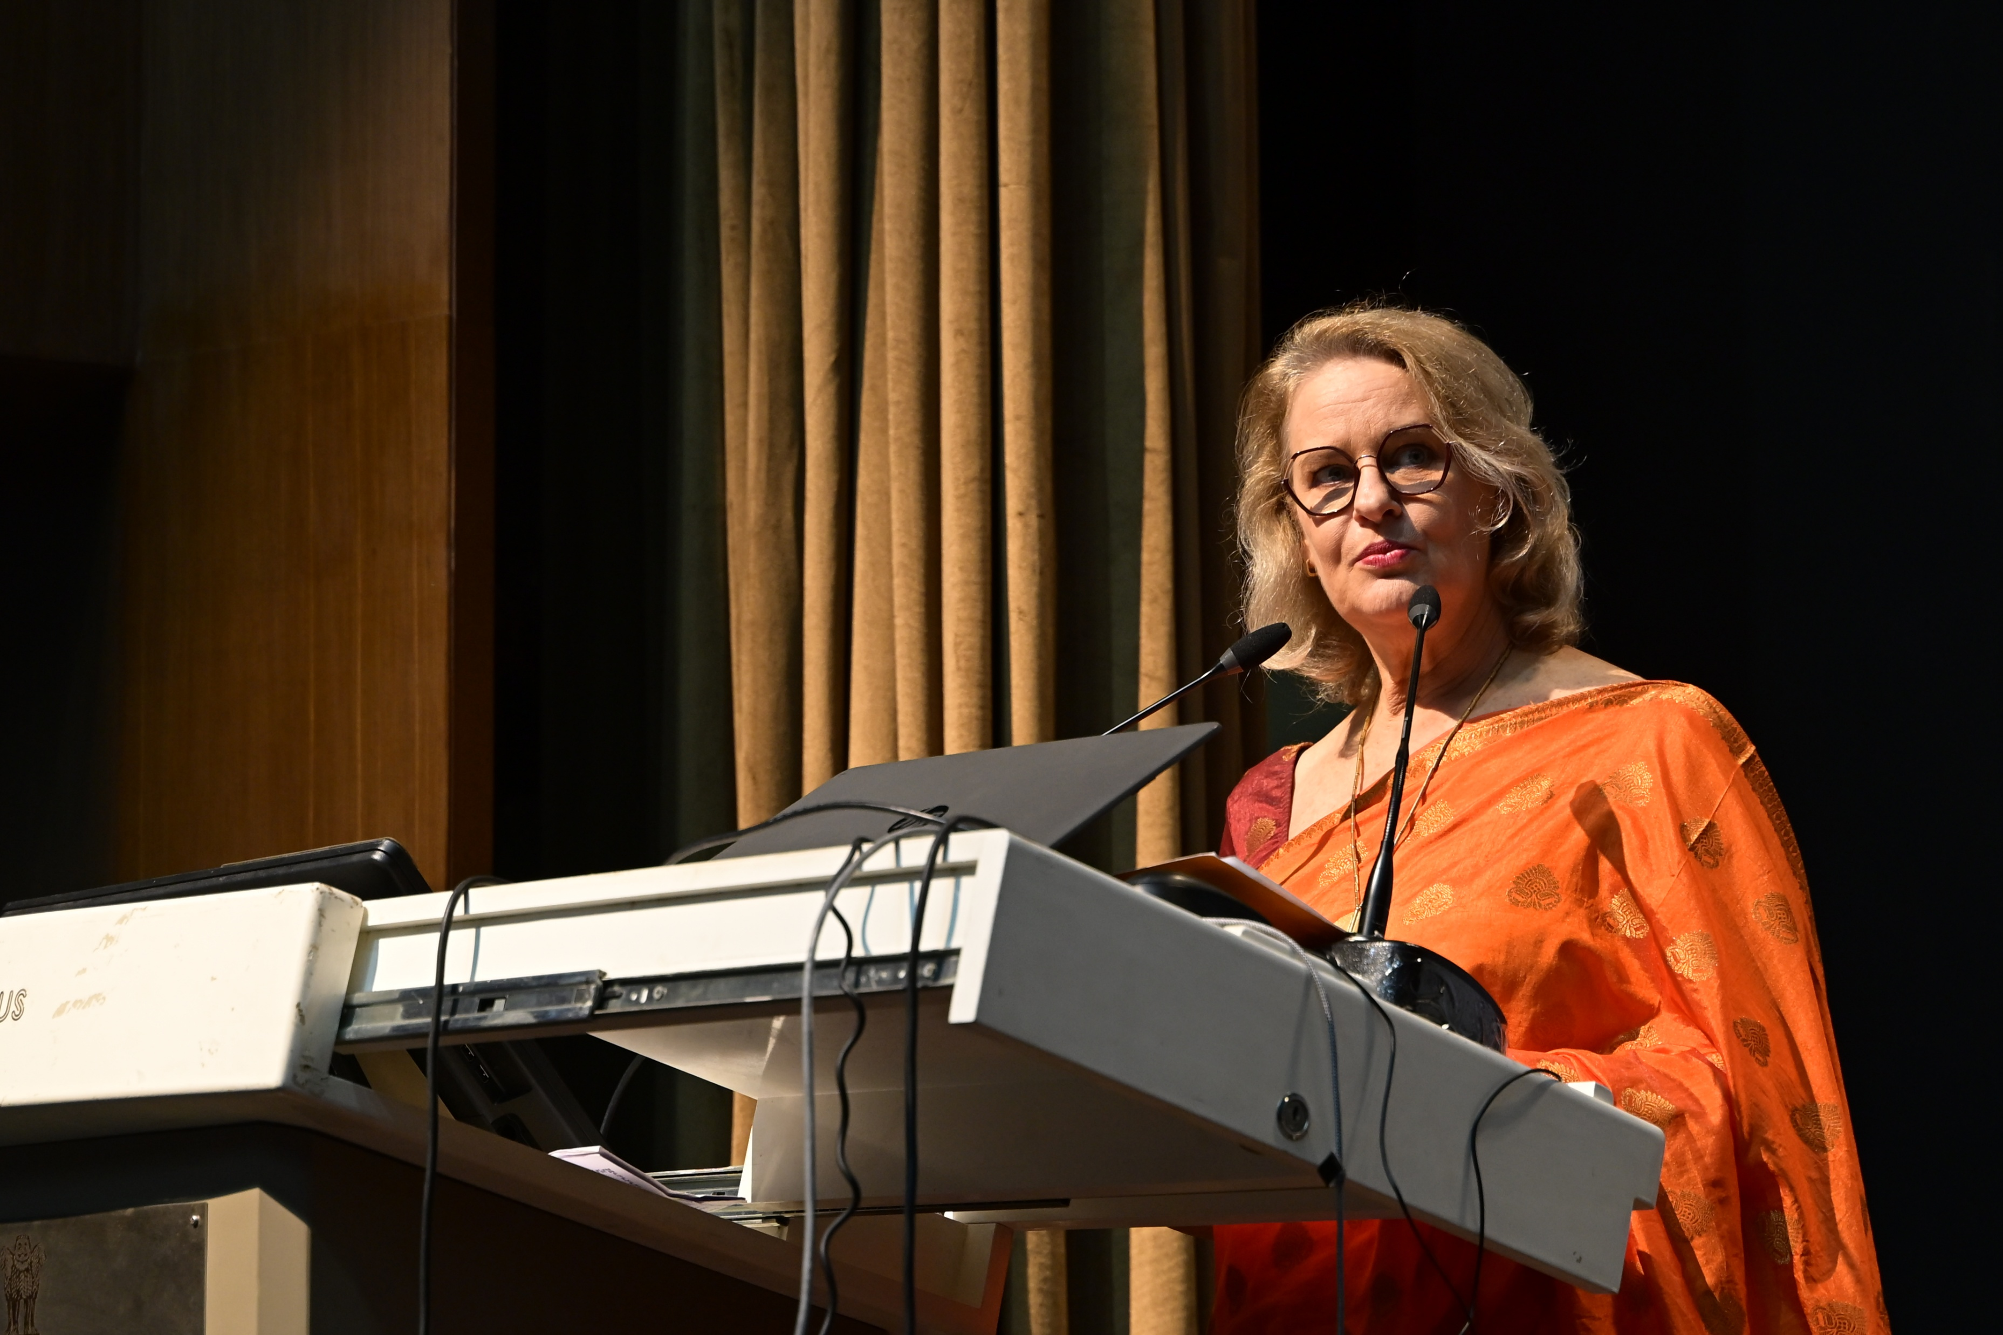
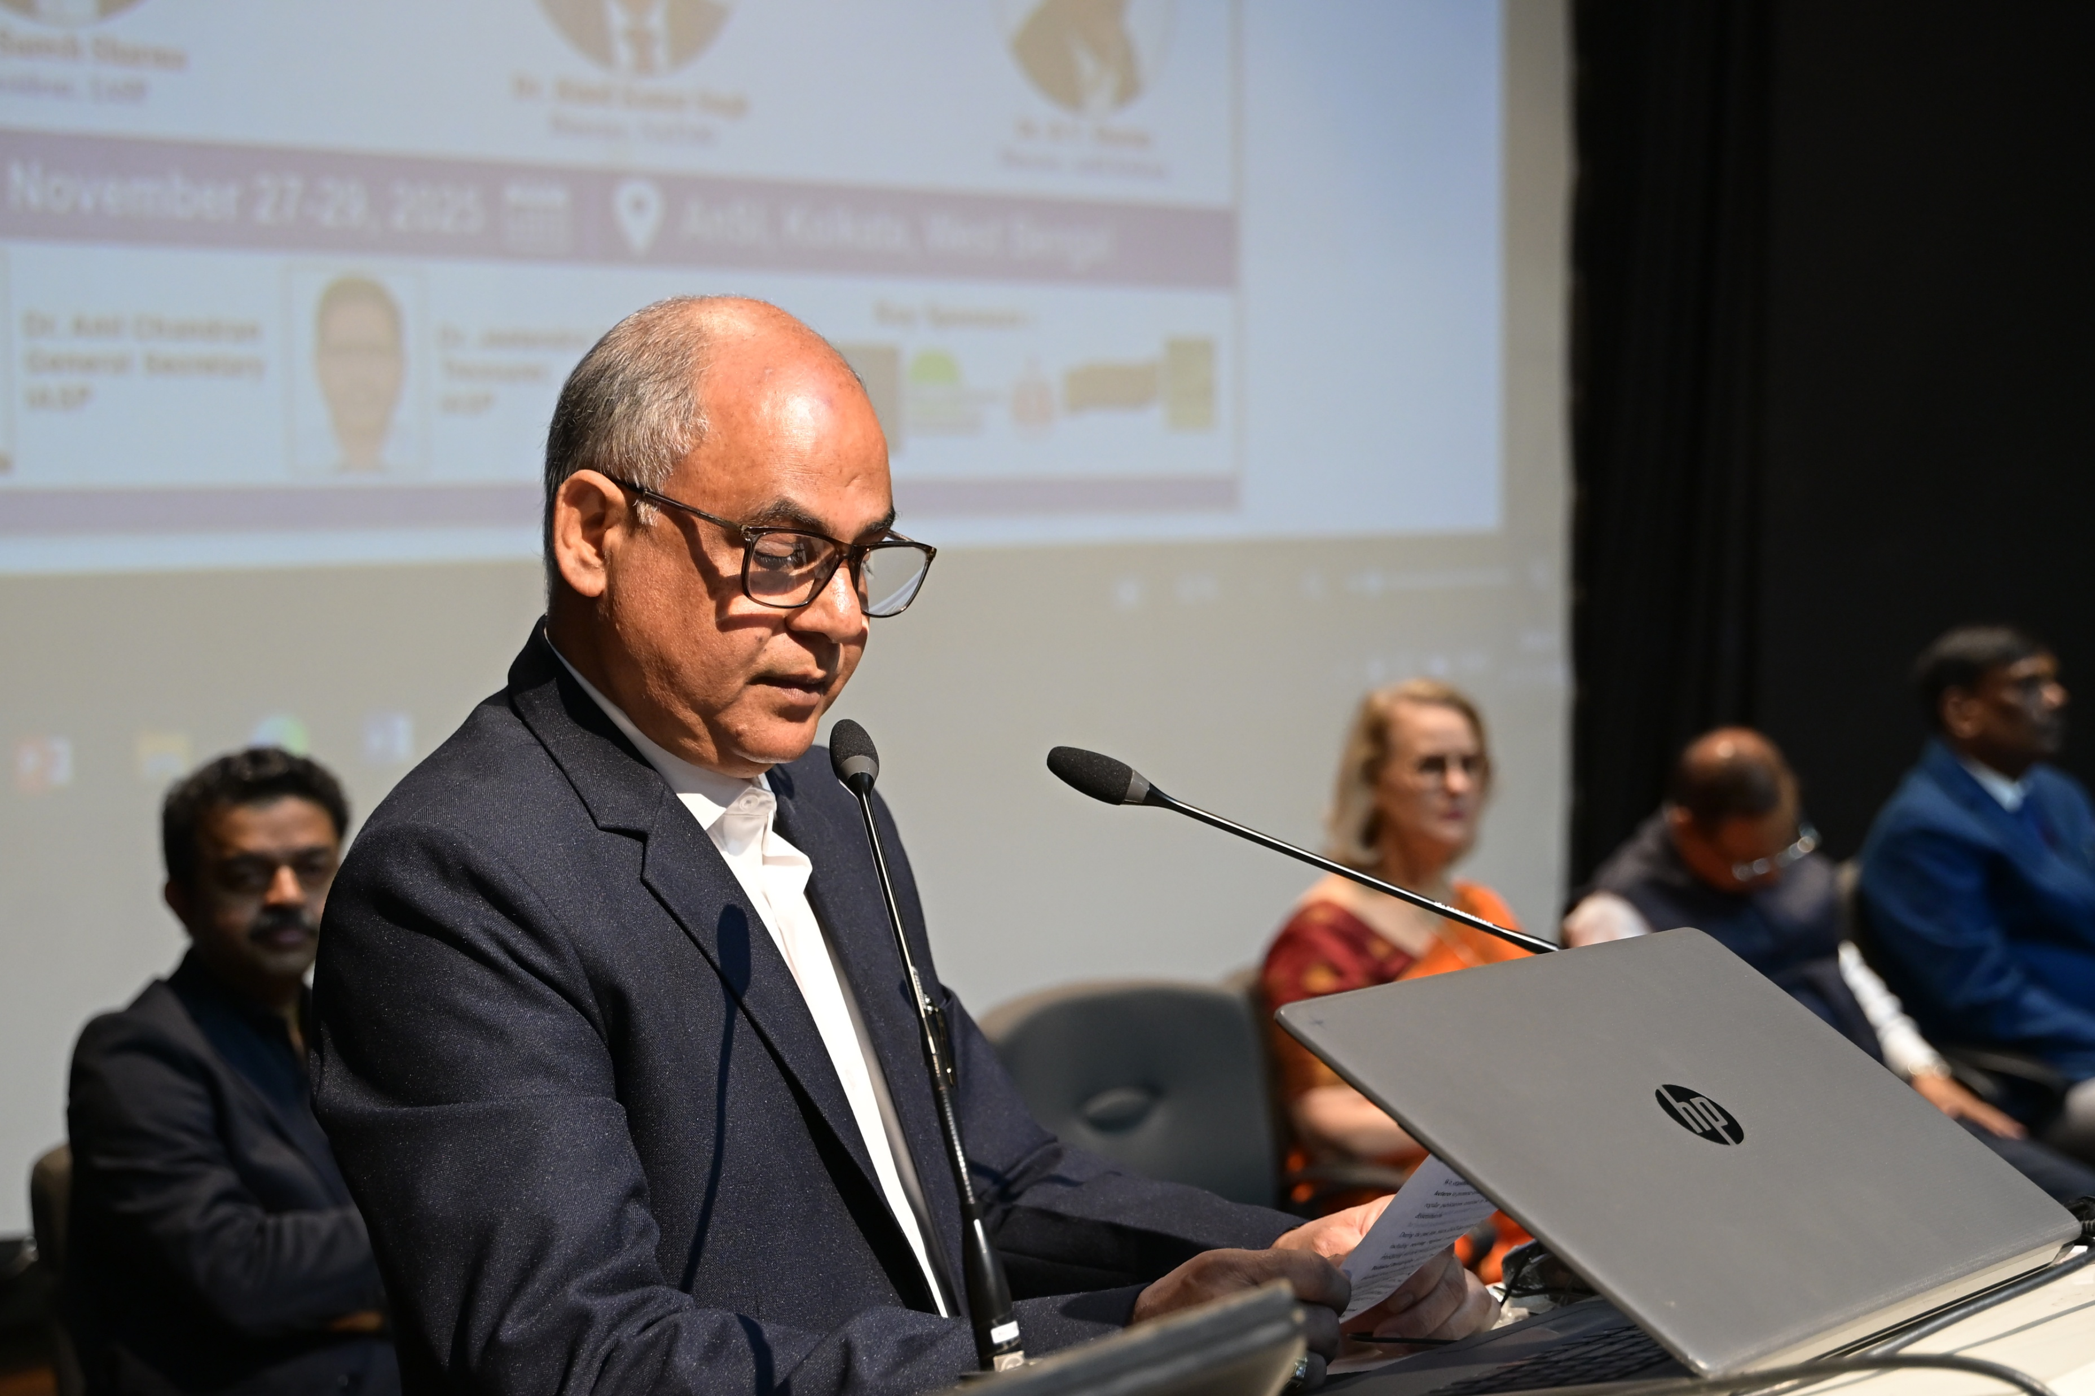
Welcome Address Dr. Binod Singh, Director, NATMO
Overview of the Conference Dr. Anil Chandran S, General Secretary, IASP
Address by the IASP President Prof. Suresh Sharma
Inaugural Address by the Chief Guest Prof. K. N. Singh, Vice-Chancellor, CUSB
Address by the Guest of Honour Shri Vijay Bharti, IAS, Govt. of West Bengal
Keynote Address Ms. Andrea M. Wojnar, UNFPA Representative India & Country Director, Bhutan
Release of Souvenir and Publications
Special Address
Prof. BV Sharma, Director, Anthropological Survey of India (AnSI)

Slide 6
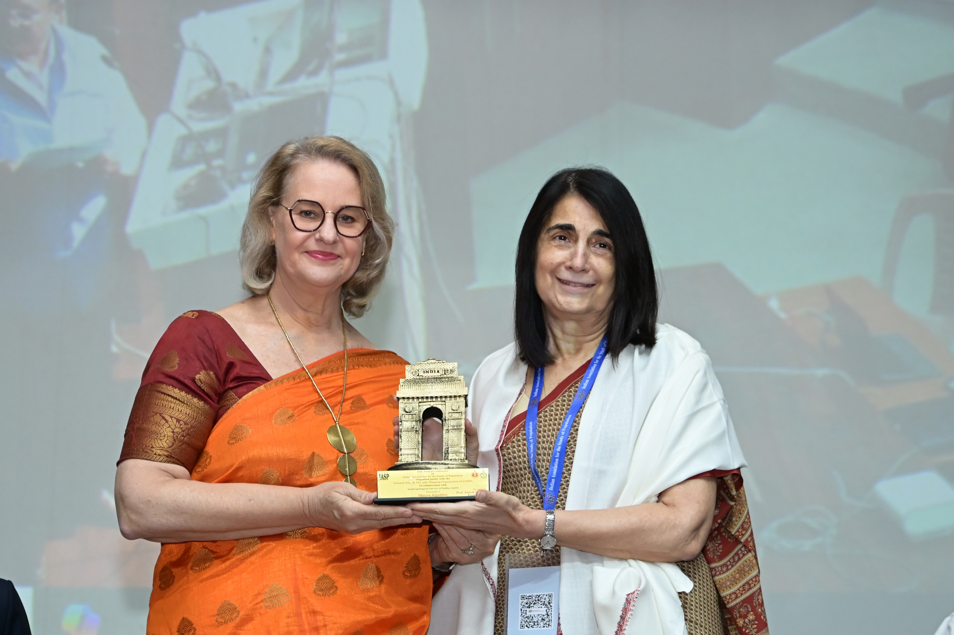
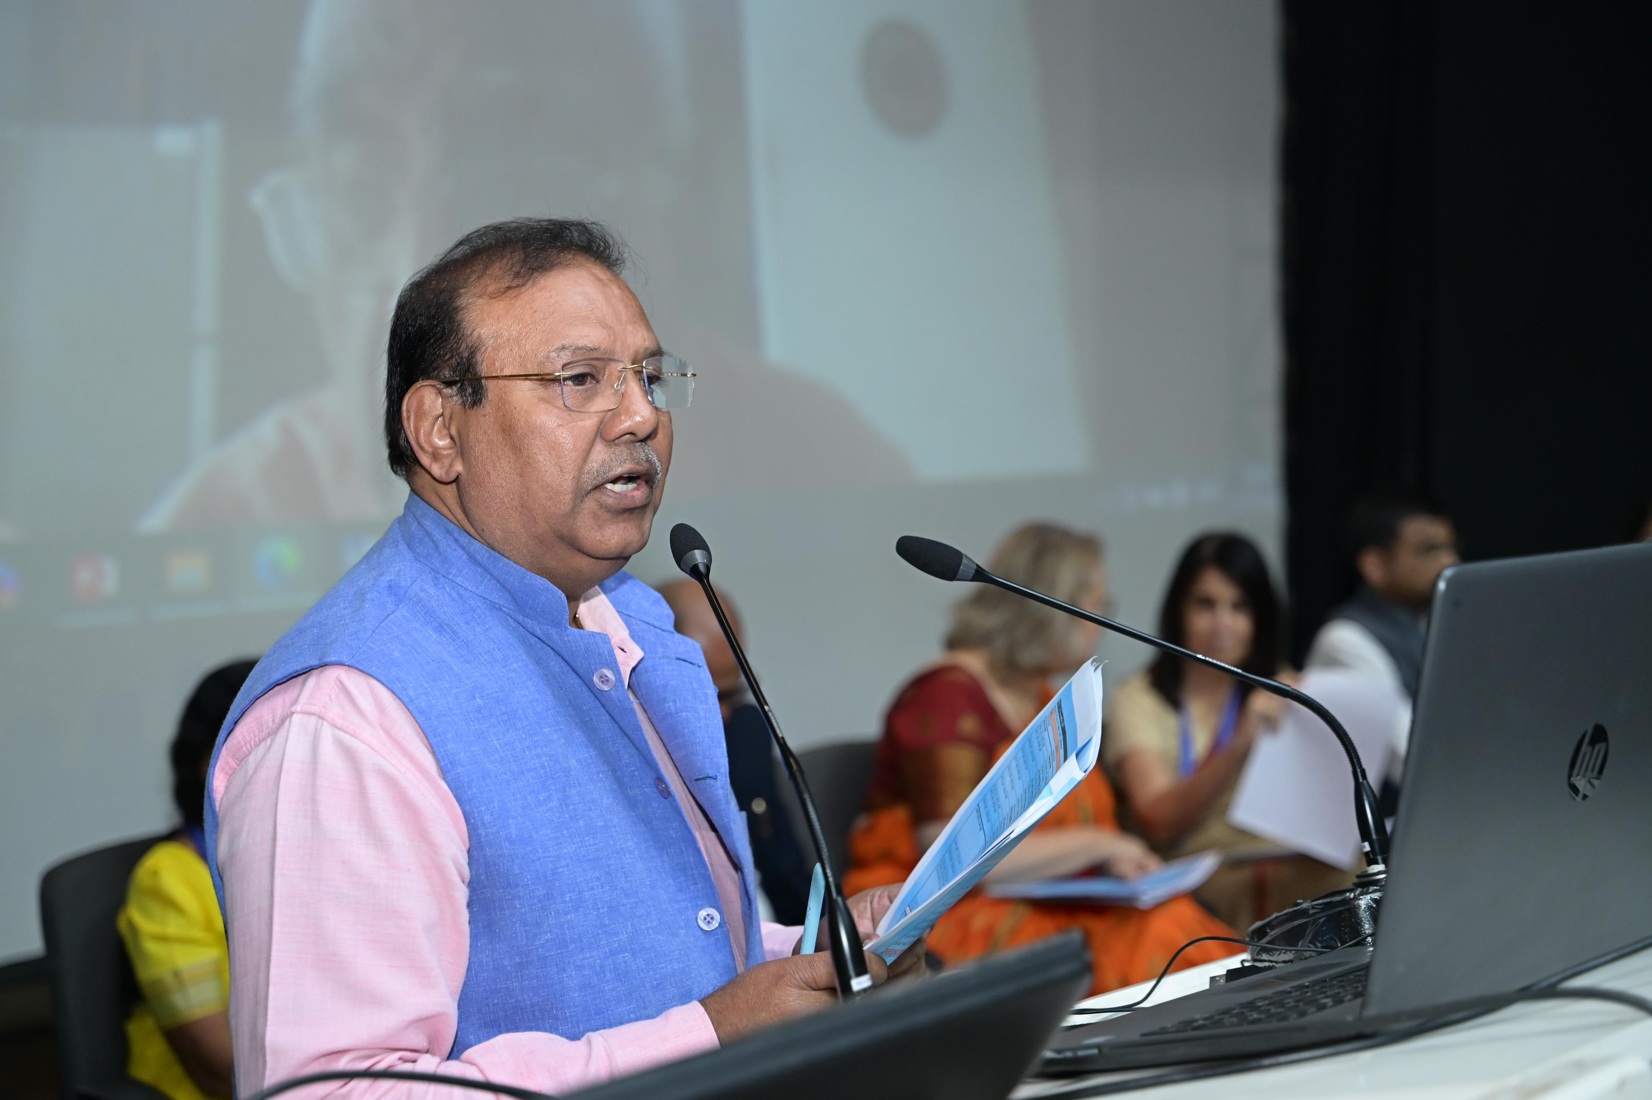
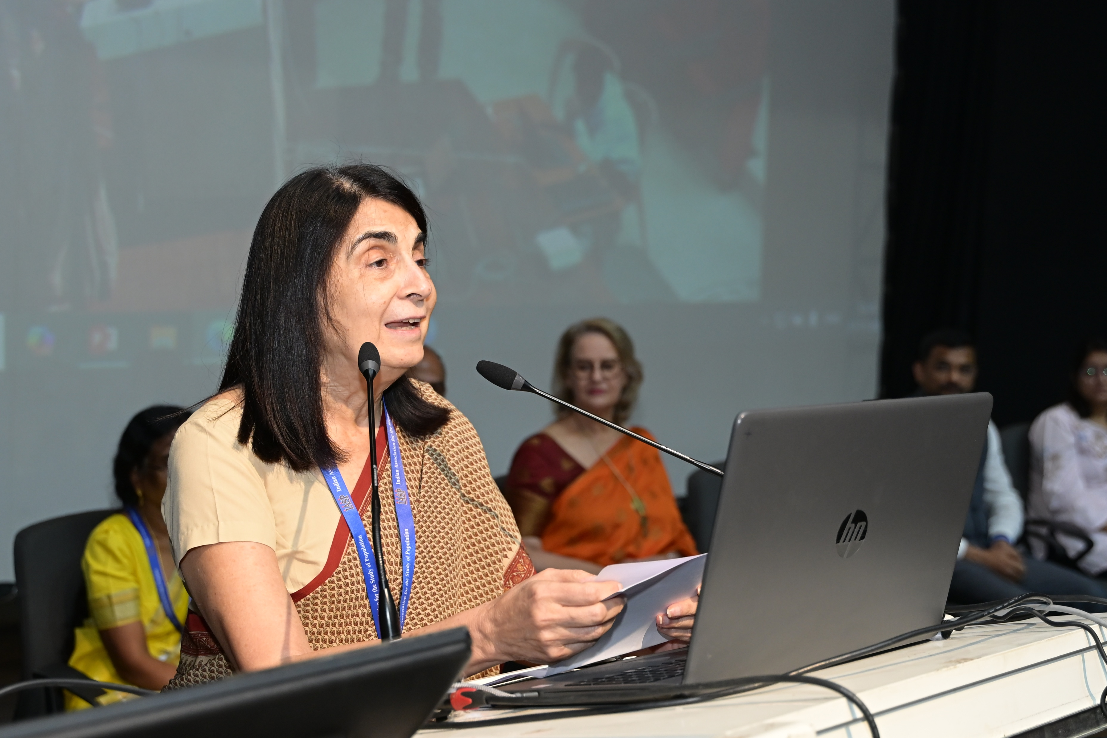
Felicitation of International Union for the Scientific Study of Population (IUSSP) on Receipt of the UN Population Award (Institutional Category), 2025 for Promoting Population Research and Collaboration Among Demographers by UNFPA
Chair: Andrea M. Wojnar (UNFPA) Speakers Shireen Jejeebhoy, Mary Ellen Zuppan, K. Srinivasan, Kajori Banerjee, K.G. Santhya, Niranjan Saggurti
Key Points:
Importance of global population research networks and role of IUSSP
Strengthening India’s demographic evidence ecosystem
Future demography challenges: ageing, fertility transition, migration

Slide 7
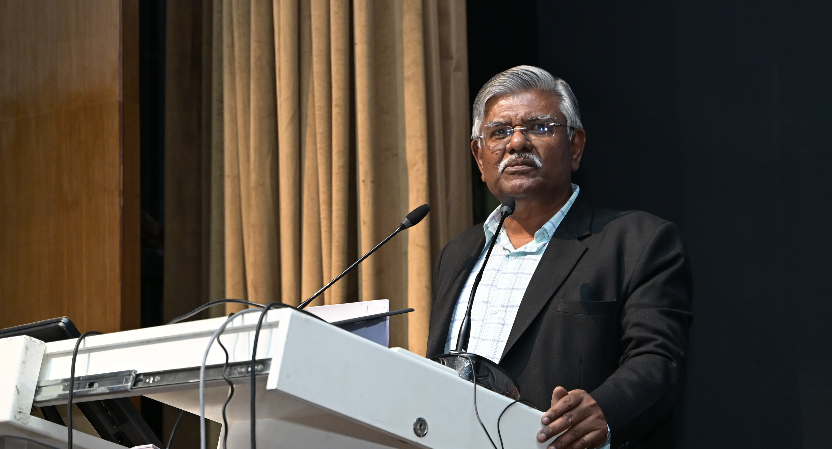
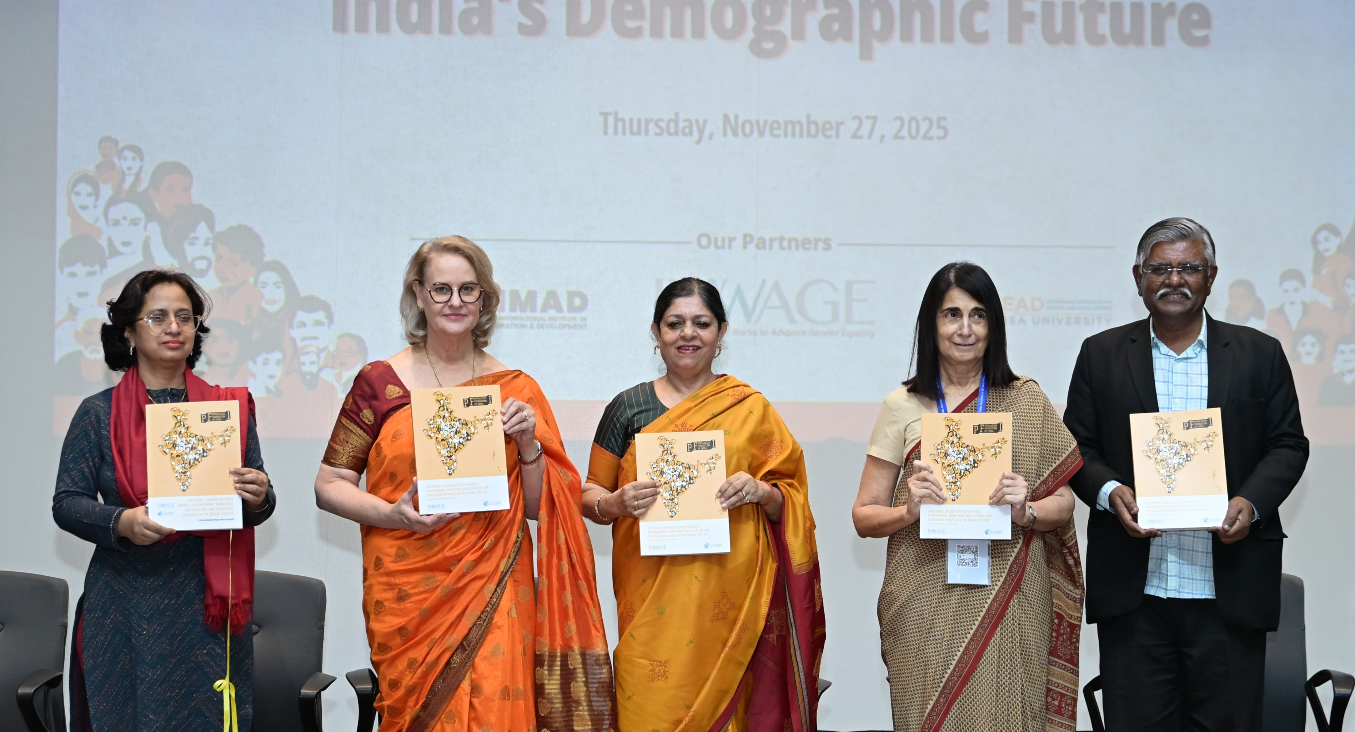
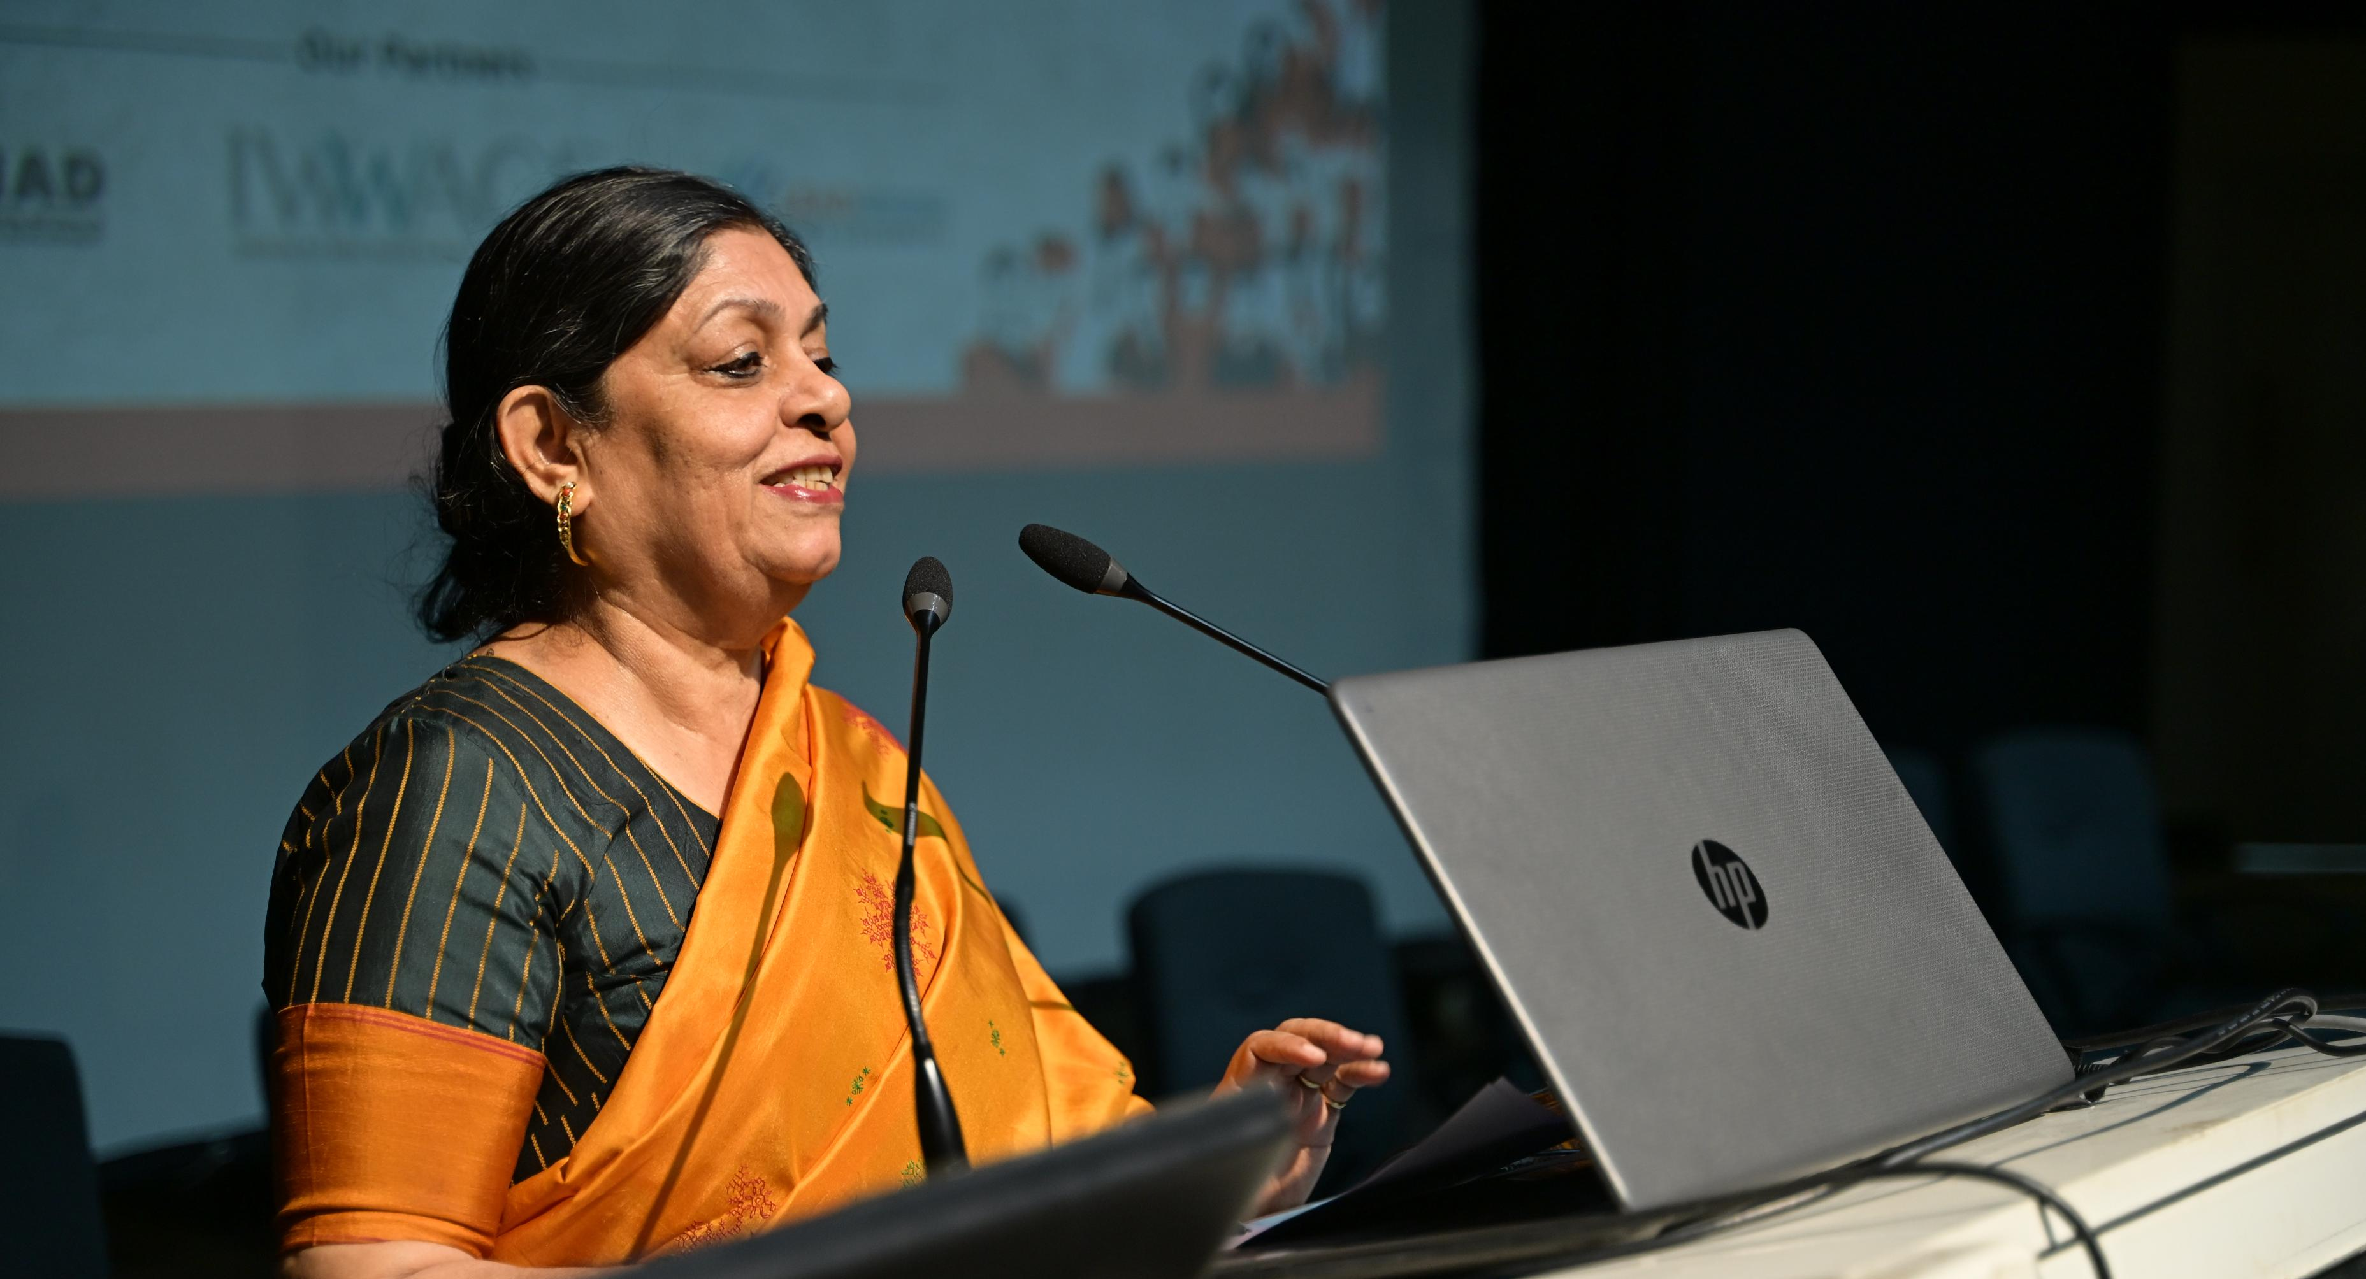
Panel Discussion by Population Foundation of India (PFI)
Presenters:
Prof. Irudaya Rajan
PFI & IWWAGE research teams
Remarks by Shireen Jejeebhoy & Andrea Wojnar
Key Points:
India’s state-level projections to 2051
Female workforce participation and empowerment linkages
Macro–micro insights for policy

Slide 8
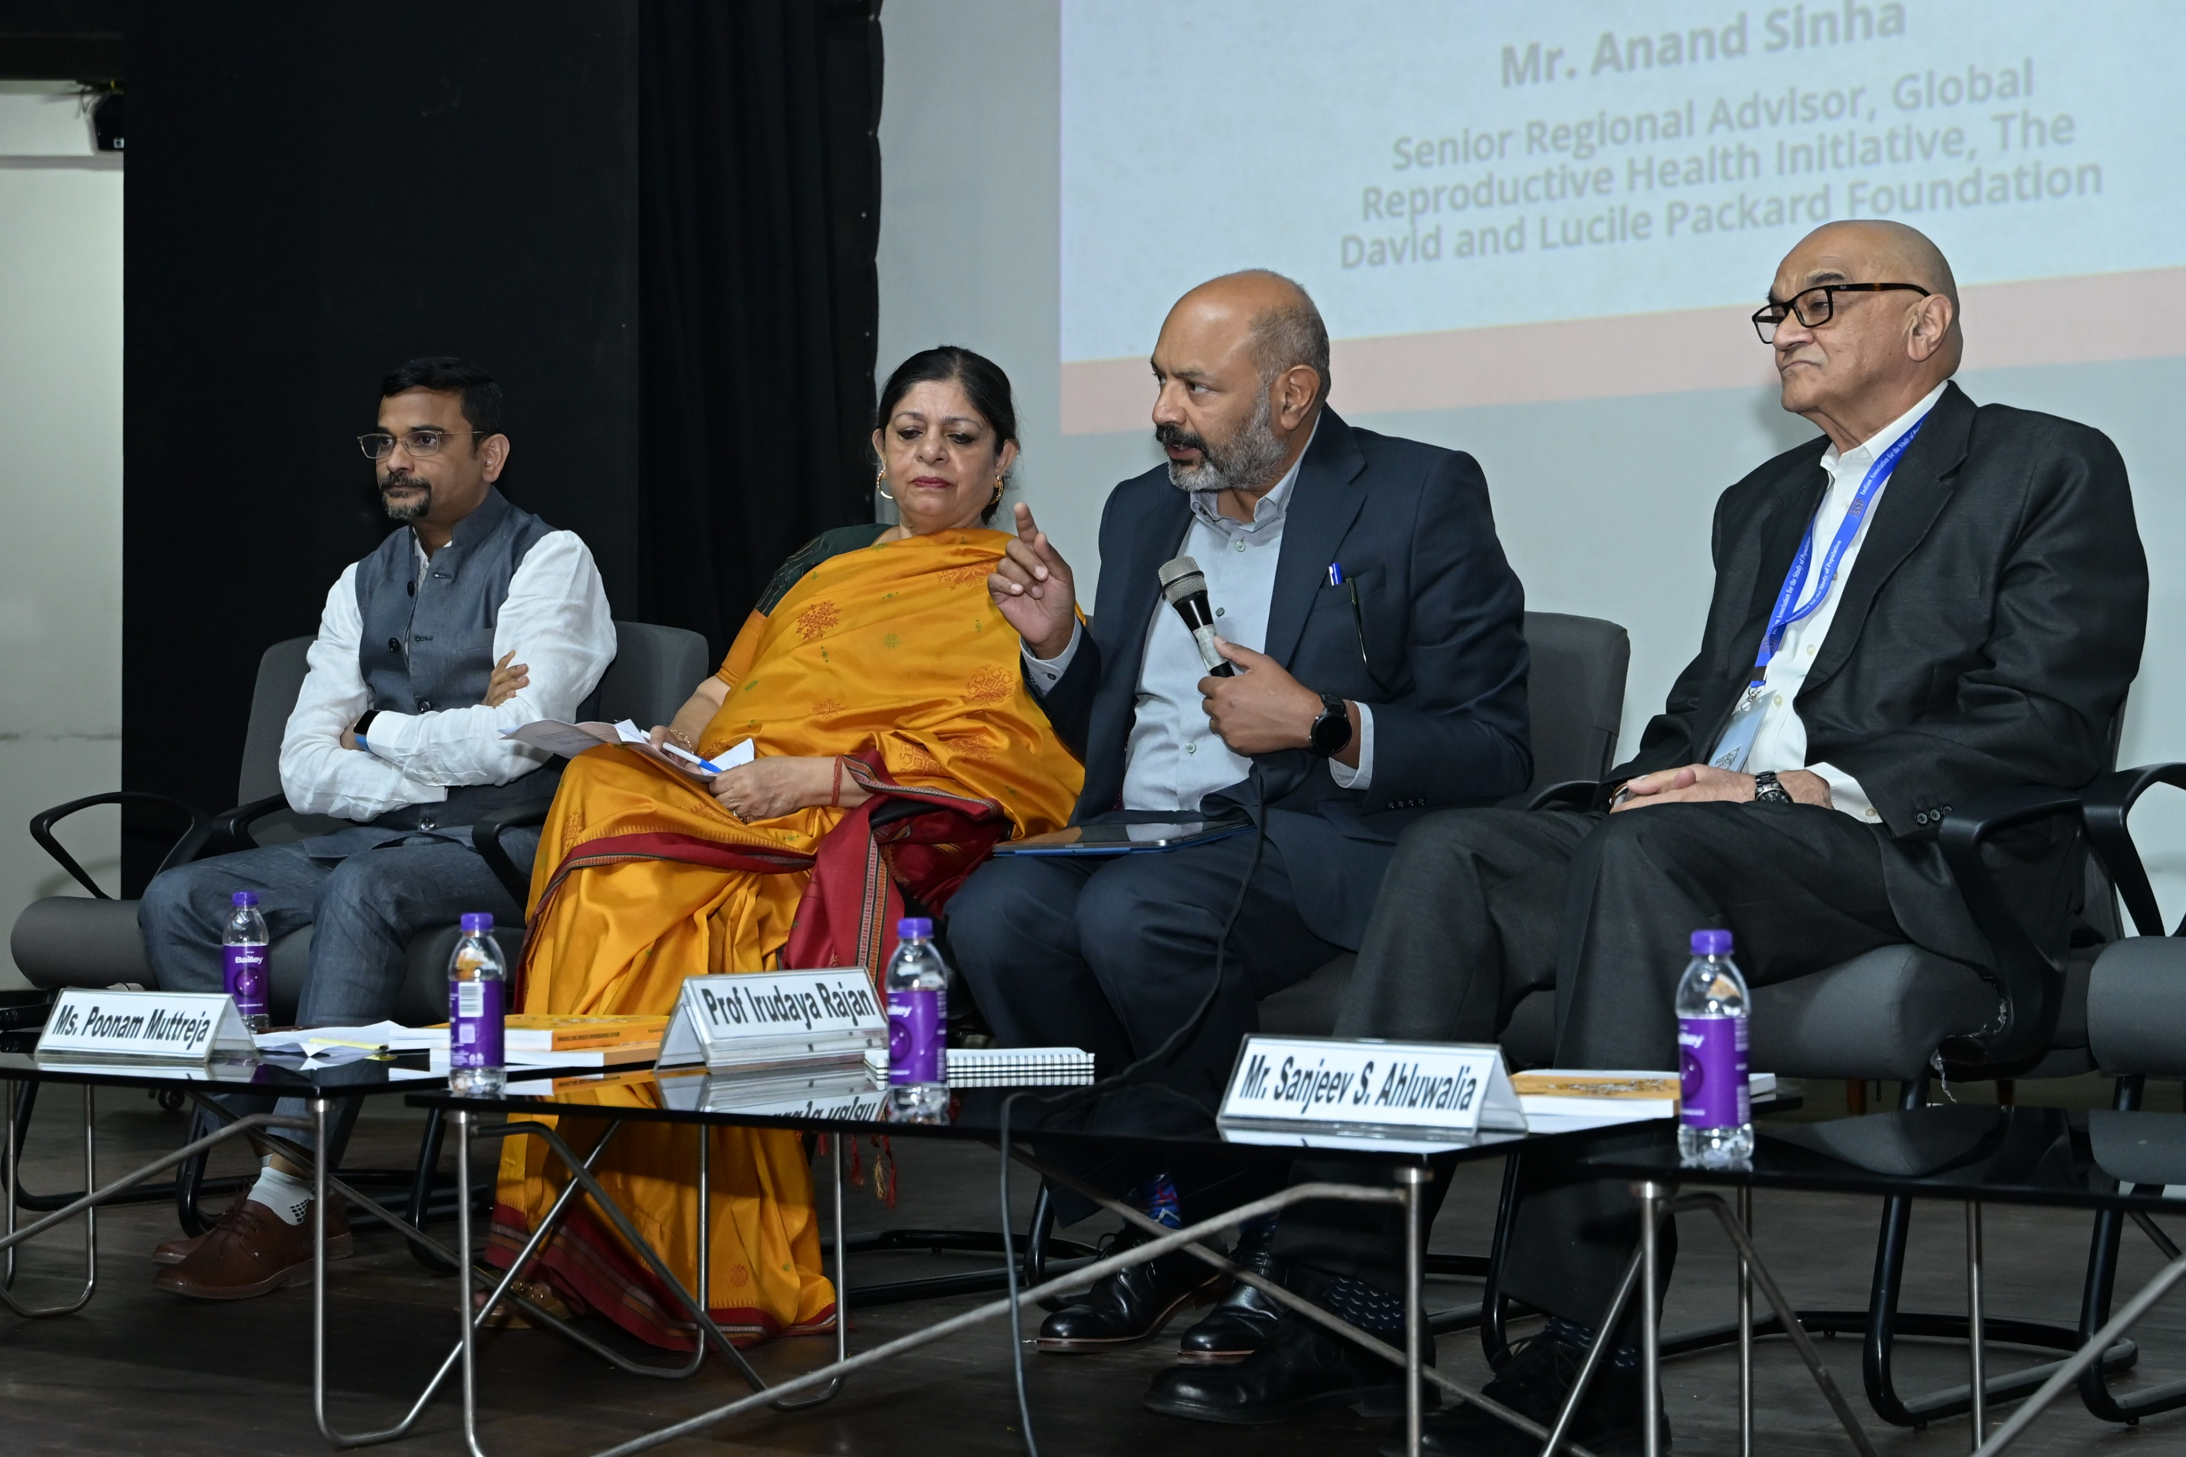
Panel discussions2 by PFI
Moderated by: Mr. Anand Sinha, Regional Advisor to the Global Reproductive Health initiative at The David and Lucile Packard Foundation
Dr. Niranjan Saggurti, India Country Director, Population Council
Mr. Sanjeev S. Ahluwalia, Distinguished Fellow, Chintan Research Foundation
Ms. Poonam Muttreja, Executive Director, Population Foundation of India

Slide 9
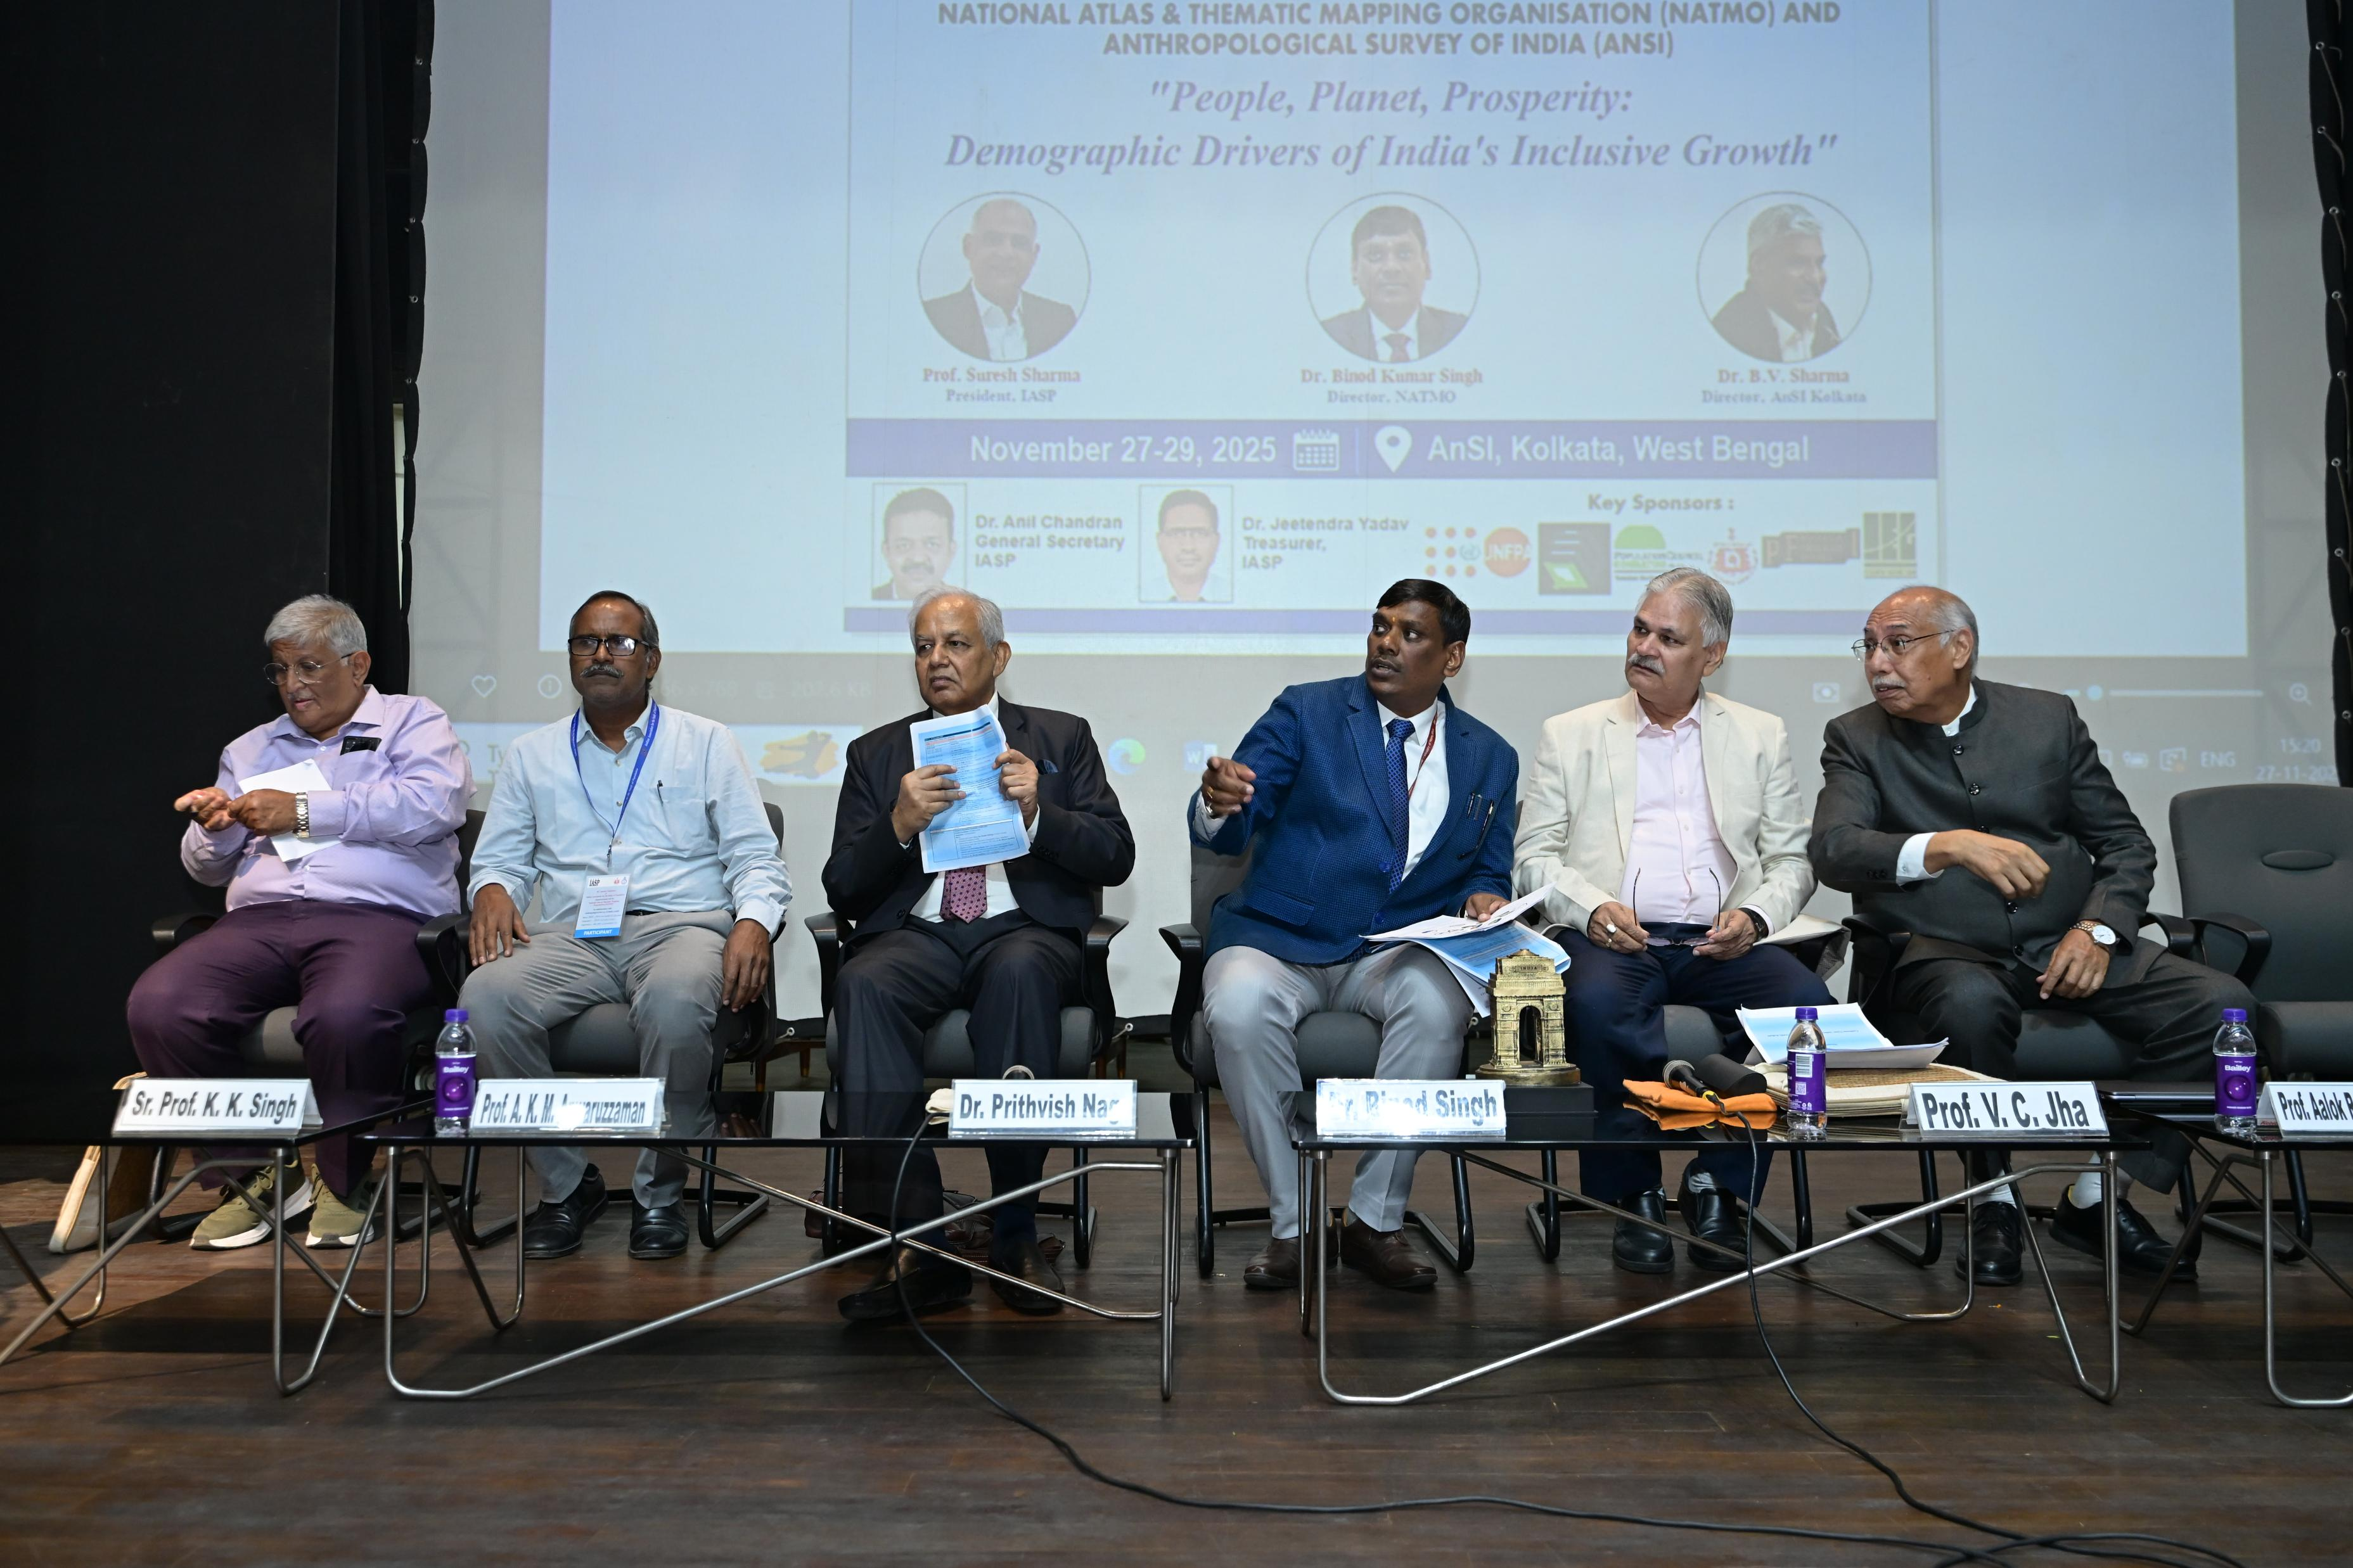
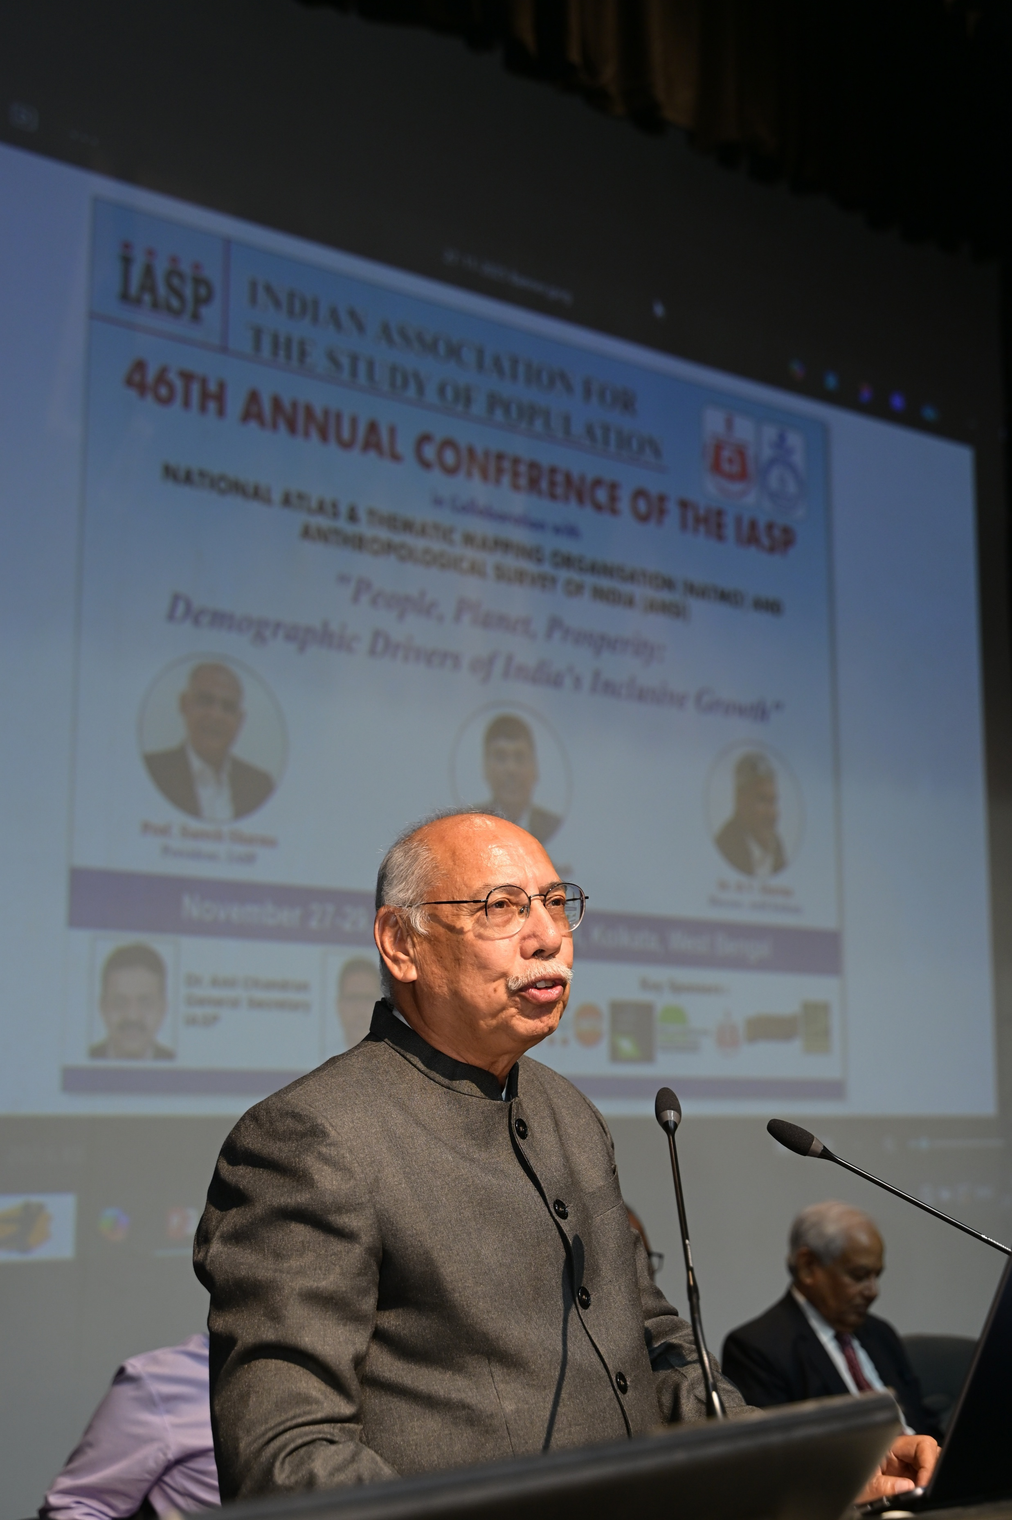
Panel Discussion by NATMO: Demography–Geography Ecosystem for Local Decision-Making
Speakers: Aalok R. Chaurasia, KK Singh, D.A. Nagdeve, VC Jha, VK Tripathi, S. Bandyopadhyay, A.K.M. Anwaruzzaman
Key Points:
GIS & spatial analytics for public policy
Integration of demographic data for micro-level governance
Climate, health, and population mapping challenges

Slide 10
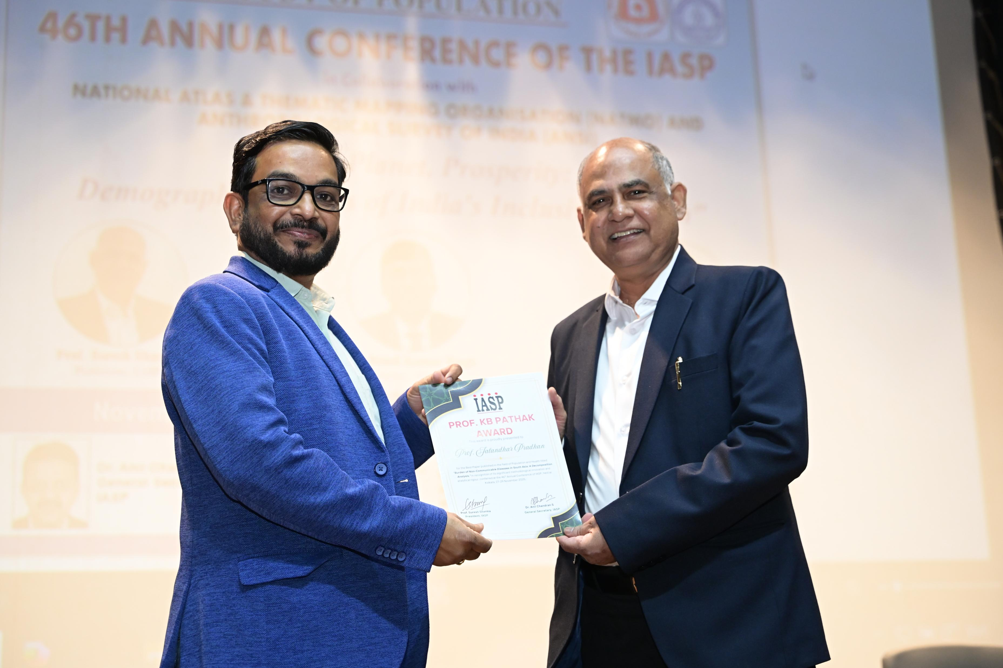
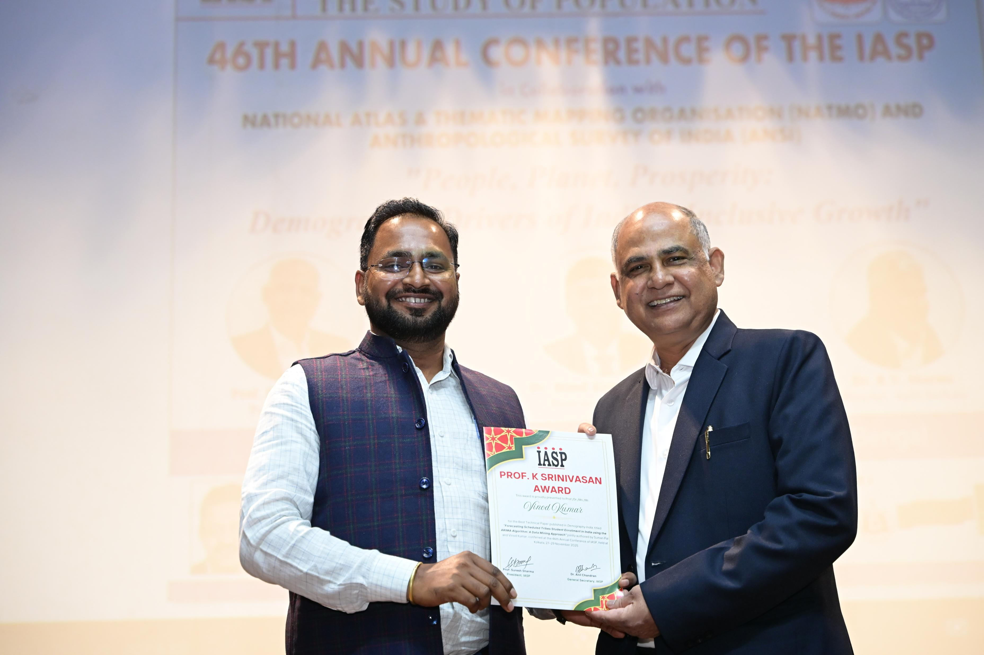
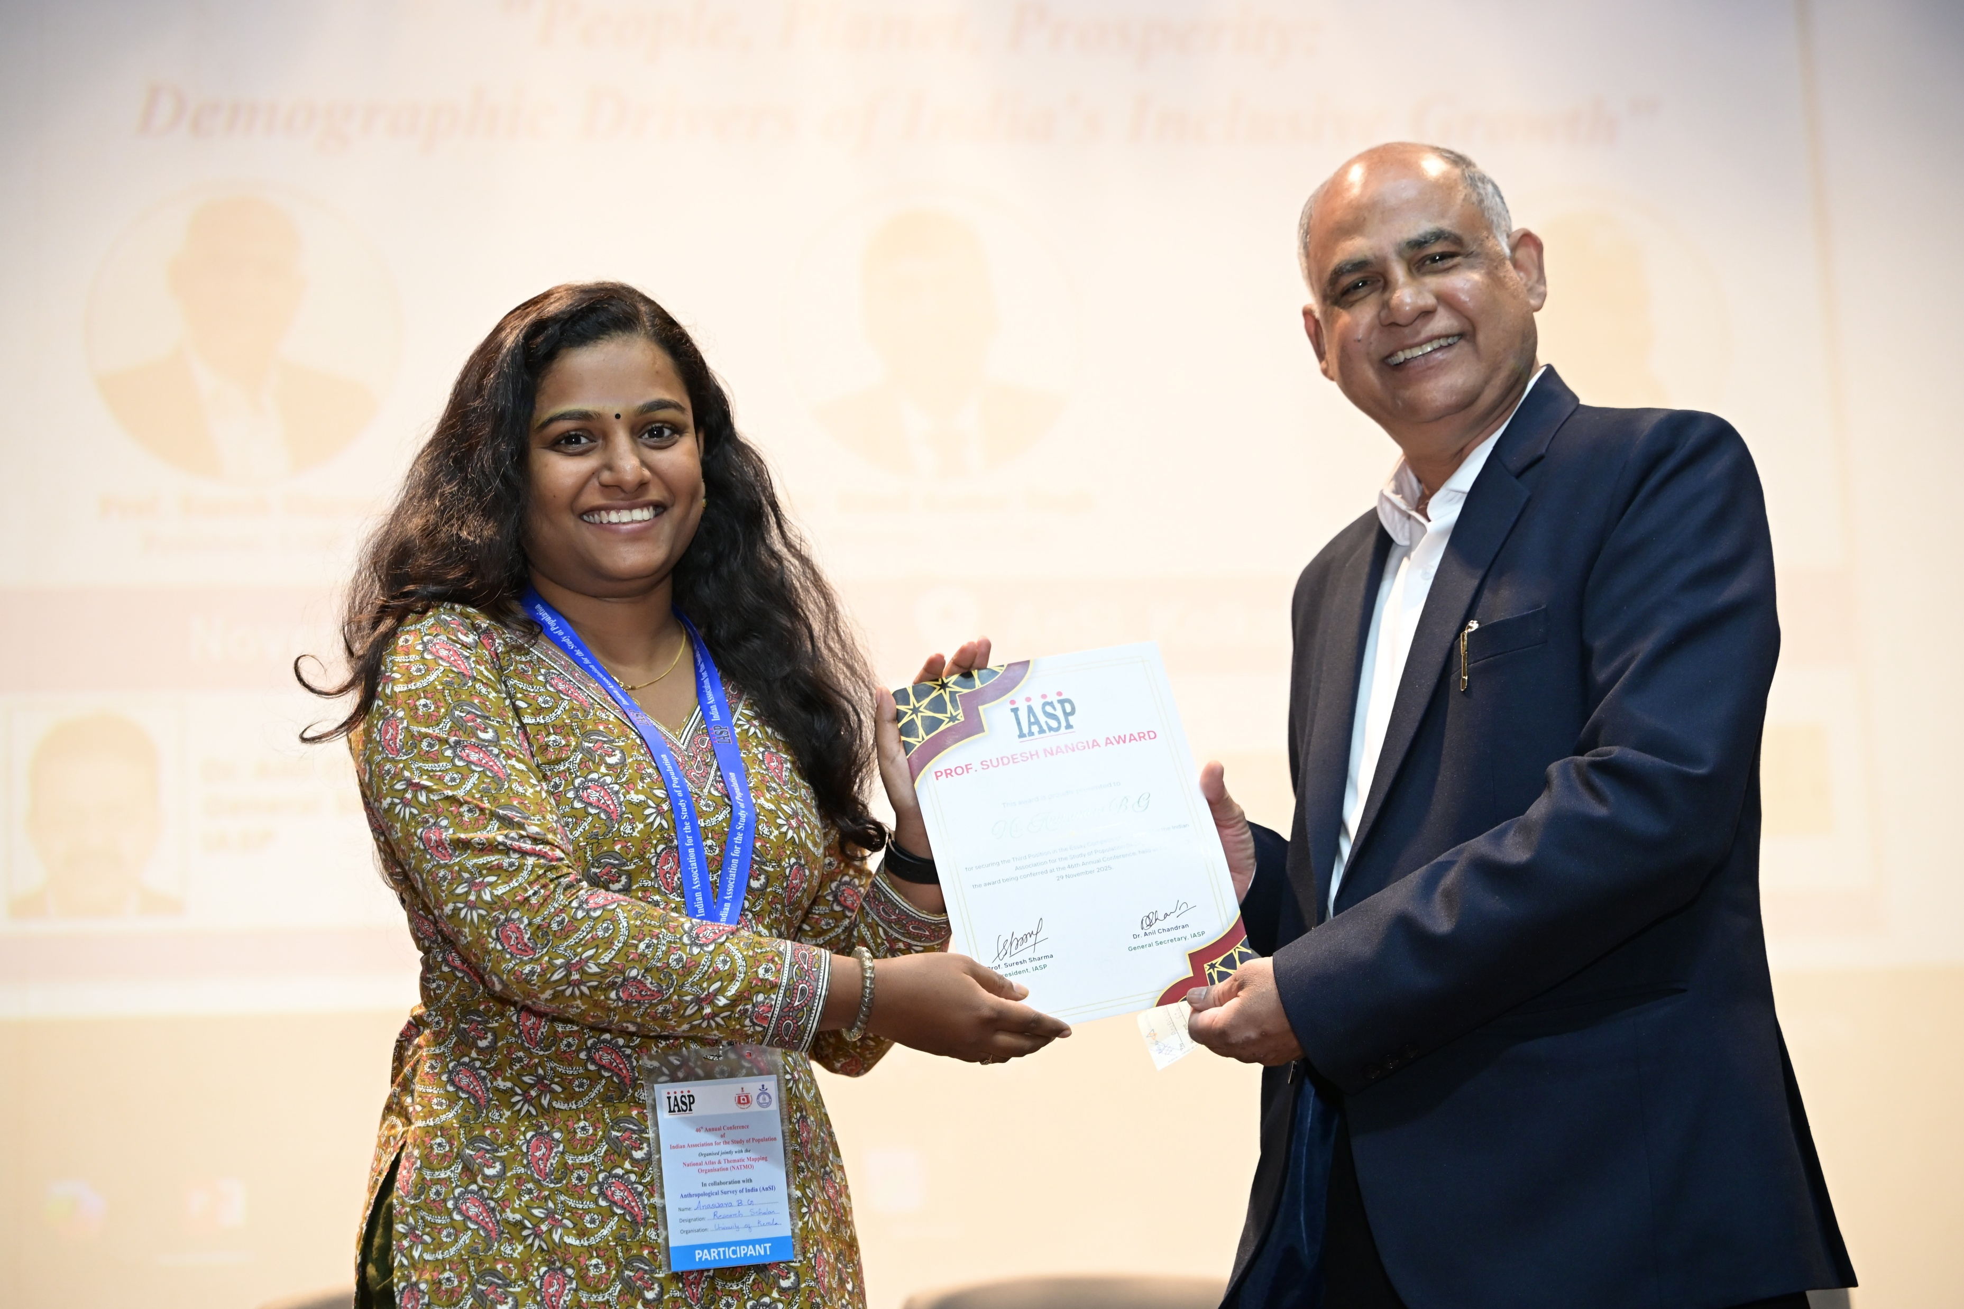
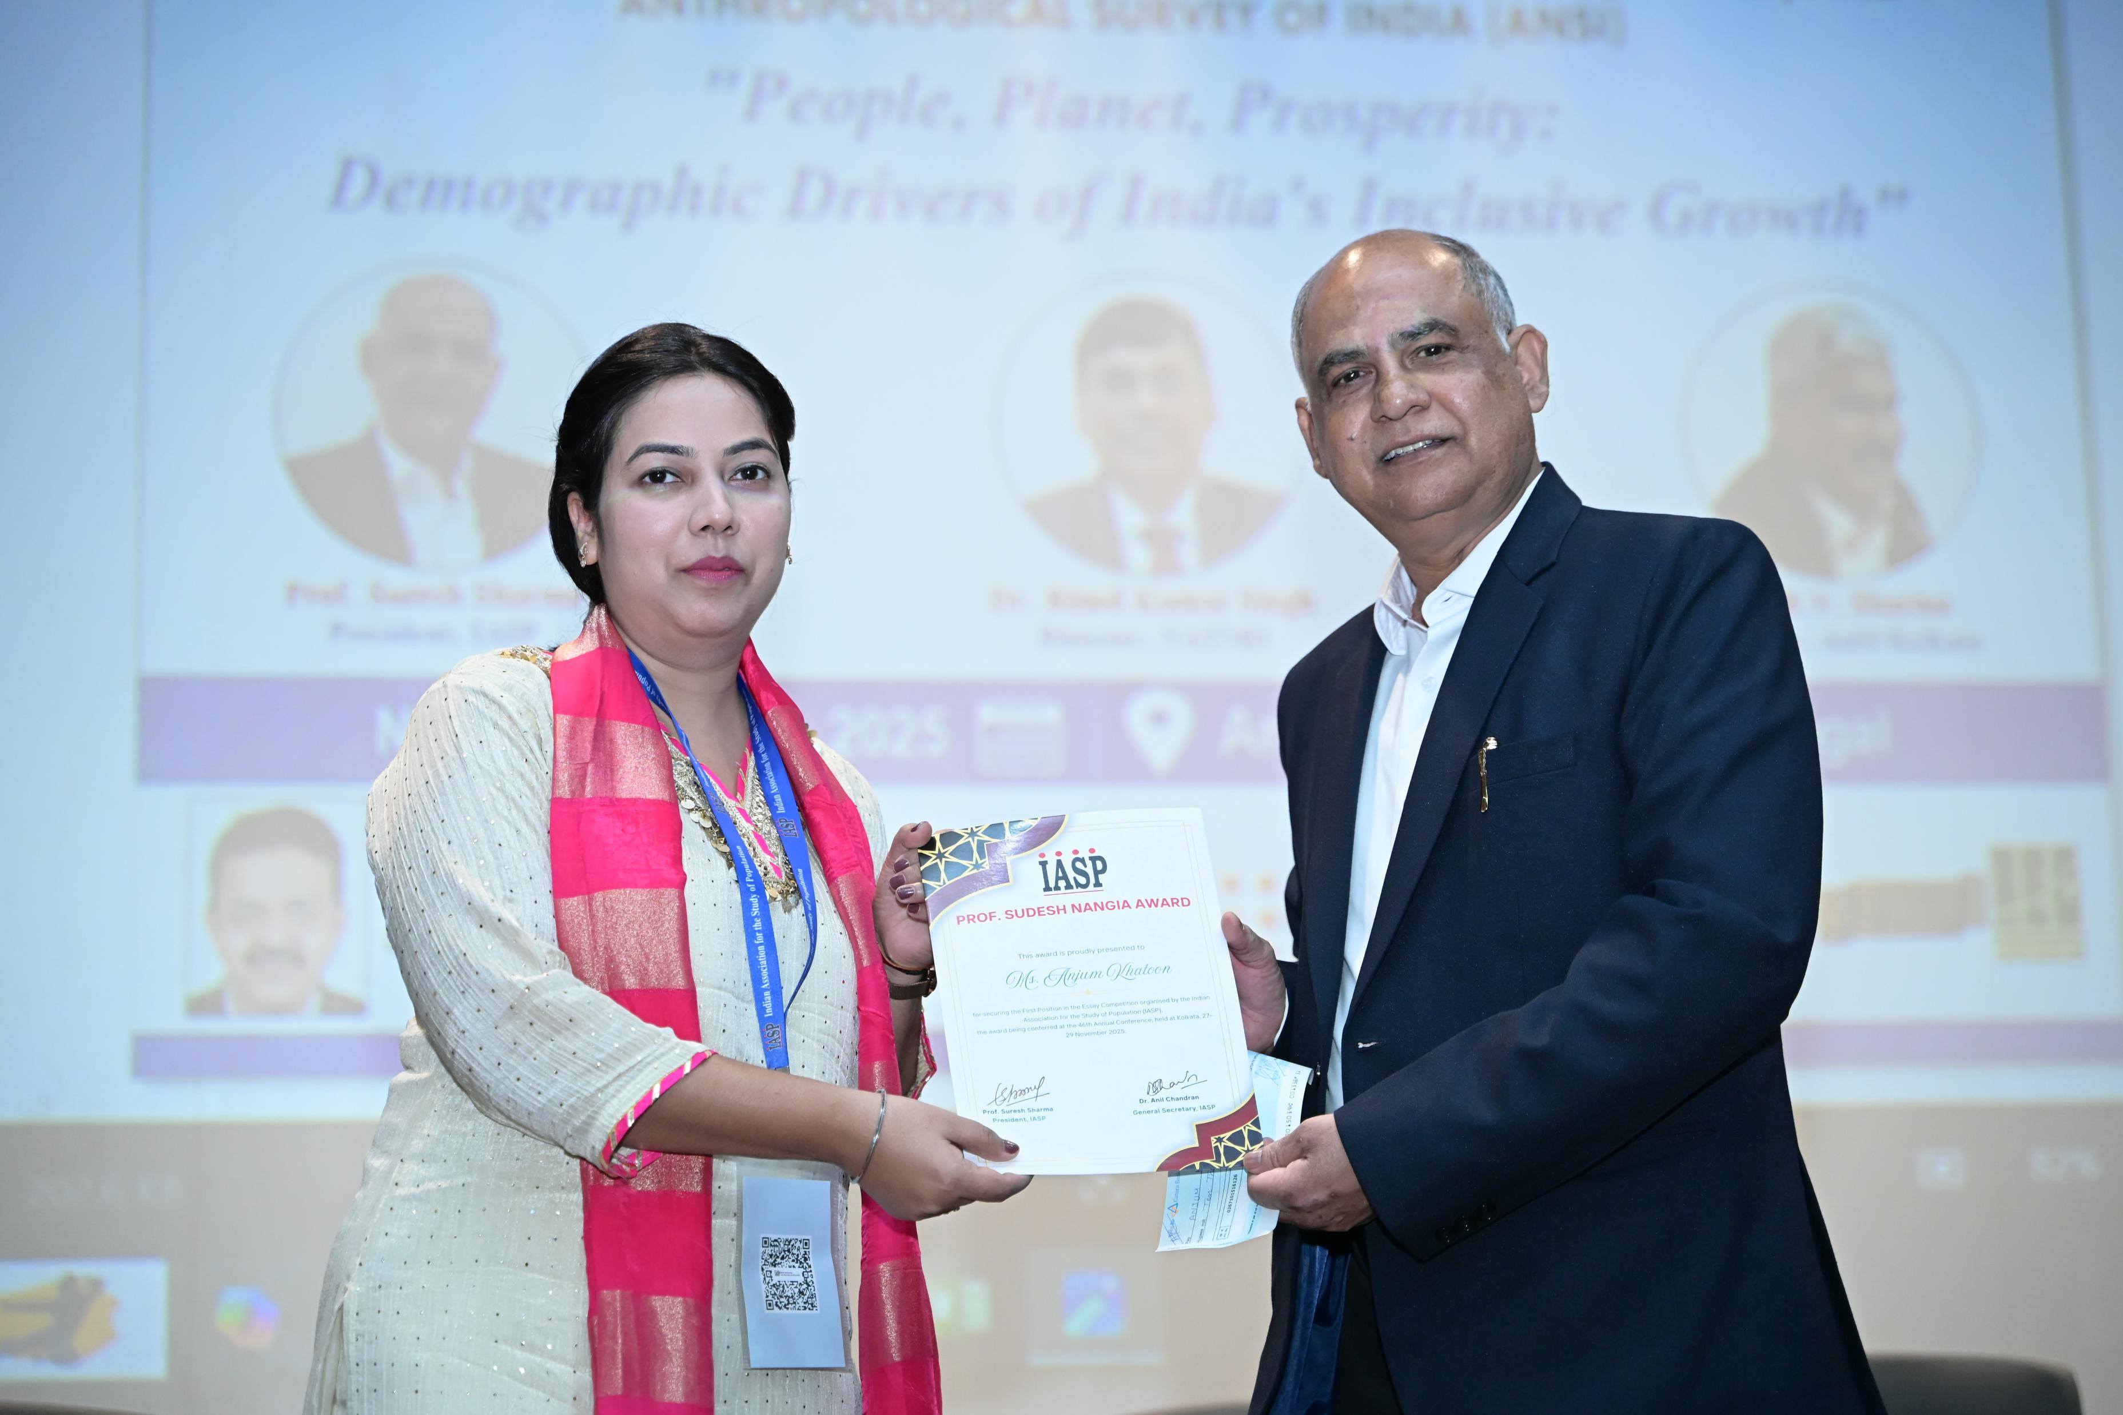
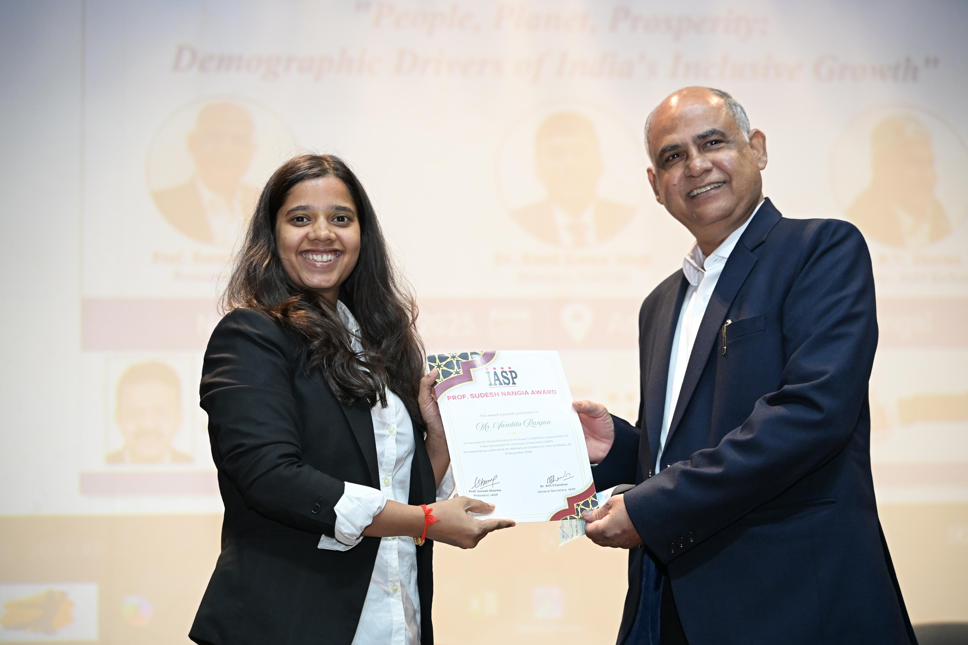
Awards KB Pathak Award, K Srinivasan and Essay Competition

Slide 11
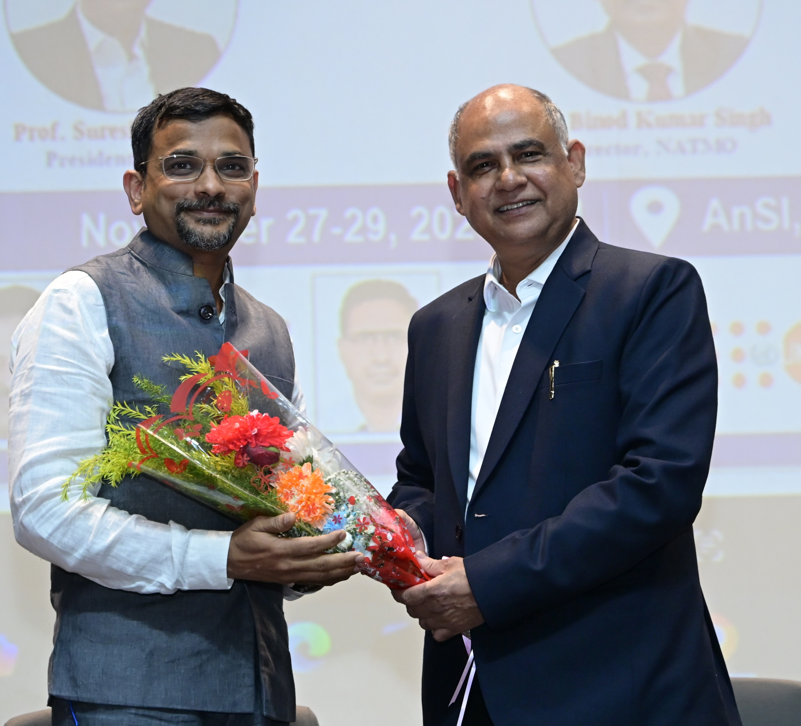
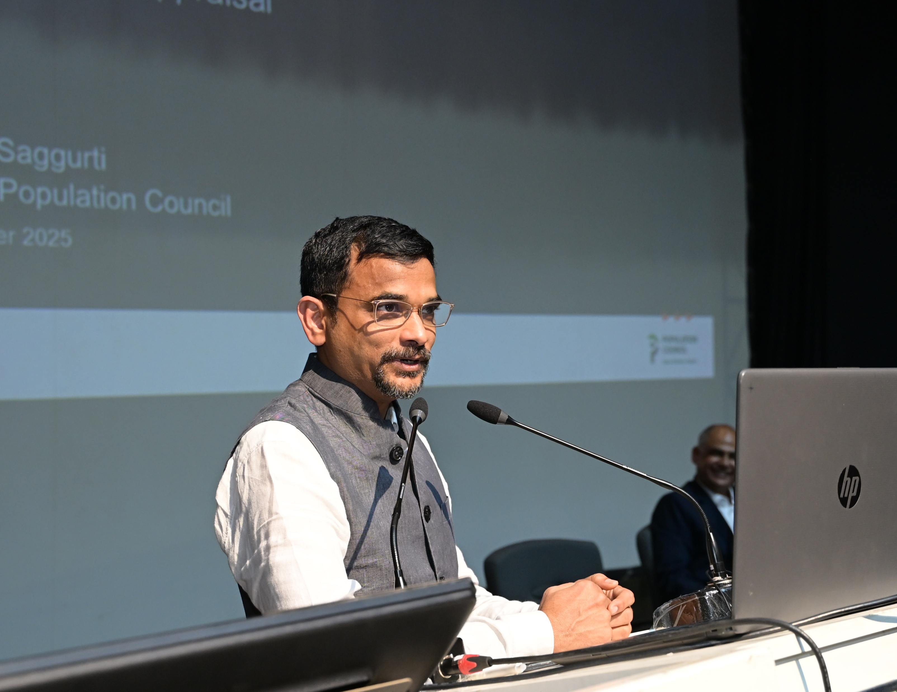
George Simmons Memorial Lecture
Speaker: Dr. Niranjan Saggurti
Key Points:
Linking social determinants with reproductive and adolescent health
New methodological challenges in population-based studies

Slide 12
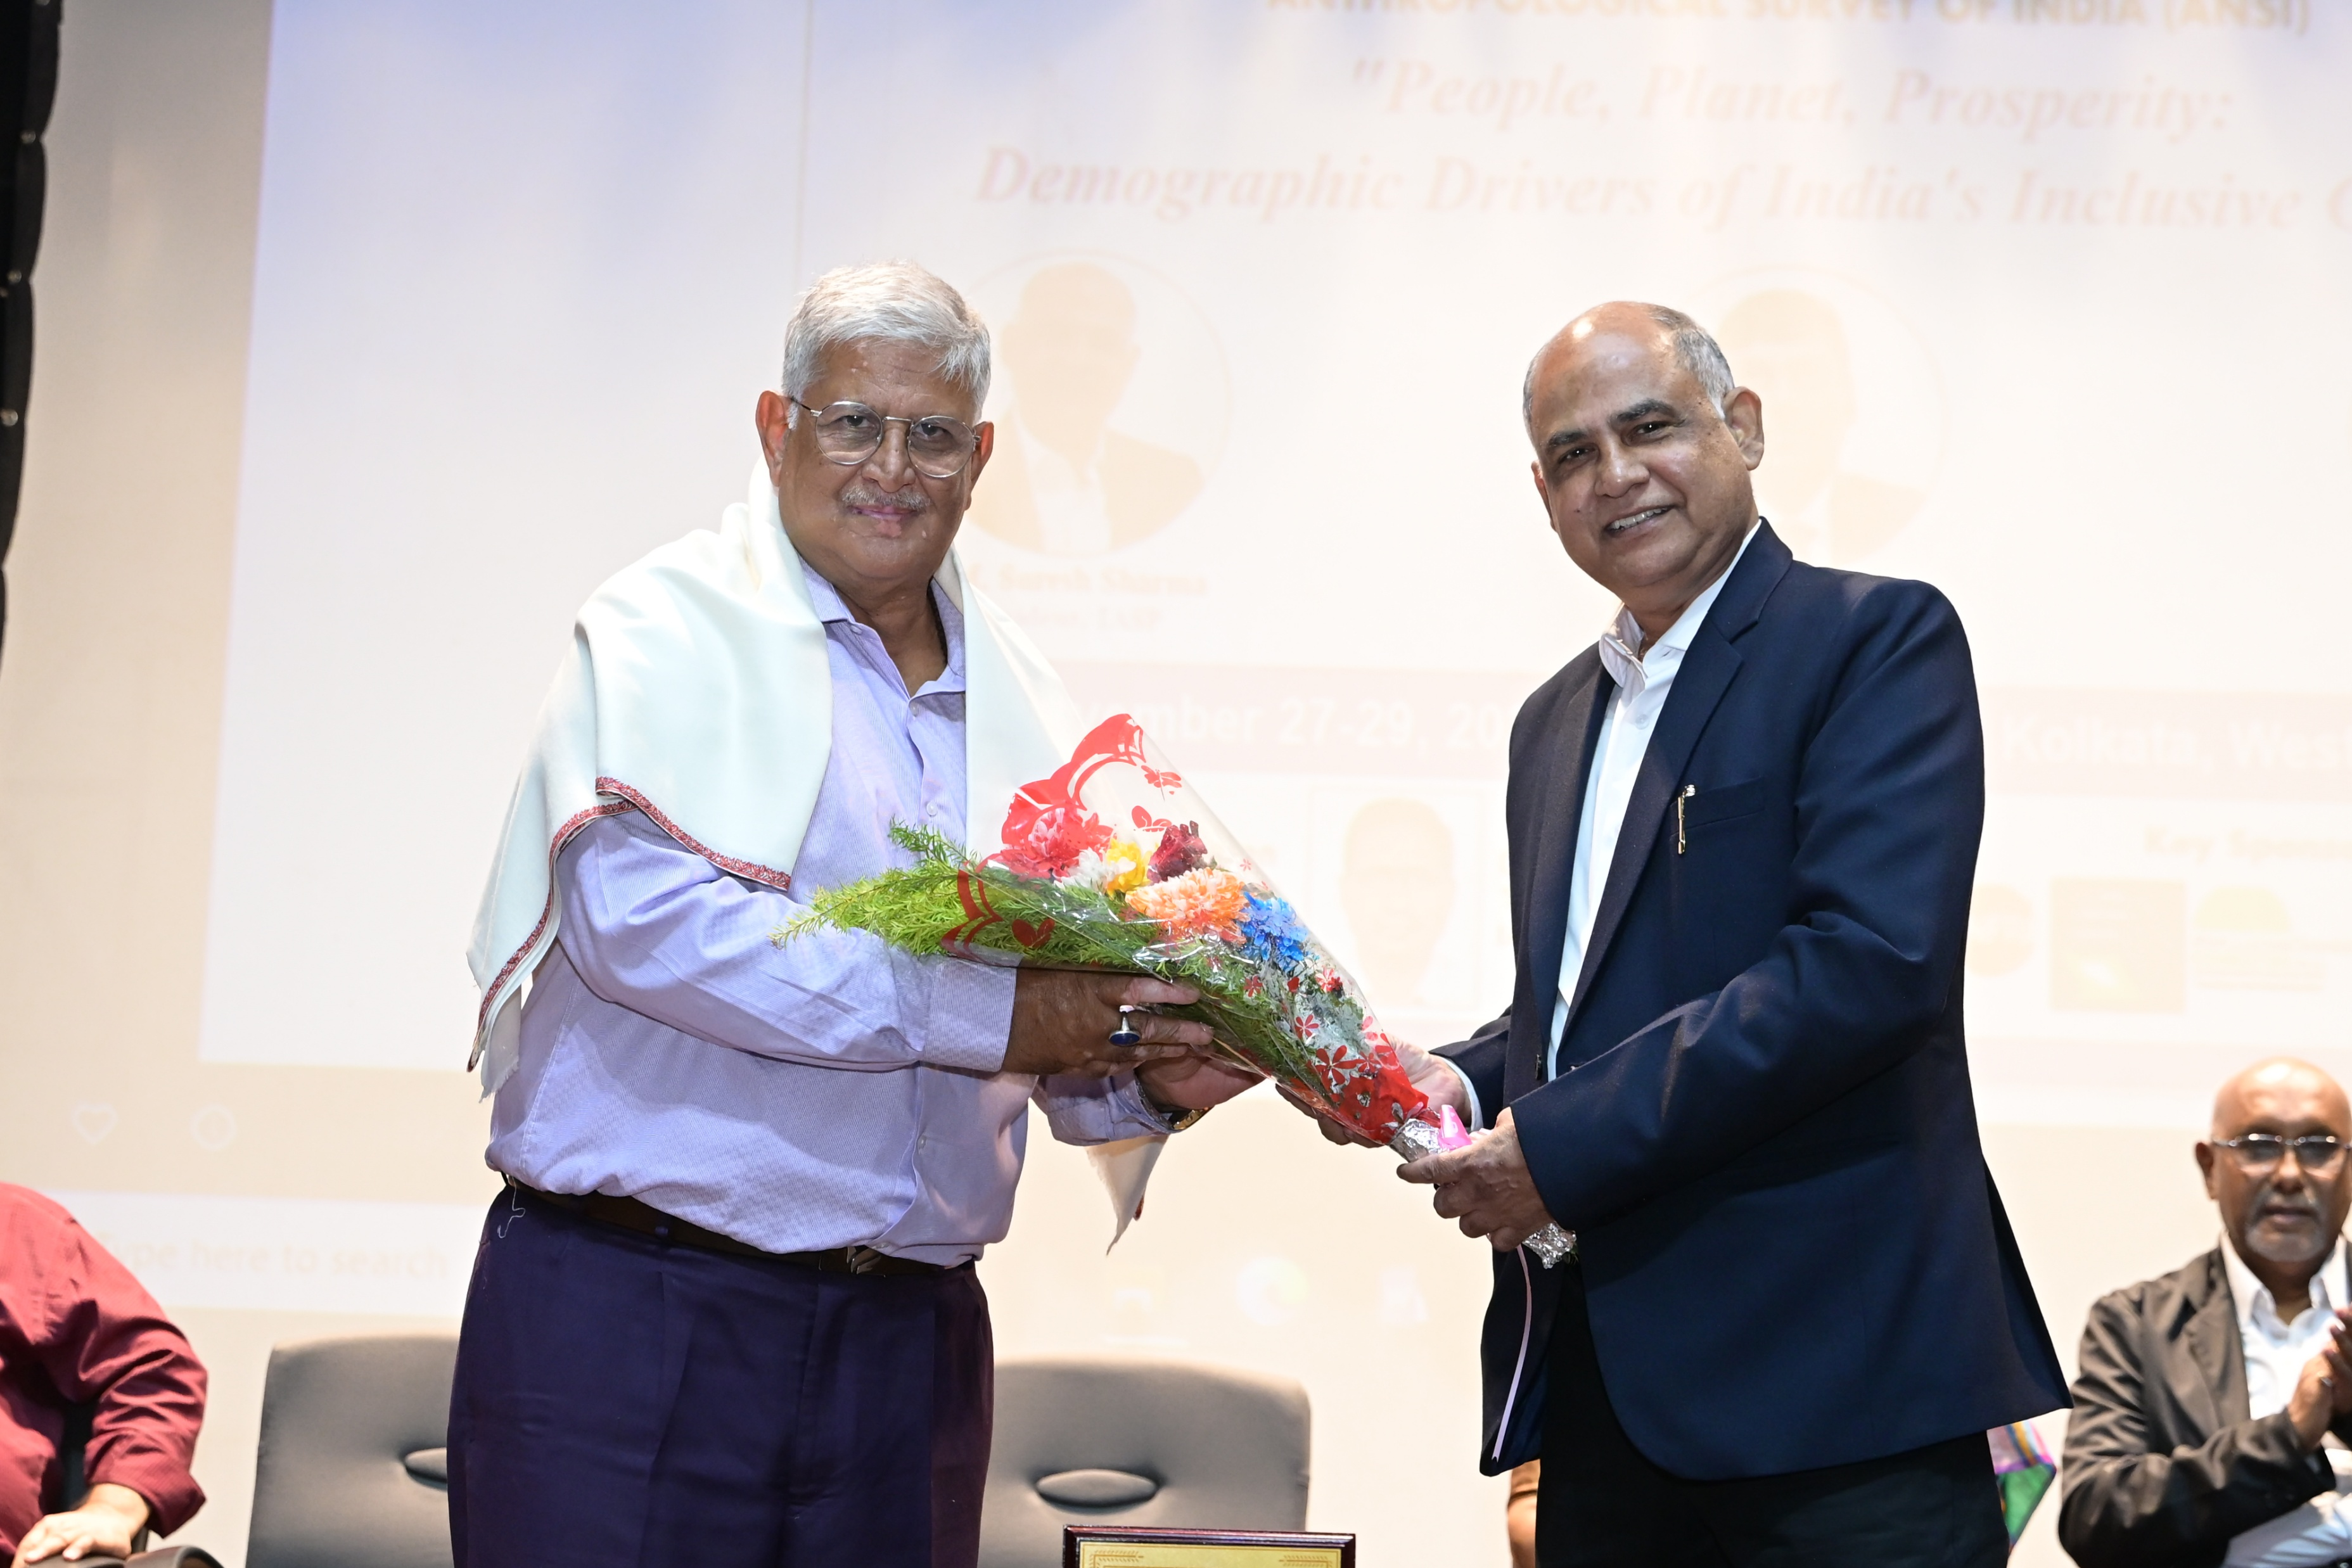
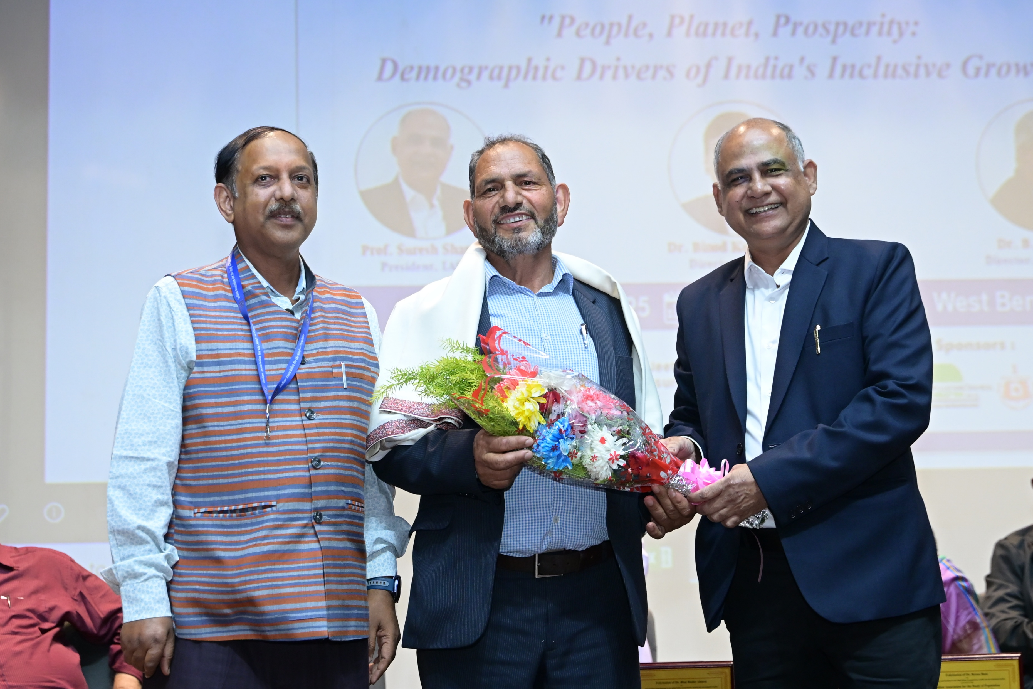
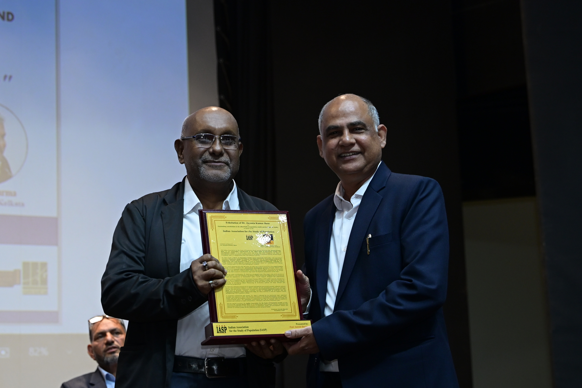
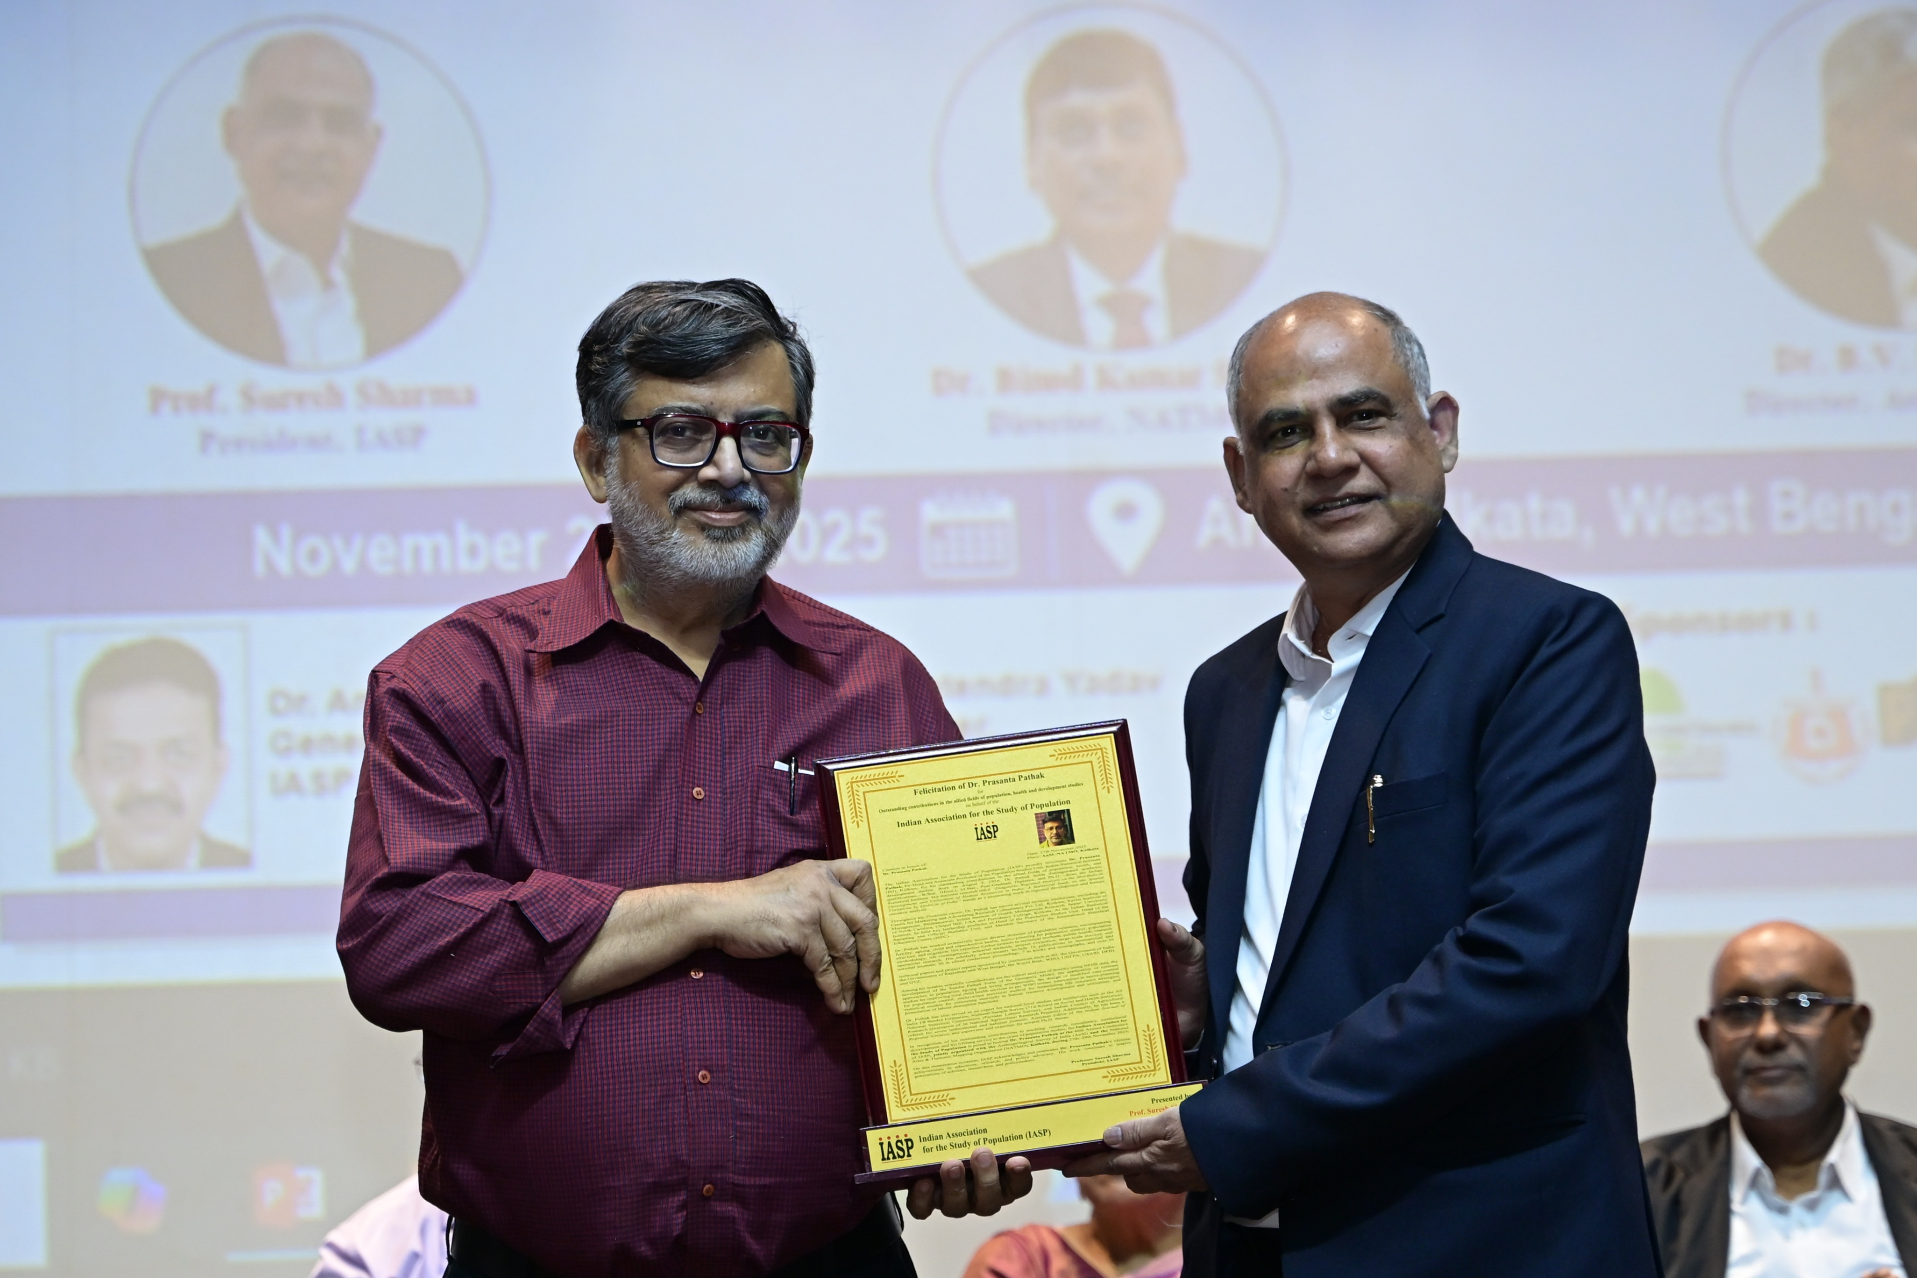
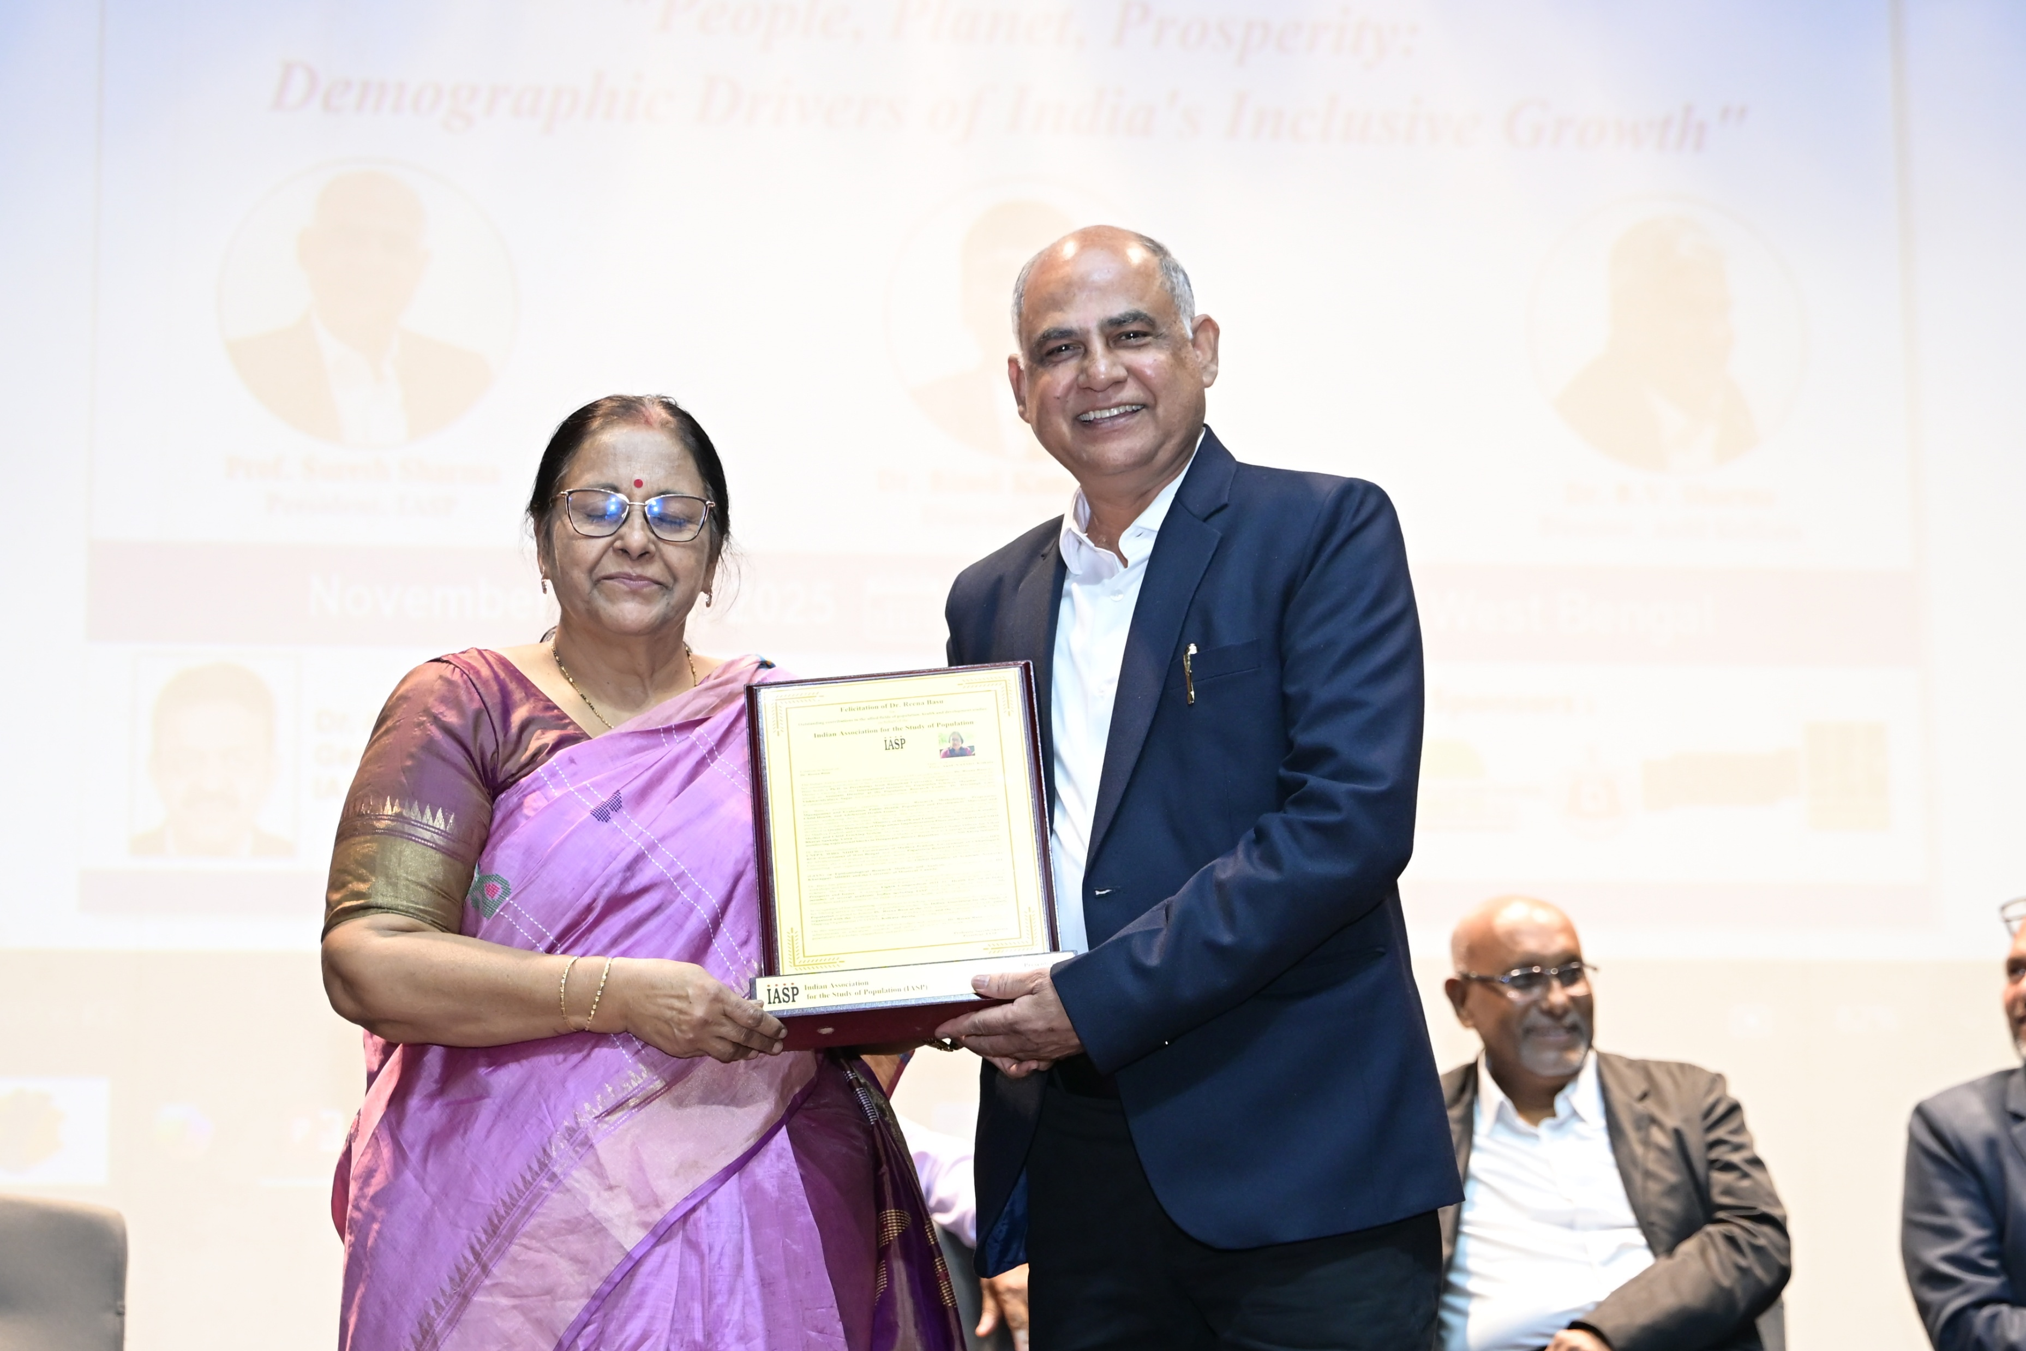
Felicitation of Senior Demographers

Slide 13
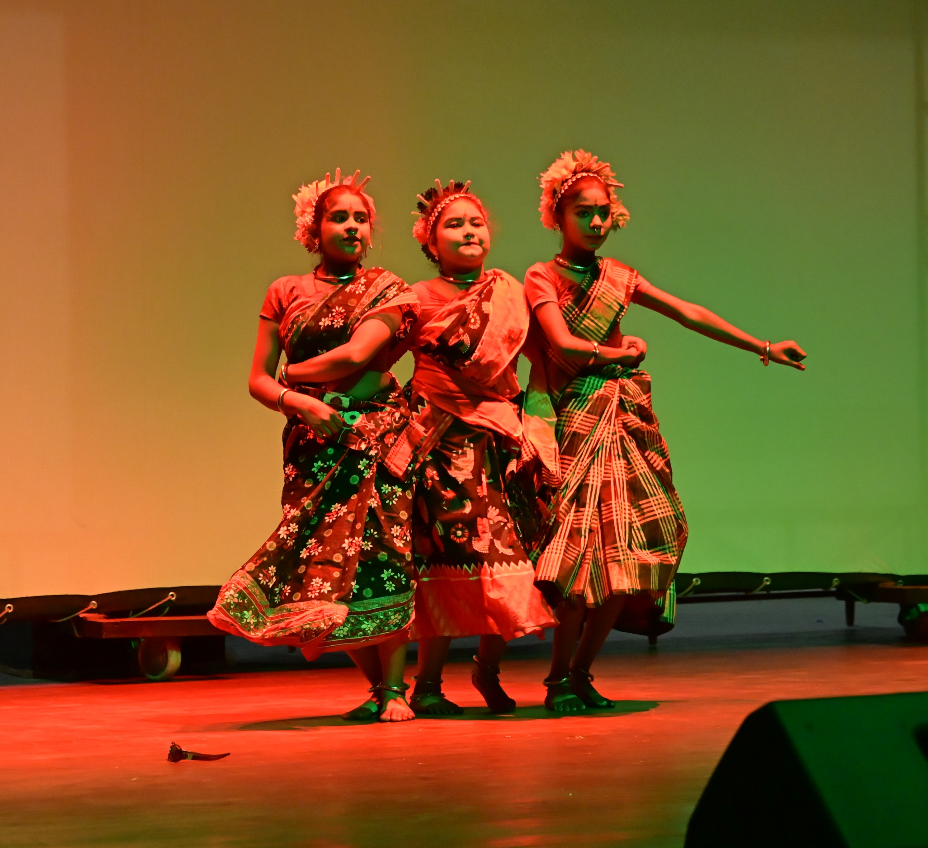
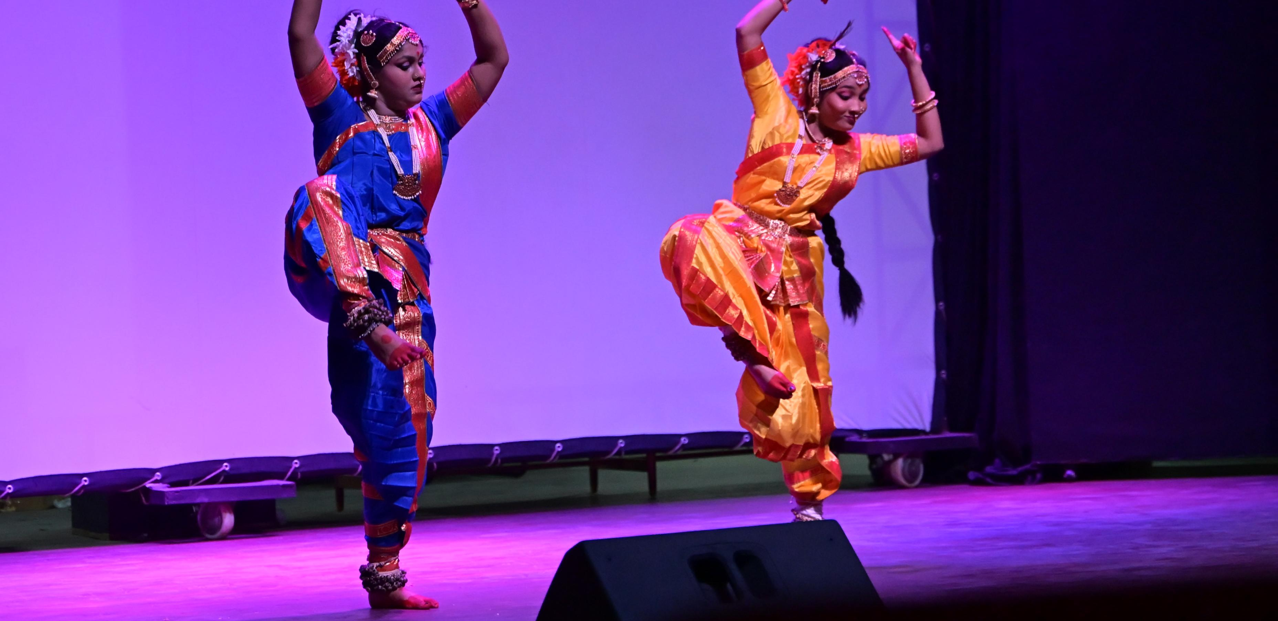
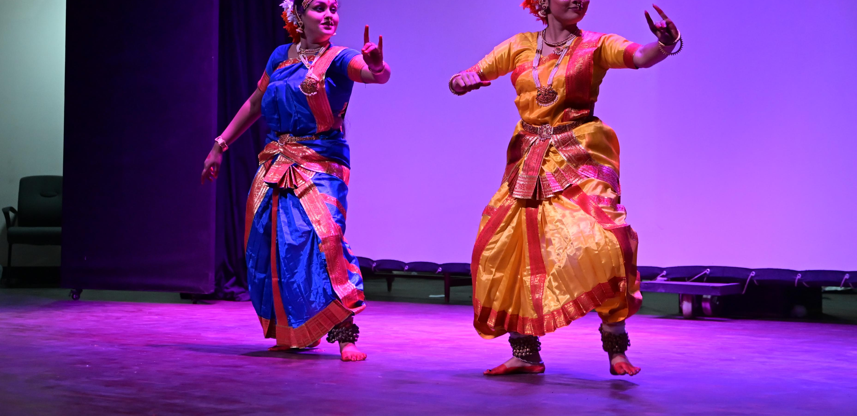
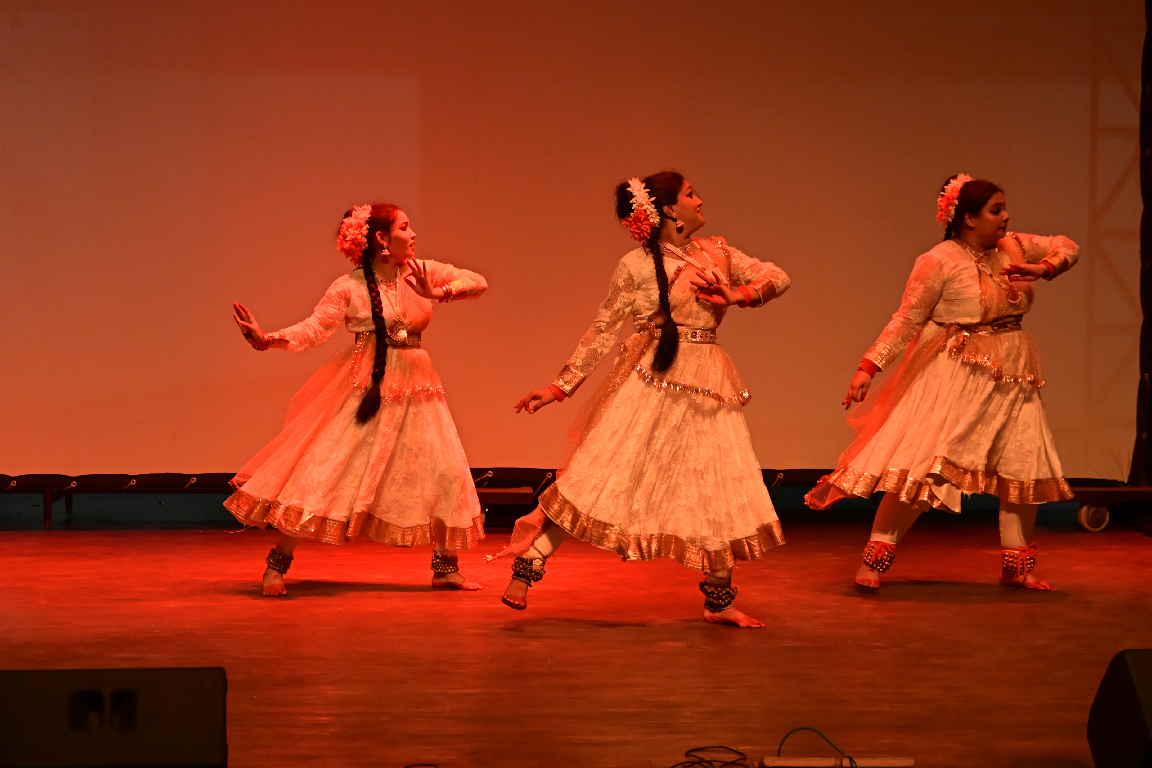
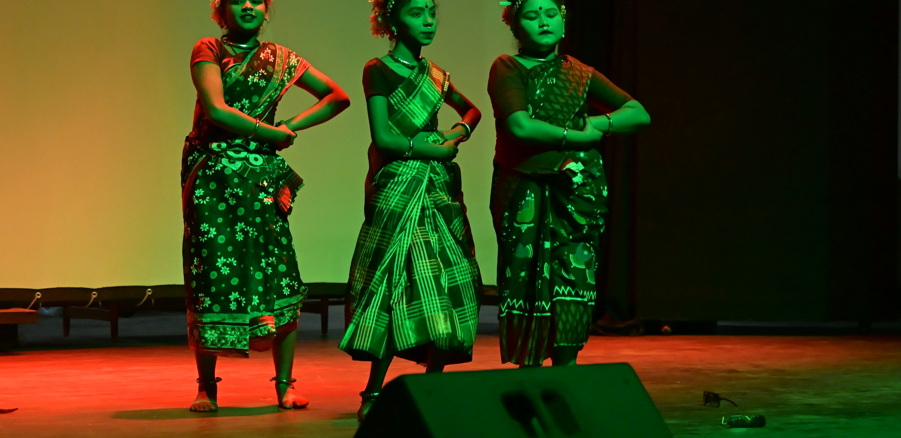
Cultural Program

Slide 14
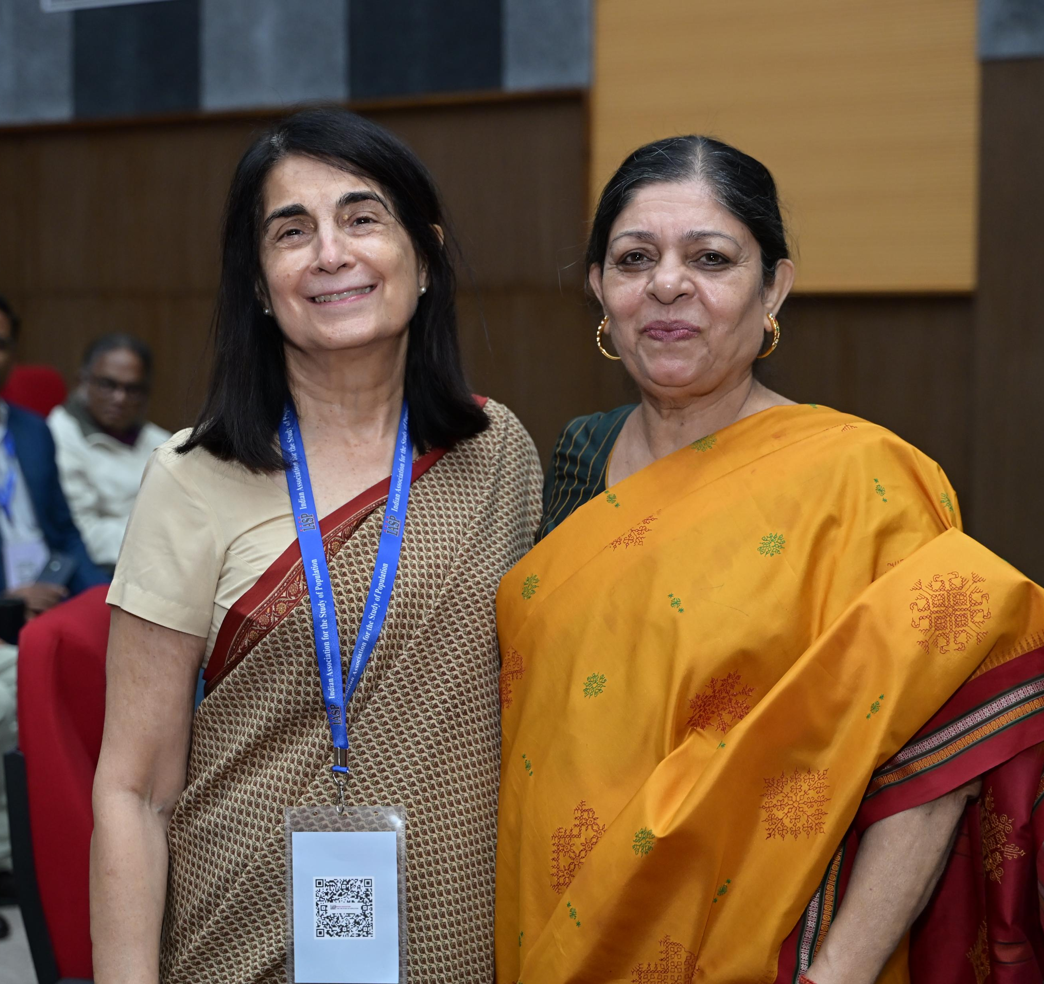
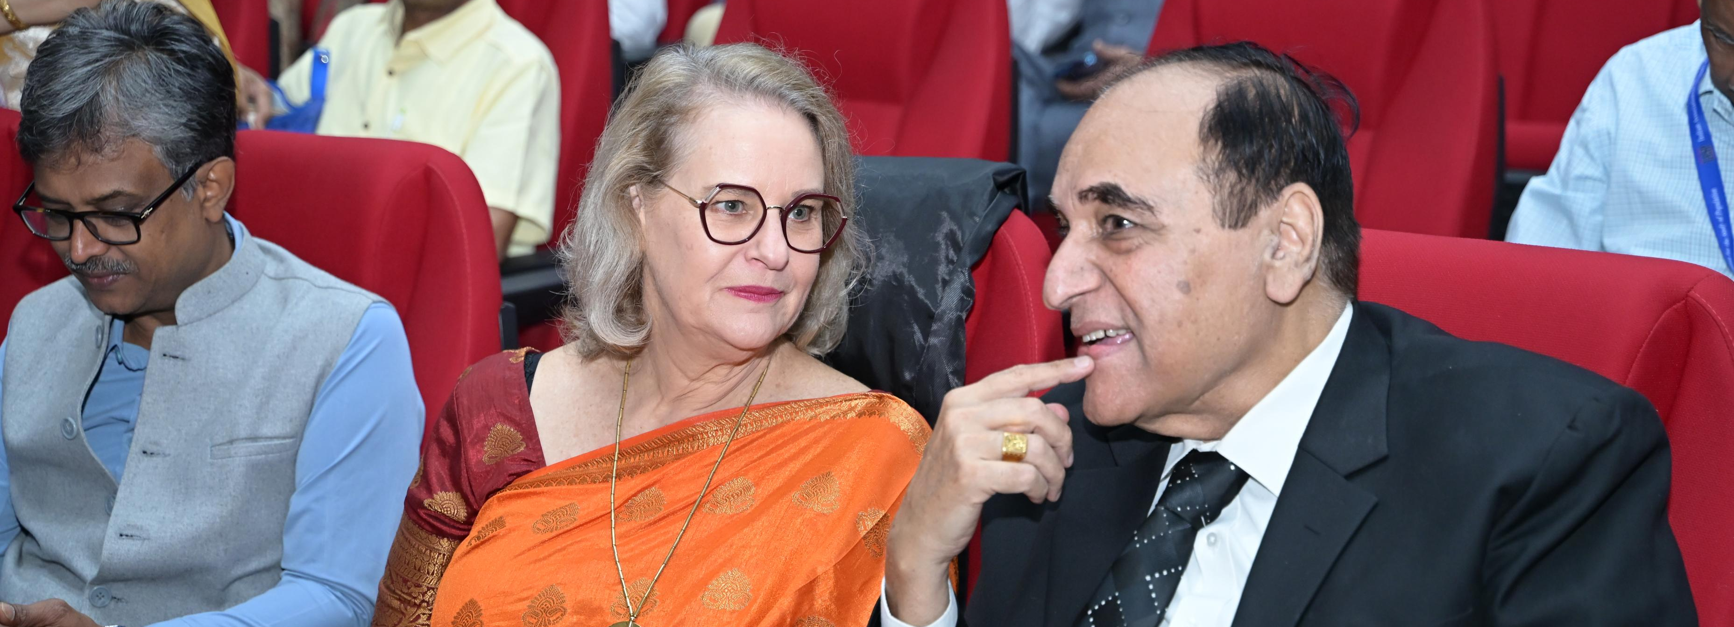
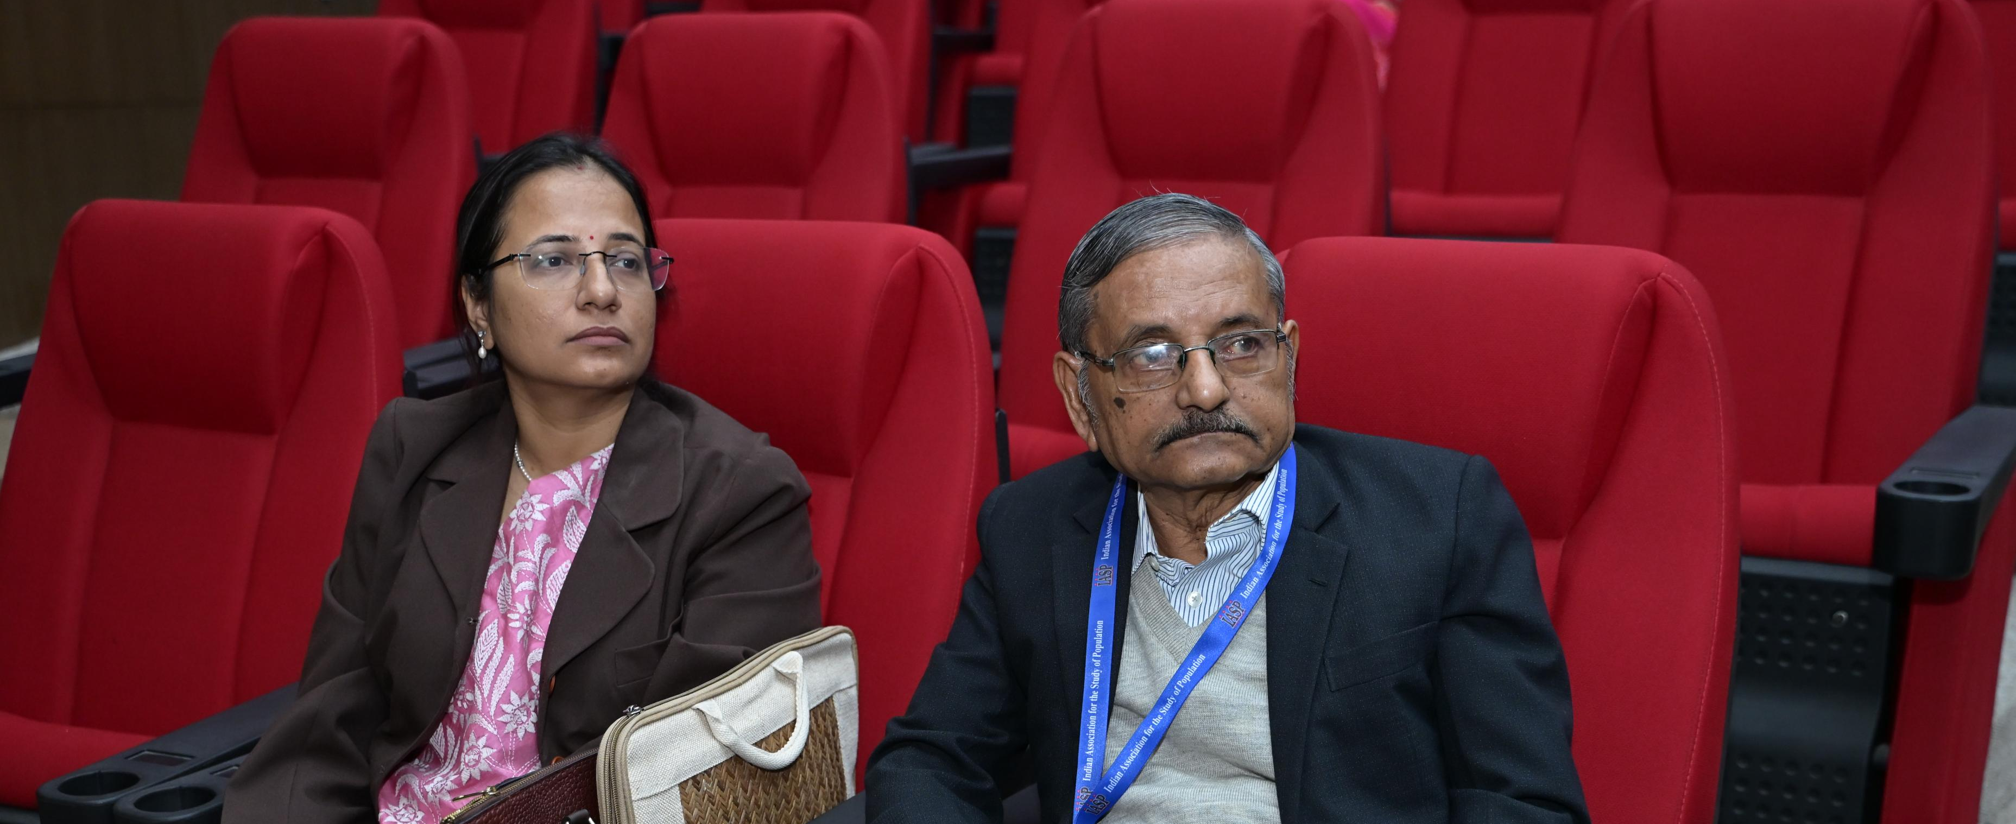
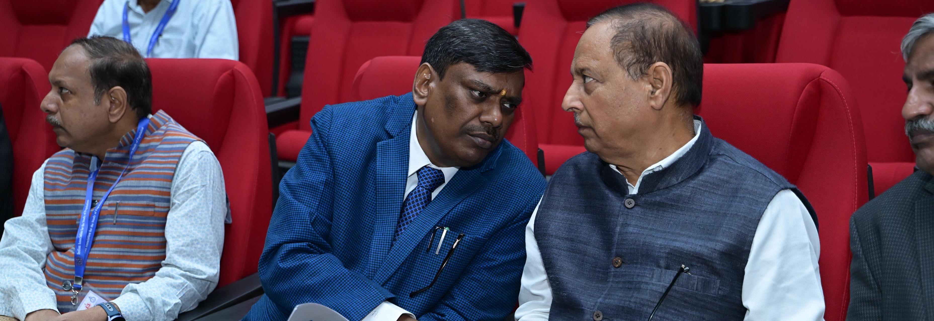
Day 2

Slide 15
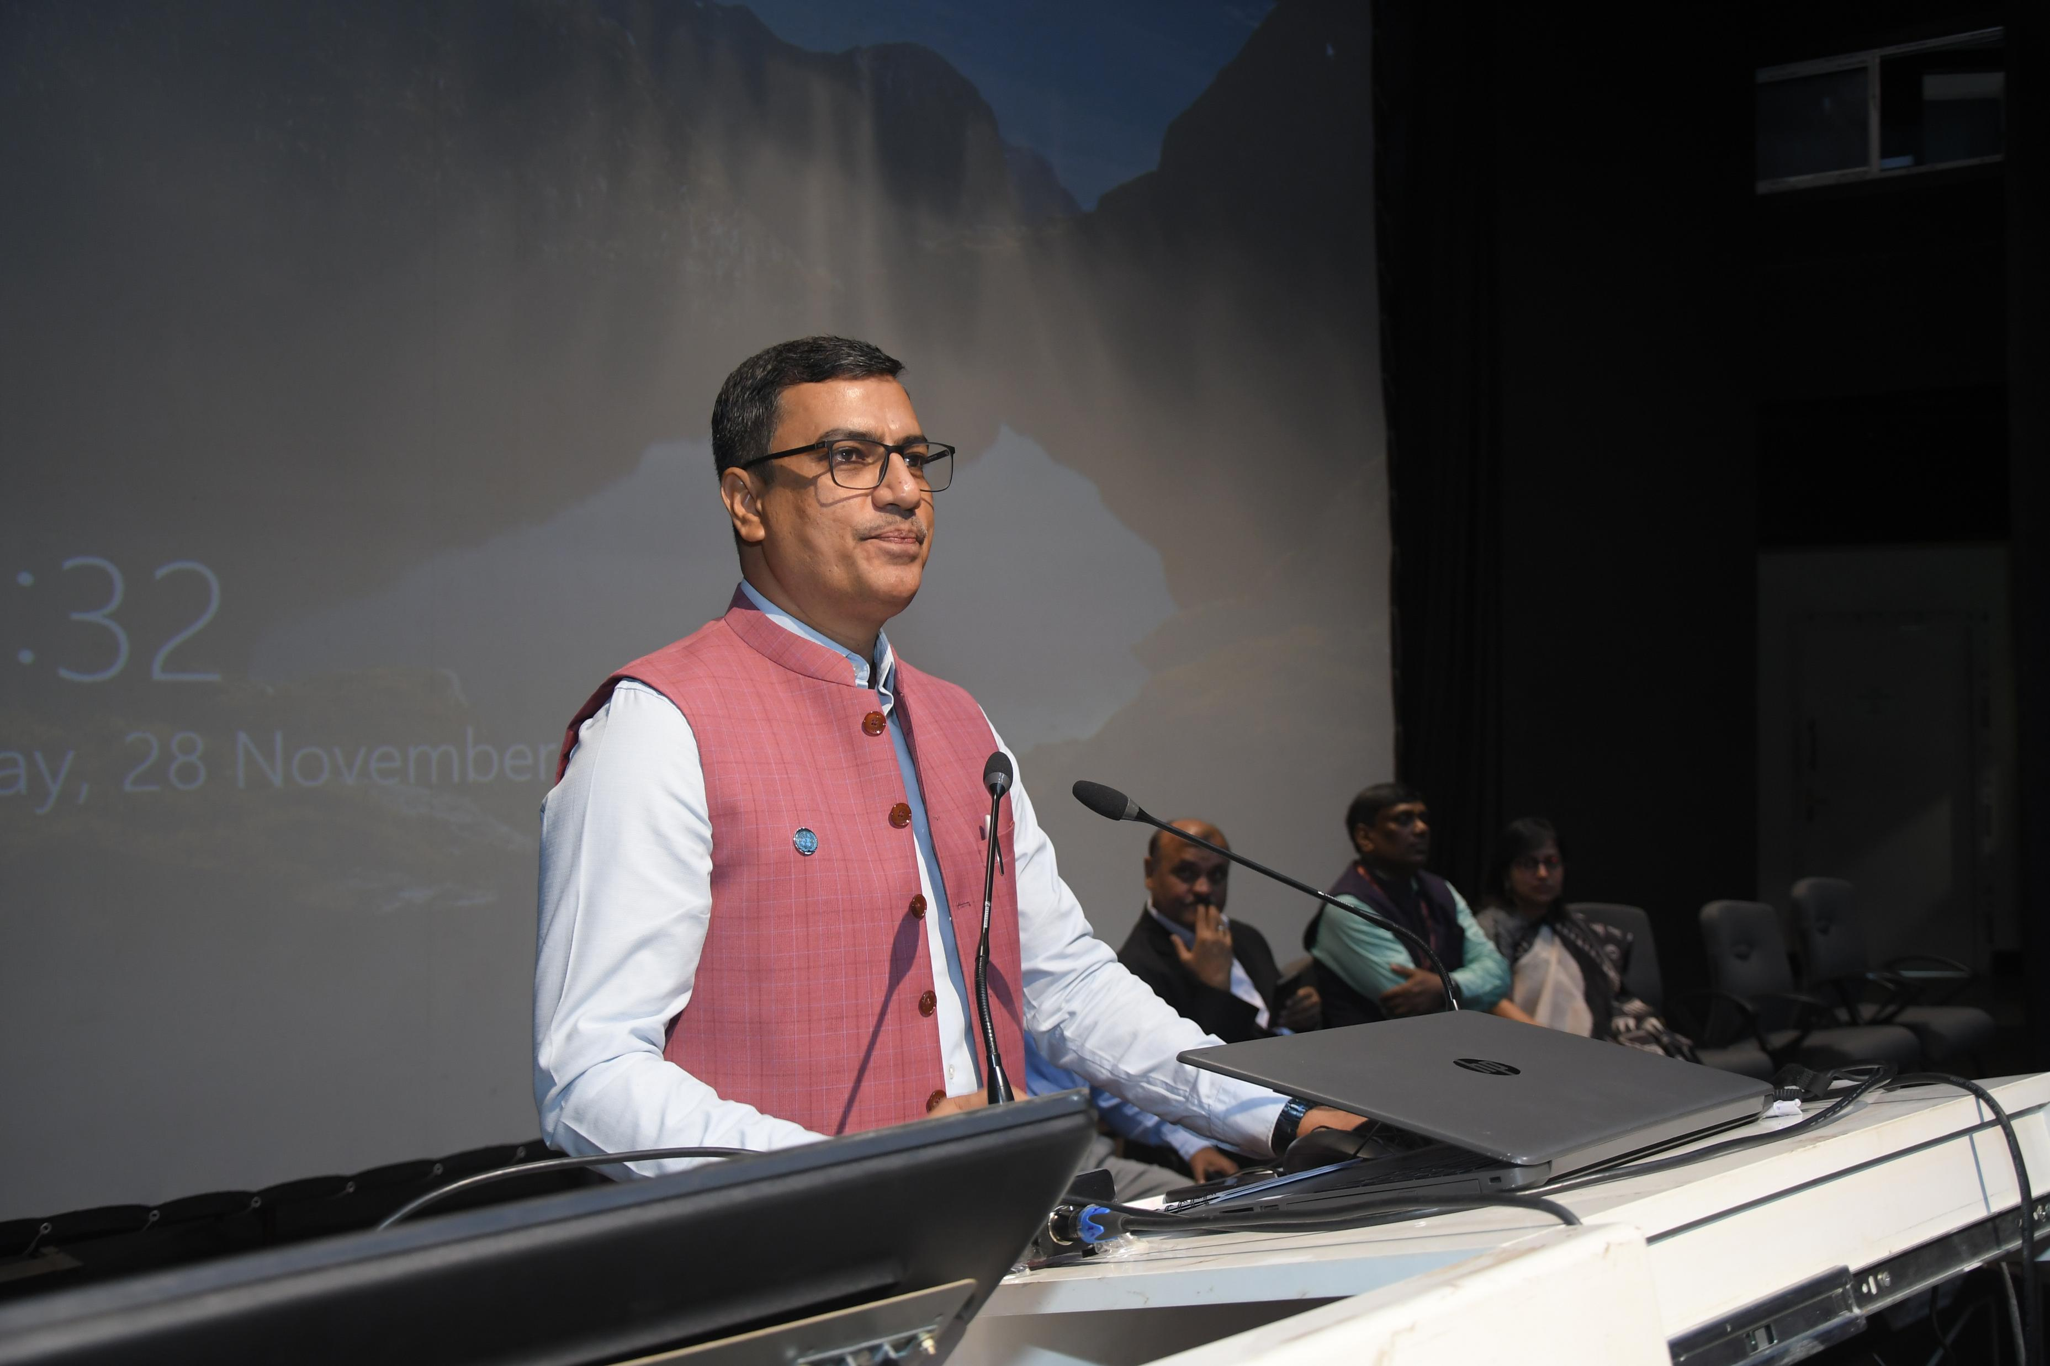
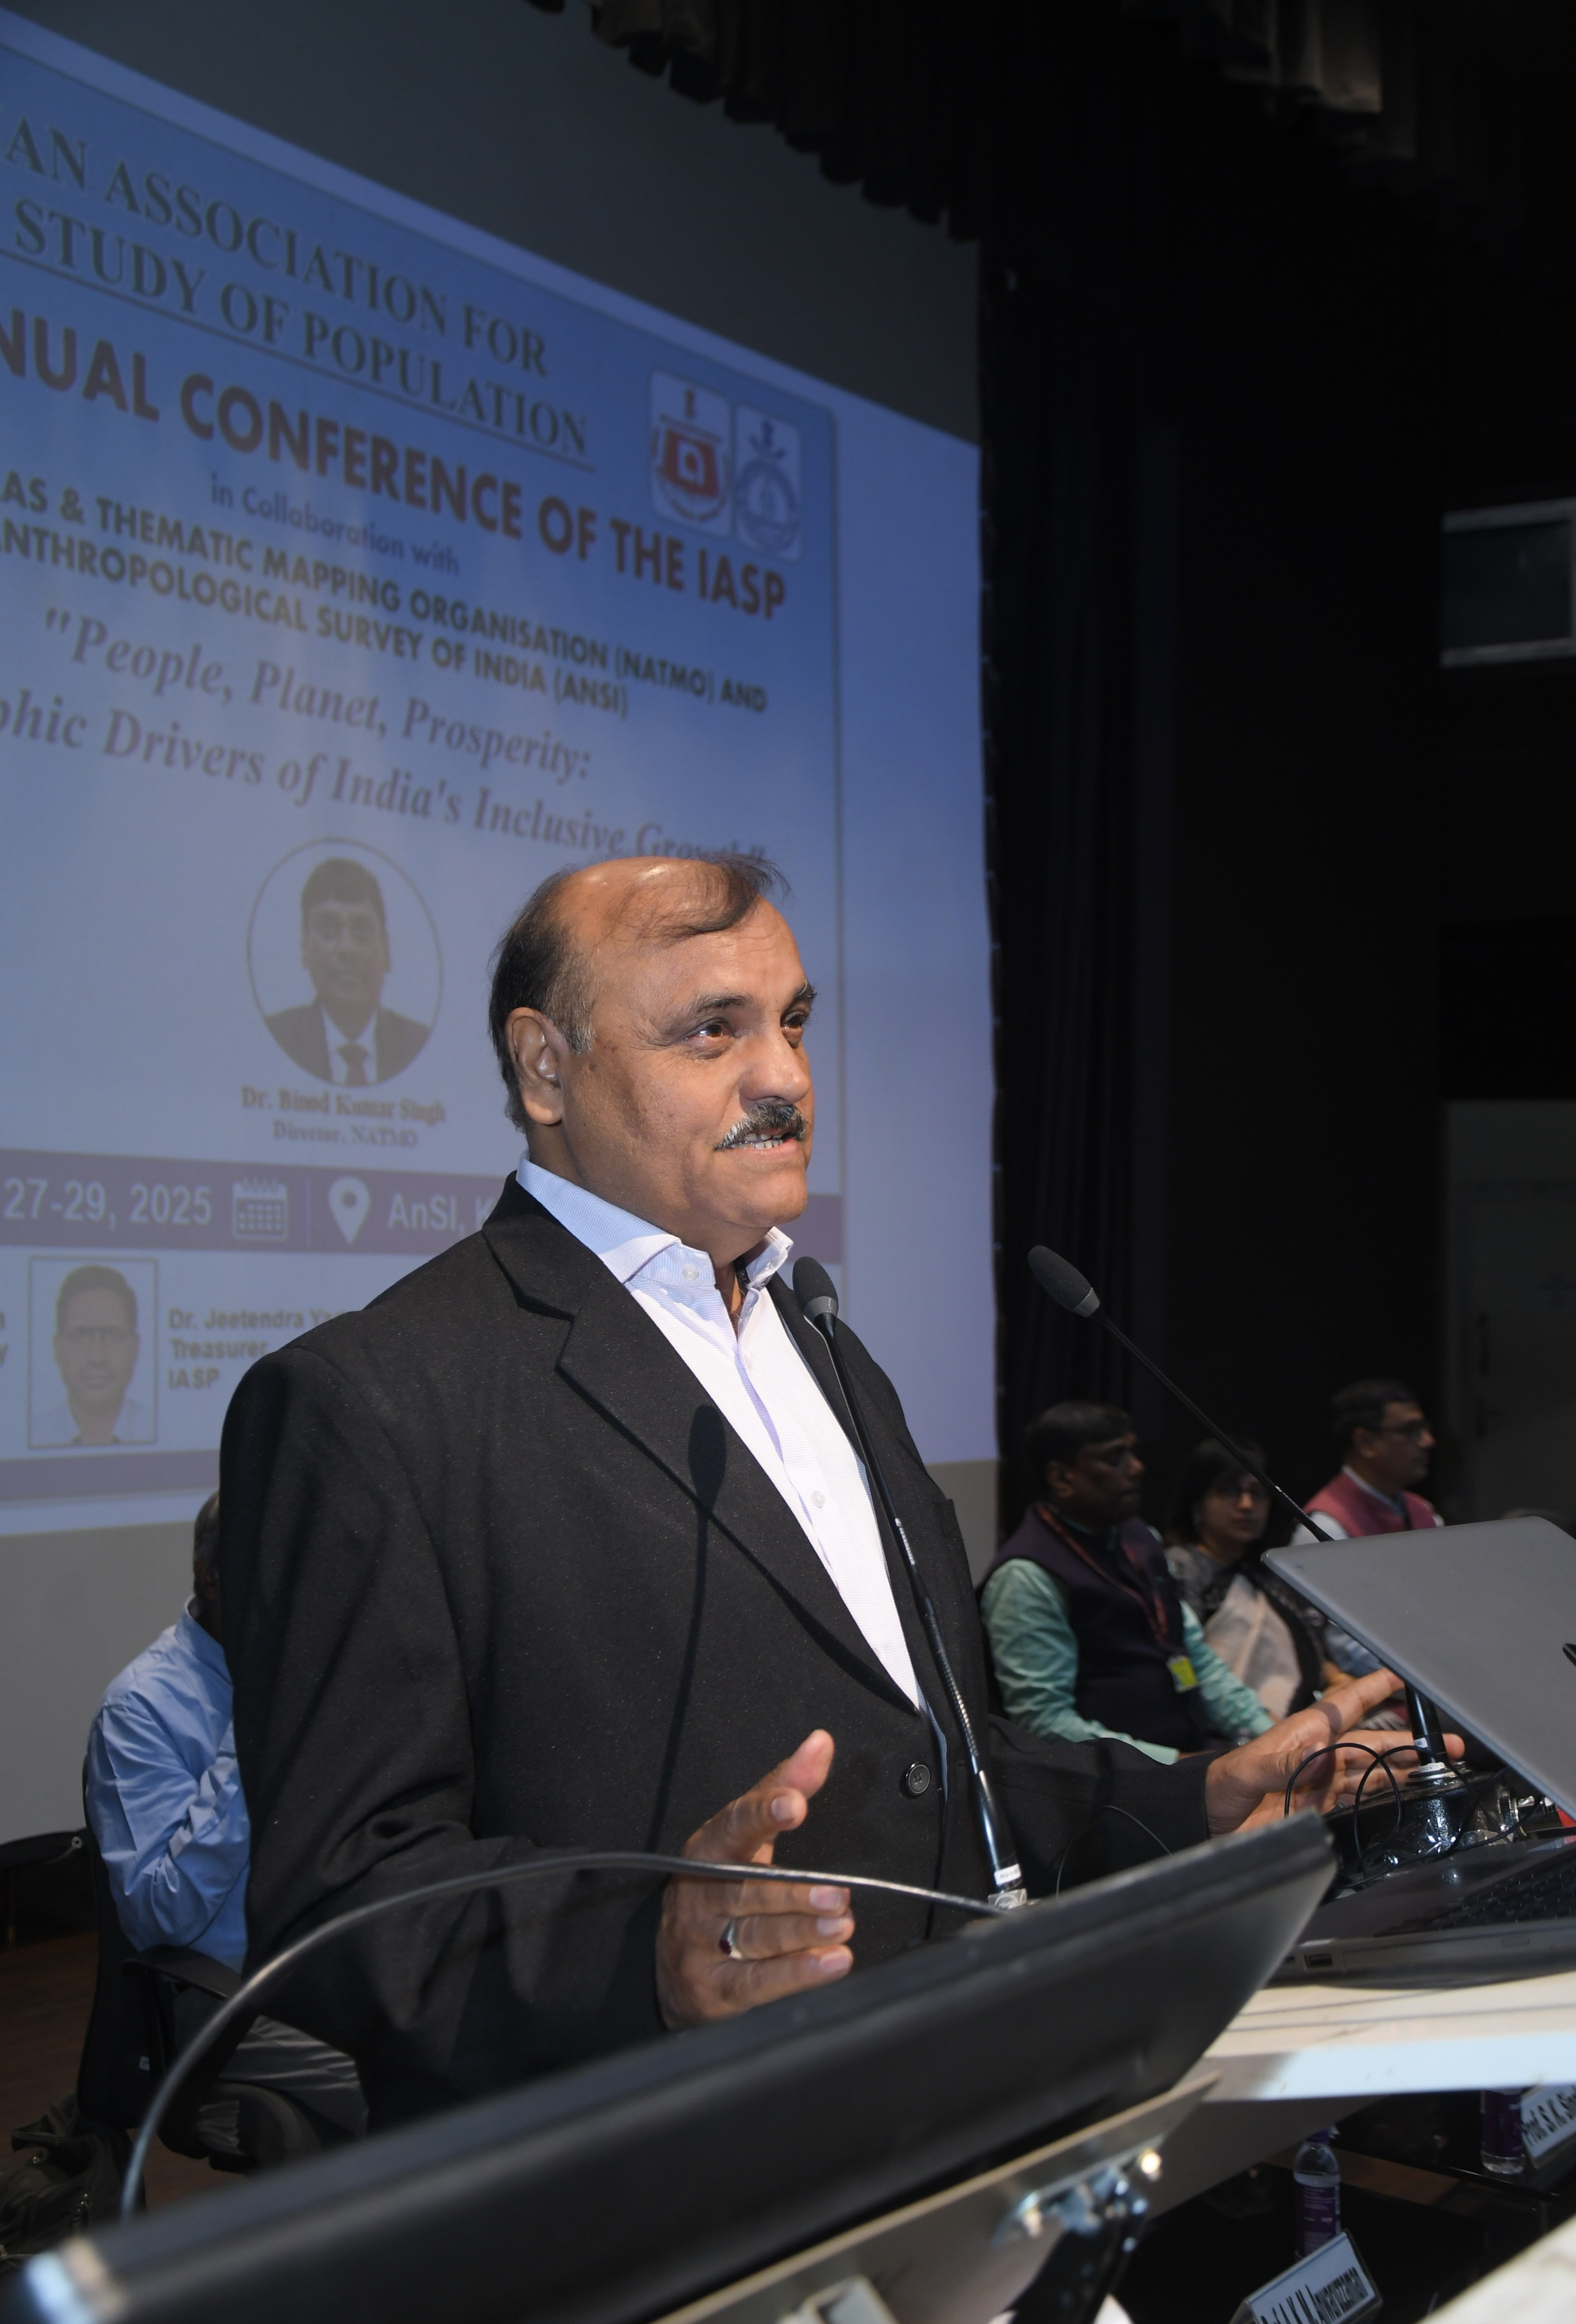
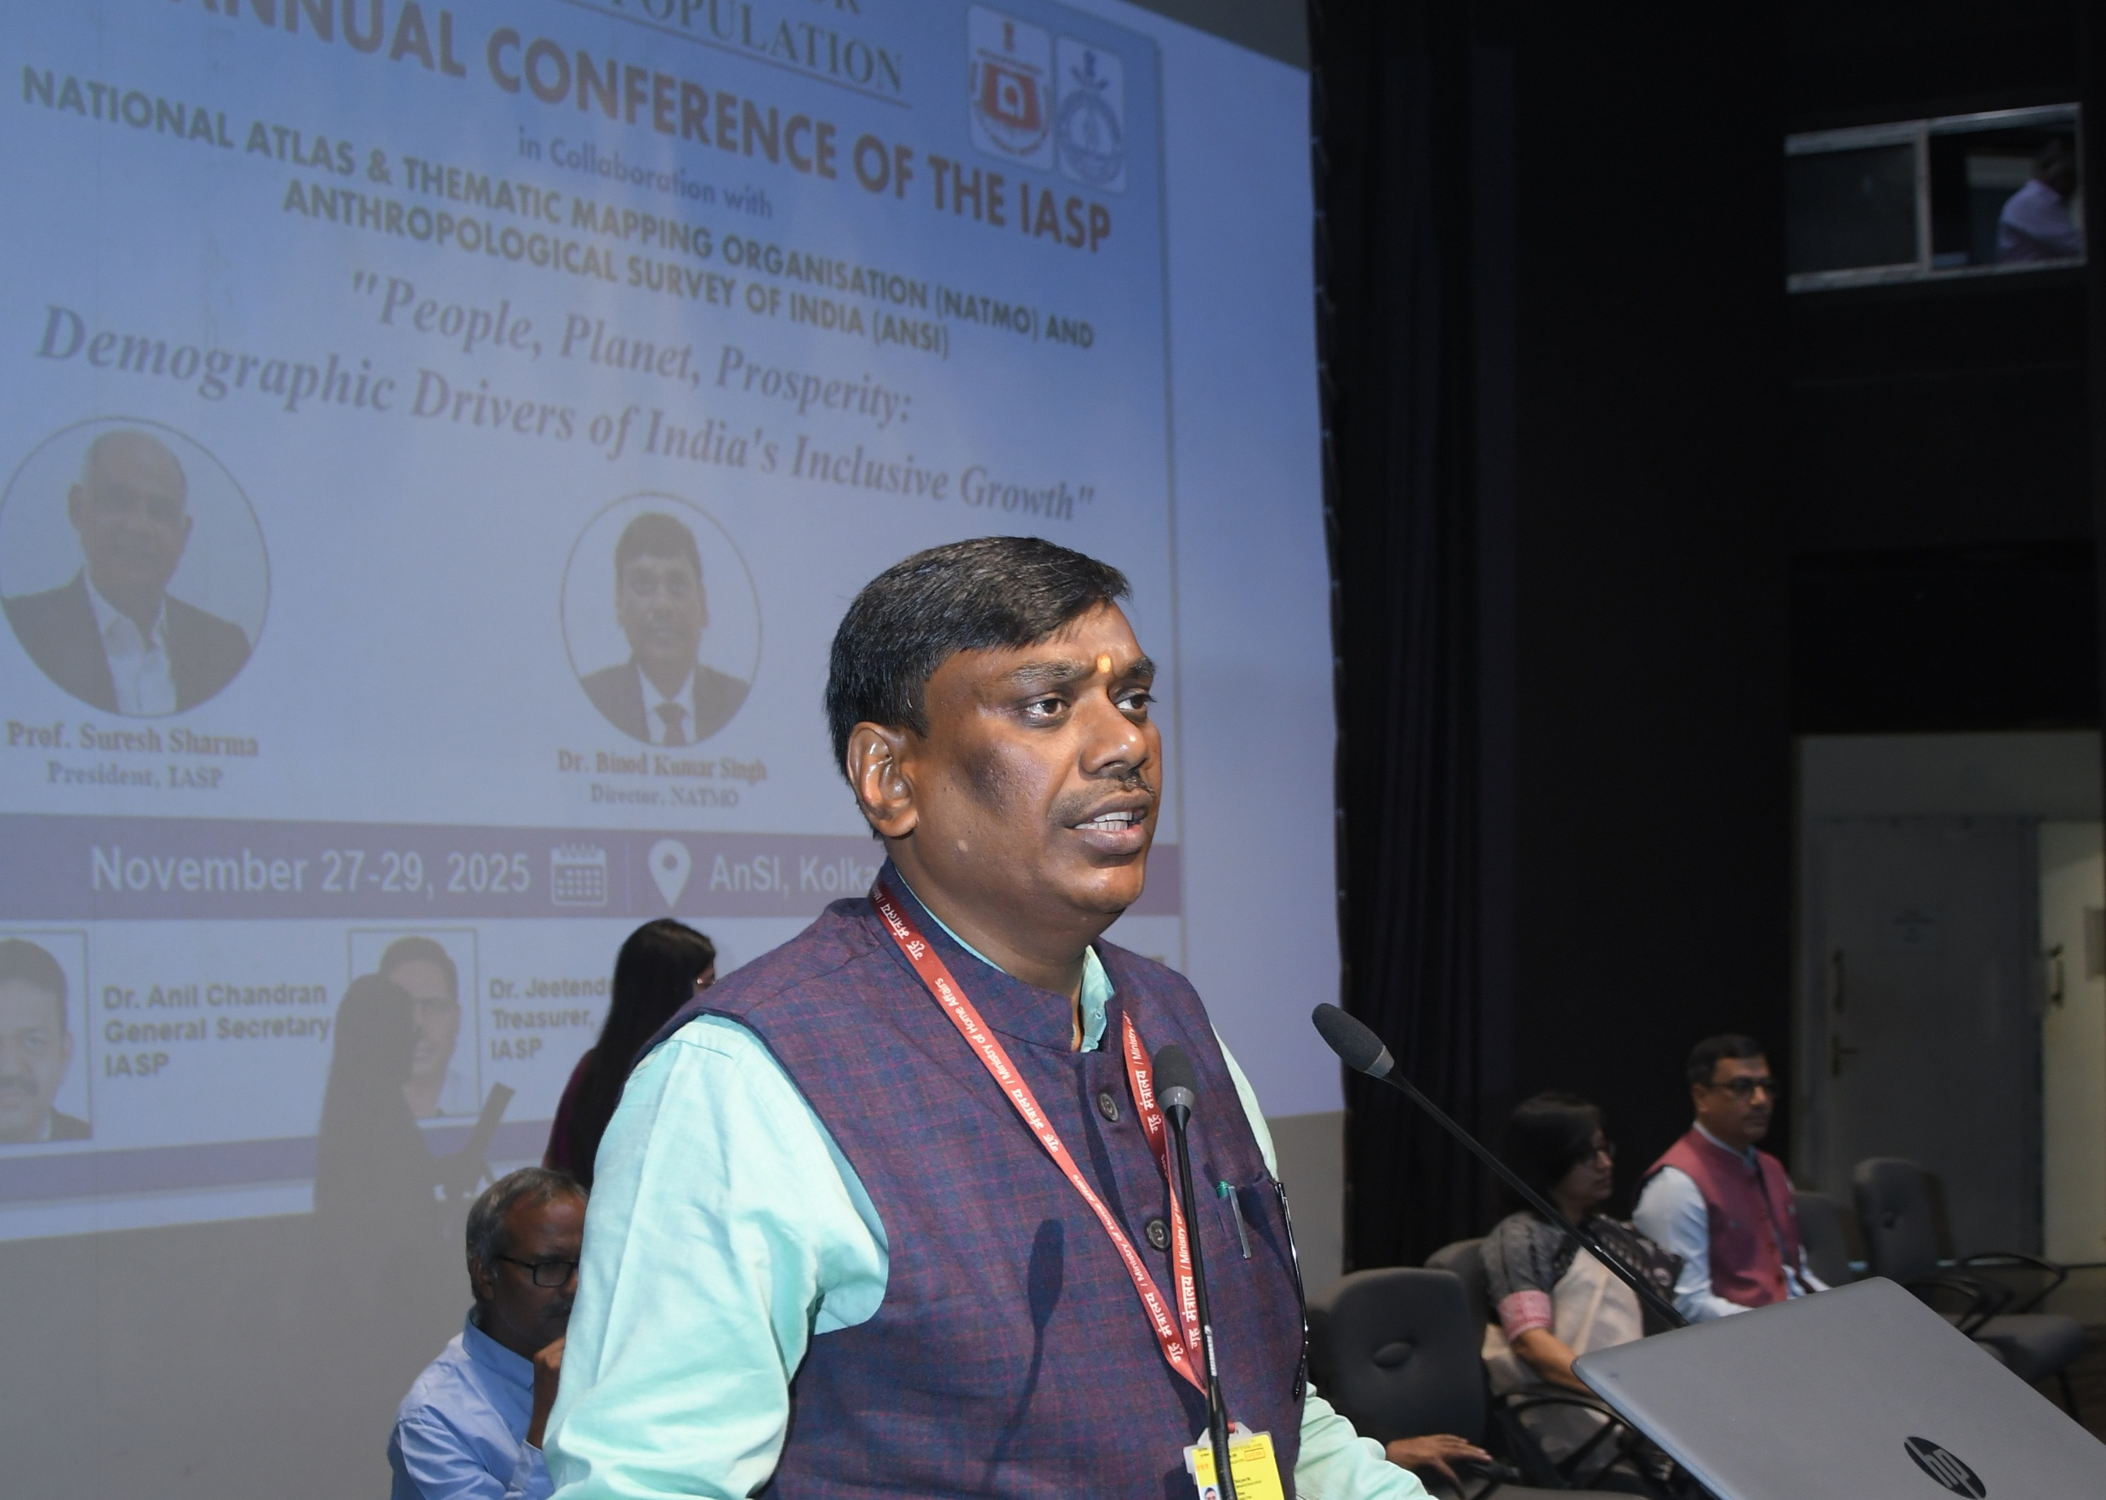
Day 2-PANEL DISCUSSION: Geo-Spatial Vulnerabilities of Persons with Disabilities
Chair: Prof. S.K. Singh Speakers: SC Rai, A.K.M. Anwaruzzaman, Upali Roy Mukherjee, Prabhat Kumar, R.M. Singh
Key Points:
District-level disability vulnerability mapping
Barriers to service access
Need for inclusive planning

Slide 16
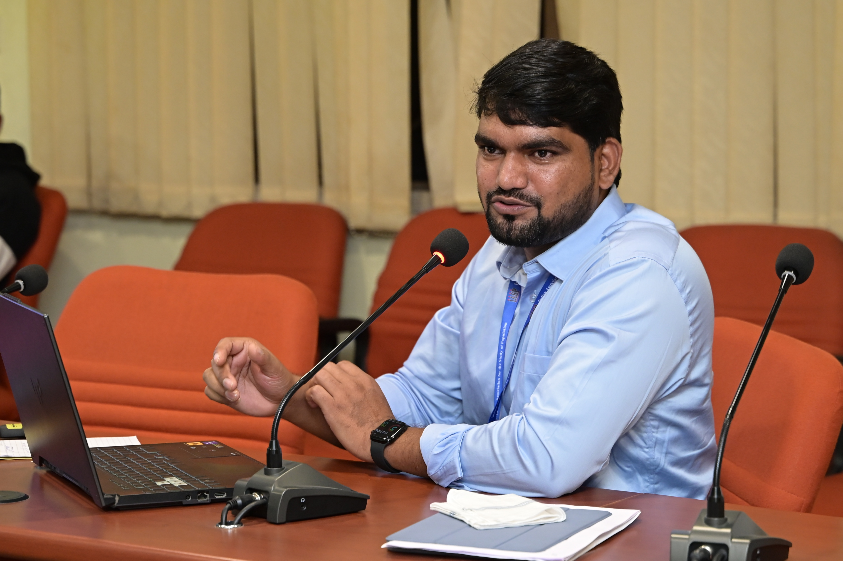
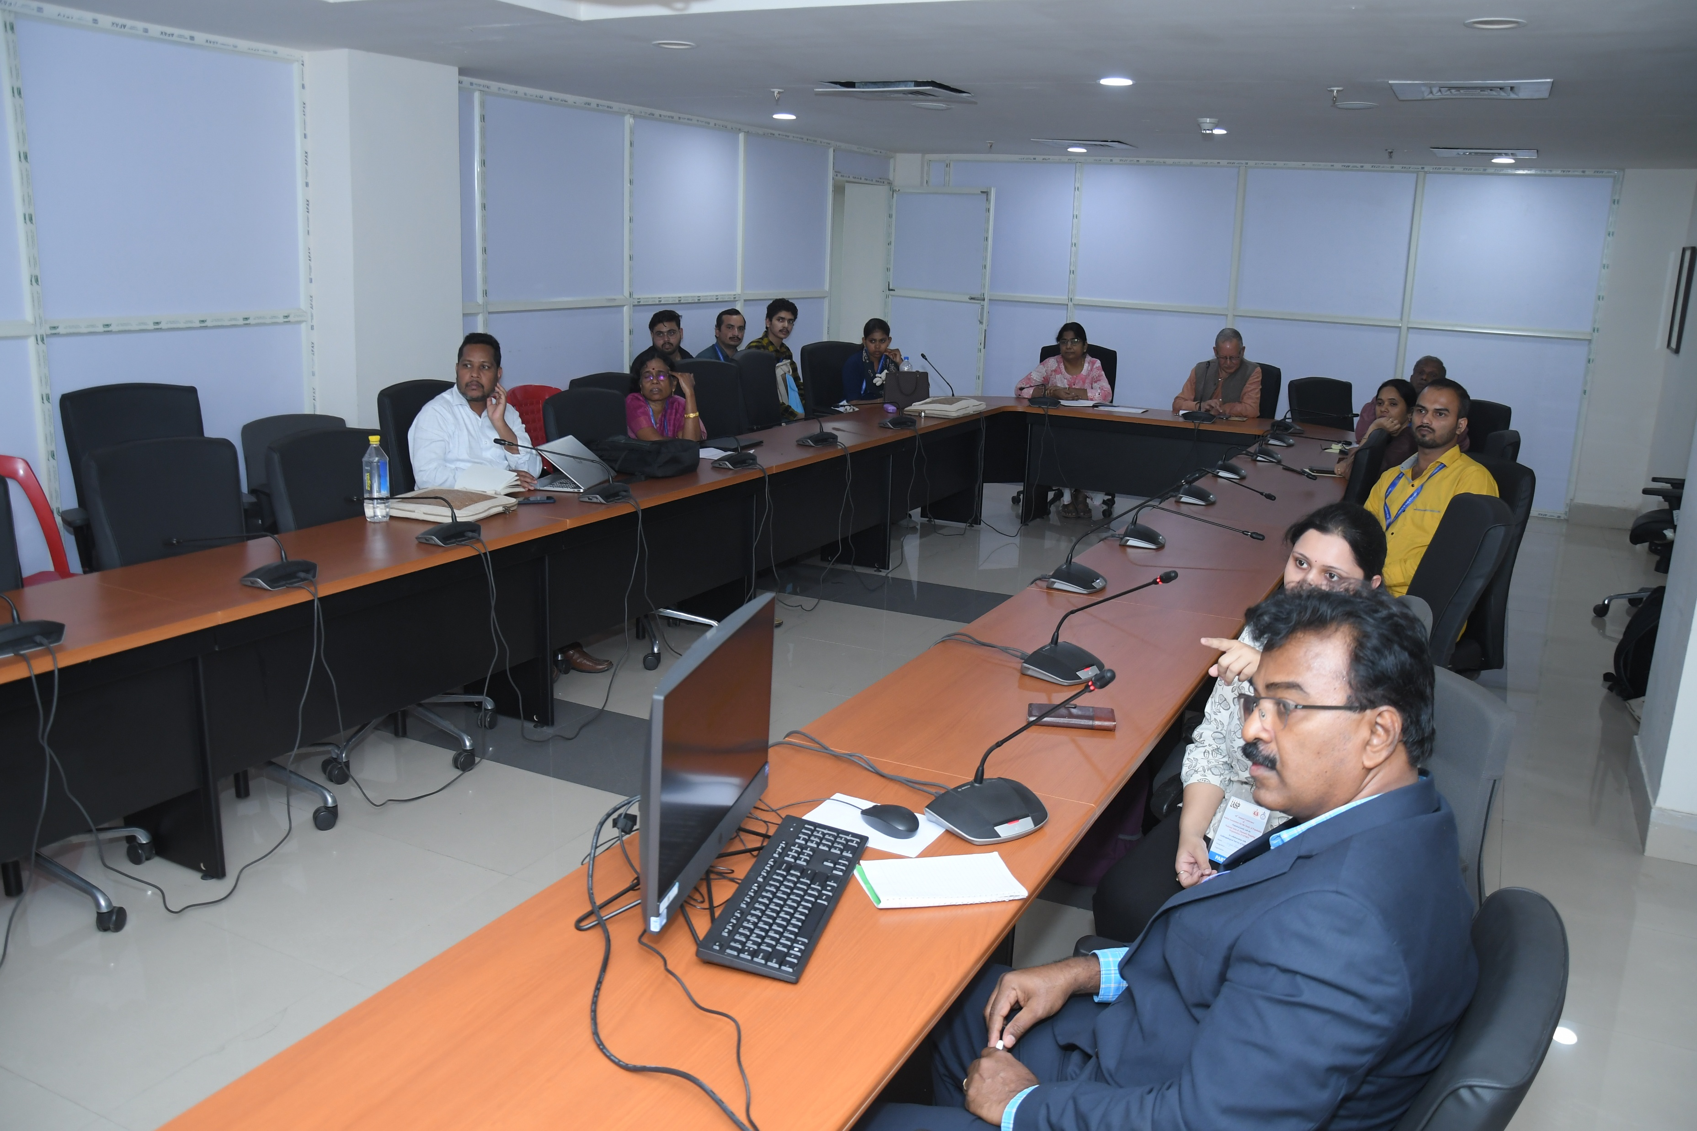
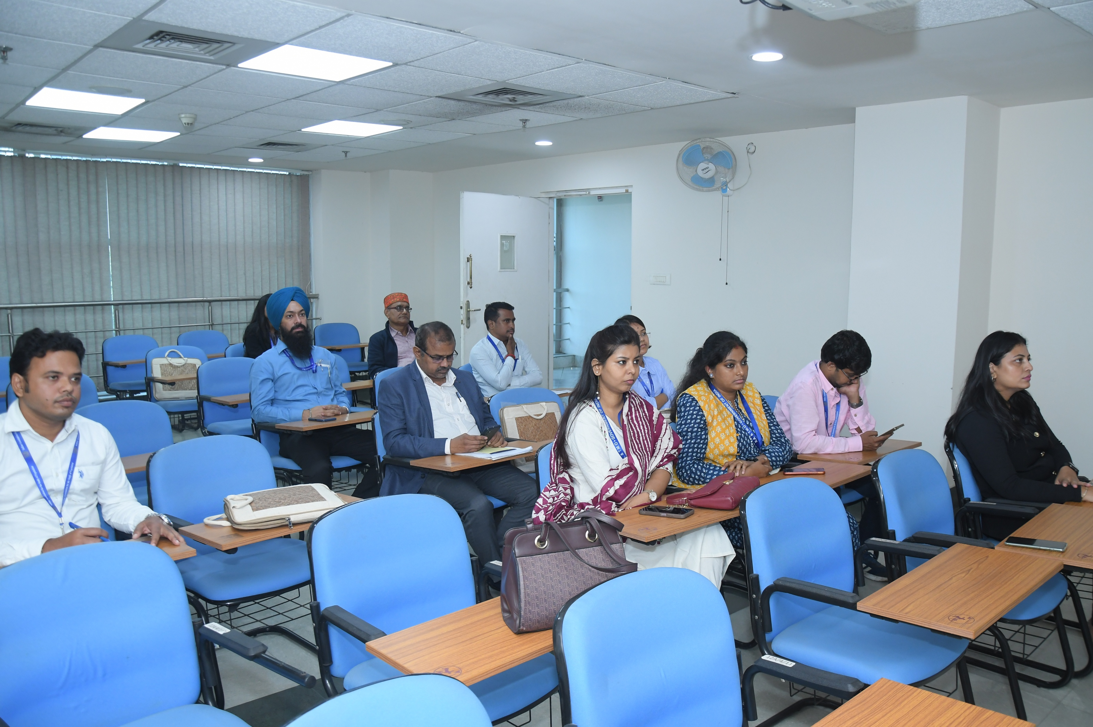
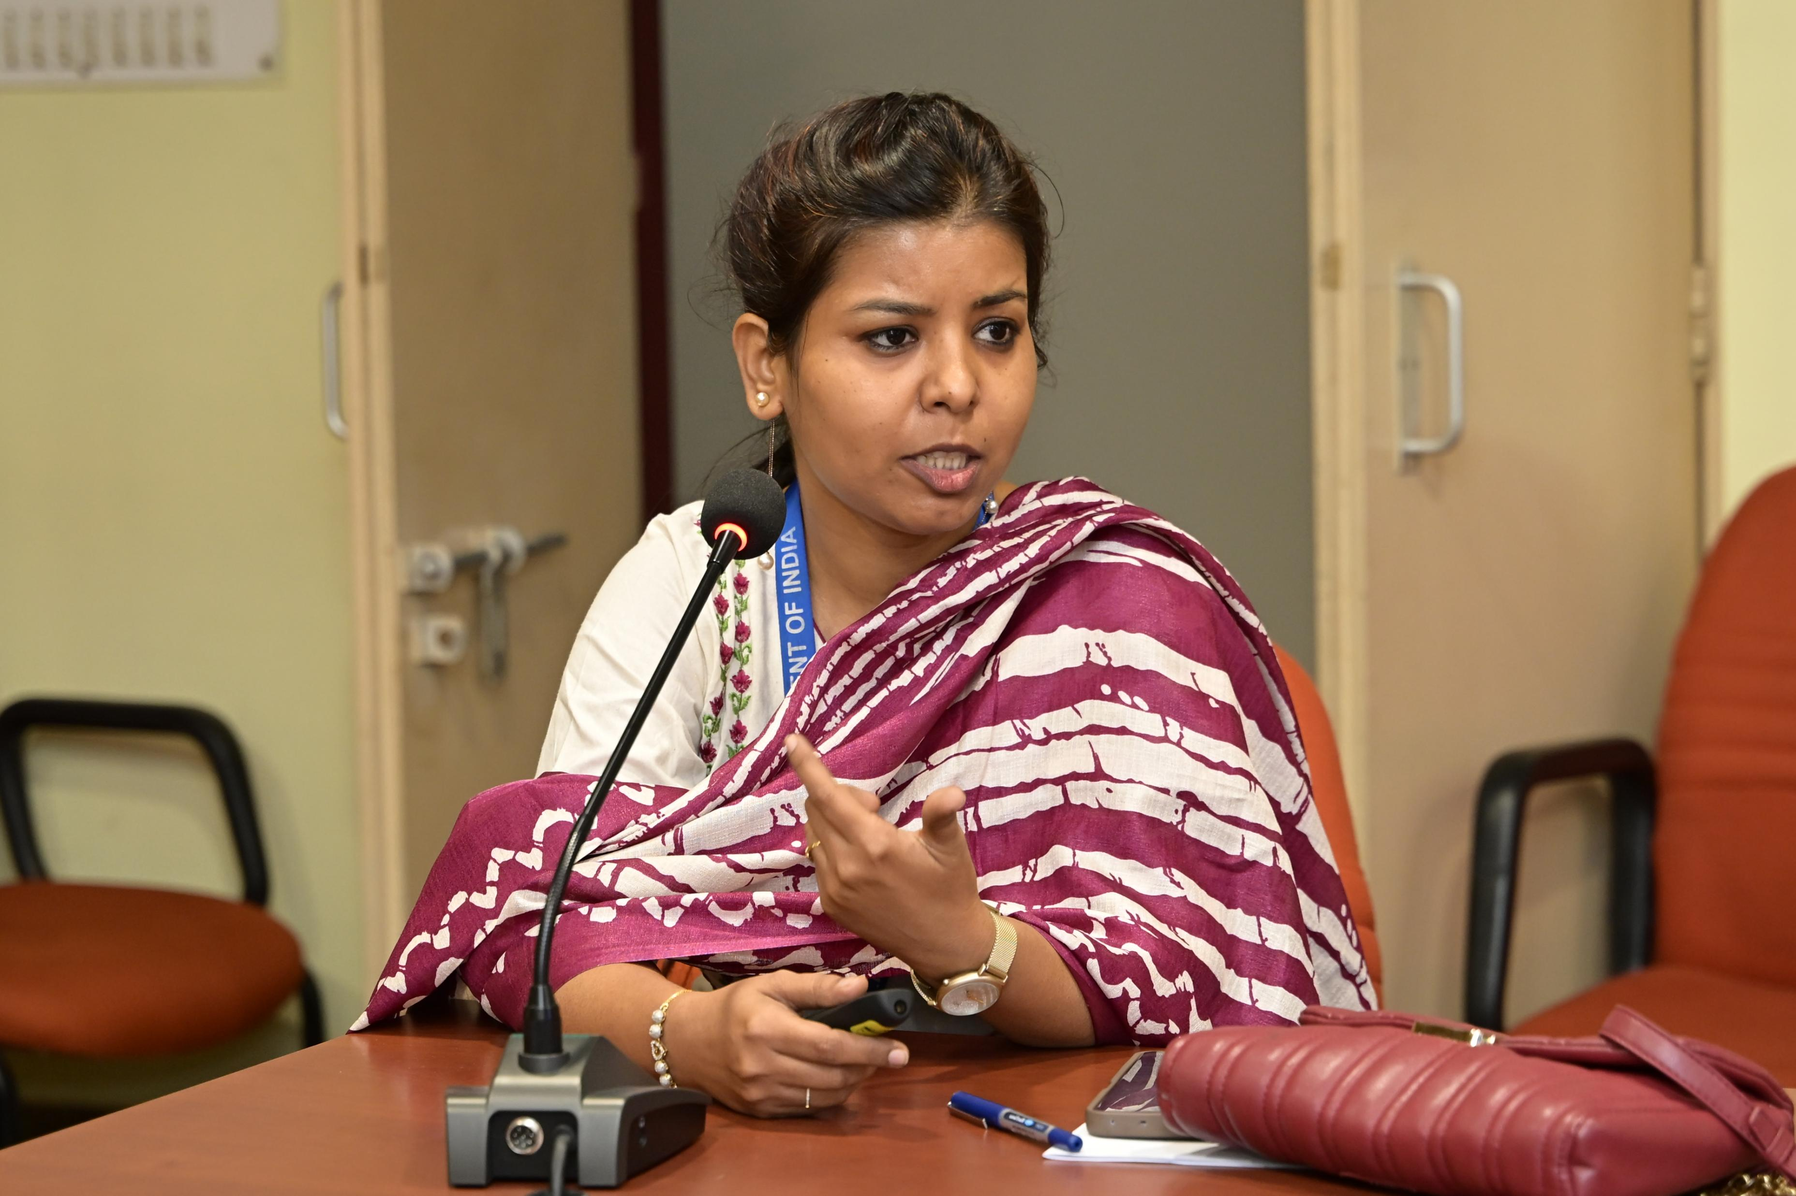
TECHNICAL SESSIONS

Slide 17
Technical Session 1
Five parallel sessions • 31 research papers
1A: Fertility & Family Planning
1B: Maternal & Child Health
1C: Mortality & NCDs
Chair: Prof. Mohanachandran Nair
Chair: Prof N.S. Bisht
Chair: Prof S.K. Singh
Son preference patterns
Teenage pregnancy inequality
Housing & fertility
Digital interventions
MCH service inequality
ASHA mental health
Cancer financial toxicity
Sickle cell barriers
COVID-19 mortality

Slide 18
Technical Session 1 (Continued)
1D: Reproductive Rights & SRH
1E: Gender & Empowerment
Chair: Dr. Anil Chandran S
Chair: Dr Bhaswati Das
Educational gaps
Gender dialogues
Financial freedom
SRH stigma & taboos
High parity patterns
Rights frameworks

Slide 19
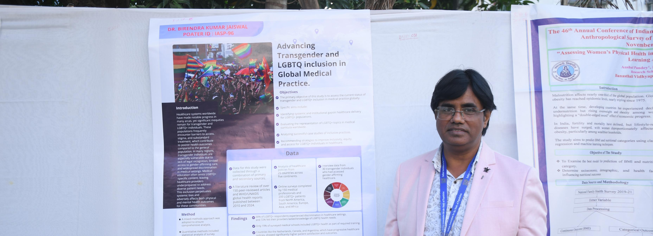


Poster Session ~35 research posters
Key Themes
Nutrition & anaemia
LGBTQ+ health
Tribal health initiatives
Digital addiction & youth
Maternal health inequalities
Environmental health

Slide 20



Plenary Session: Adolescents in Transition (Population Council)
Speakers: Aditi, Basant Panda, Monica Shrivastav, Kajori Banerjee
Key Points:
Life skills and mental resilience
Gendered pathways for adolescent opportunity
Digital exposure and risks
Systems thinking in nutrition

Slide 21


Plenary Session: Population, Environment & Culture (AnSI) Interdisciplinary Approaches from Ongoing Projects of the Anthropological Survey of India
Speakers & Key Points
Dr. Mithun Sikdar, SA(P), SRC Mysore Perceptions of happiness among the elderly in Mysuru
Dr. Abhishikta Roy, SA(P), NWRC Dehradun Pesticide use and emerging health burden among tribal farmers in Vidarbha
Shri Kiran Uttaravalli, RA(P), CRC Nagpur Agro-chemical exposure and neurogenic consequences among tribal farmers
Ms. Anjali Nikam, RA(P), NWRC Dehradun Loosening of friendship and neighbourhood bonds after the pandemic
Shri Ganesh Chandru Ramteke, RA(P), NWRC Dehradun Deforestation and biodiversity loss due to iron ore mining in Surjagad, Gadchiroli
Shri Tushar Srivastava, RA(P), NWRC Dehradun Social support and active aging: Case study from Swabhimaan Kendra, Dehradun Smart City
Ms. Priya Dey, JRF, Head Office Kolkata Cash-crop monocultures, pesticide exposure, and health impacts on Indigenous agrarians in Vidarbha
Dr. Parikshit Chakraborty, Research Investigator, Cultural Research Institute Health status and disability assessment of the oldest-old population in West Bengal

Slide 22
Technical Session 2
Five parallel sessions • 30 research papers
2A: Adolescents & Education
2B: Public Health & Nutrition
2C: Urbanisation & Infrastructure
Sex education
Tribal SRHR
Mental health
Life skills impact
ARI in children
Urban poverty
Period poverty
Local governance
Plastic pollution
Aspirational cities
Census towns
Healthcare access

Slide 23
Technical Session 2 (Continued)
2D: Ageing & Elderly Wellbeing
2E: Morbidity & Tribal Health
Malnutrition & TB
Anaemia patterns
Morbidity compression
Life skills education
Housing patterns
Depression & tobacco
Fintech adoption
Health indicators

Slide 24





General Body Meeting (IASP Members Only)

Slide 25
Day 3 Awards Sessions (29 Nov)
Prof. Chandrasekharan Award
Prof. P.P. Talwar Award
6 exceptional research papers
6 outstanding presentations
Maternal health analytics
Migration & food security
Remote area infrastructure
Quality of care analysis
Mobility innovations
Policy translations

Slide 26



Poster Sessions 35 Posters
Key Themes
Climate Change and Health
Maternal Health
Migration and Labor

Slide 27
Technical Session 3
Five parallel sessions • 28 research papers
3A: Climate Change & Health
3B: Data, AI & Analytics
3C: Migration & Labour
Climate migration
Heat mortality
NCD vulnerability
Transgender health
AI in demography
Machine learning
Fréchet models
Digital divide
Migration decisions
Gulf dynamics
Female migration
Older migrant loneliness

Slide 28
Technical Session 3 (Continued)
3D: Community Health & Interventions
3E: Economic Development & Inequality
Nutrition interventions
Migration governance
Substance rehabilitation
Male involvement
HDI decompositions
Digital literacy
Consumption inequality
Economic opportunity

Slide 29


Valedictory Session
Speakers: Suresh Sharma, Ajay Kumar Singh, Anil Chandran S, AG Khan, BV Sharma, Jeetendra Yadav
Key Points:
Summary of scientific contributions
Need for continued interdisciplinary collaboration

Slide 30

Thank you

